Slide 1
New Mexico Environment Department
Air Quality, Initiatives and Upcoming Regulations in New Mexico
Control Strategies, Air Quality Bureau
June 23, 2022

Slide 2
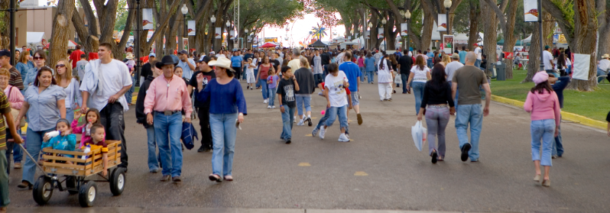

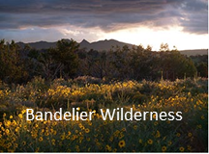
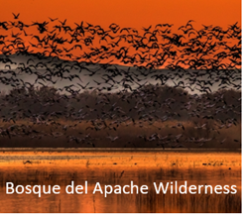
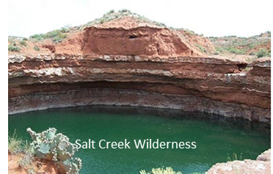
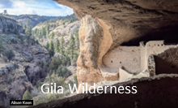
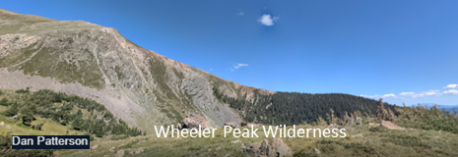
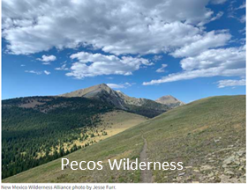
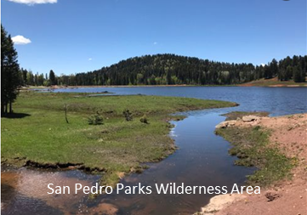
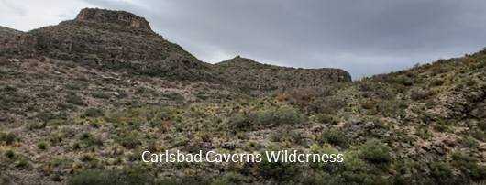
Air Quality Bureau – Our Mission
To protect the inhabitants and natural beauty of New Mexico by preventing the deterioration of air quality

Slide 3
Today’s Agenda
Regulatory Authority and Responsibilities
Air Quality Programs
National Ambient Air Quality Standards
Monitoring Network
Air Quality, Monitoring Data and Nonattainment
Ongoing and Upcoming Initiatives, Rulemakings and Hearings.
Breakout Rooms, Round Robin Reports, Office Hours, Future Meetings, etc.
Notes:
30 minutes breakout rooms

Slide 4
Air Quality Management Roles and Responsibilities
EPA - Federal Government
NMED AQB - State Government
Statutory Authority – Clean Air Act (CAA)
Regulations – Code of Federal Regulations (i.e., 40 CFR Part 50 - 99)
National Ambient Air Quality Standards (NAAQS)
Statutory Authority - Air Quality Control Act, CAA
Rules – New Mexico Administrative Code, CFRs
State Implementation Plan (SIP), Emissions Guidelines and Delegated Authorities to meet the NAAQS and other CAA Requirements

Slide 5
AQB – Programs
Air Quality Bureau
84 Full Time Employees
Planning
Control Strategies
Modeling and Emission Inventory
Small Business Assistance Program
Permitting
Minor Sources
Major Sources
Technical Services
Compliance and Enforcement
Inspections
Reports
Enforcement
Operations
Monitoring
Quality Assurance
Administrative Support
Jurisdiction over entire state
excluding Bernalillo County and tribal lands

Slide 6
Control Strategies
SIP
Other AQ Management Plans
Rule Adoption and Implementation
Special Projects – VW, DERA, Research/Modeling Studies
Outreach and Education
Air Quality Stakeholder Groups - Border, 4CAQG, Ozone Advance, WESTAR/WRAP, NACAA

Slide 7
National Ambient Air Quality Standards
Criteria Air Pollutants
NAAQS
Carbon Monoxide (CO)
Lead (Pb)
Particulate Matter (PM₁₀ & PM_{2.5})
Nitrogen Dioxide (NO₂)
Ozone (O₃)
Sulfur Dioxide (SO₂)
*AQB operates monitors for these pollutants
Primary Standards – Protect Public Health
Secondary Standards – Protect Public Welfare
  Visibility
  Crop Damage
  Building/Property Damage

Slide 8
Monitoring Network
State and Local Air Monitoring Stations (SLAMS) Network
Siting and operation criteria set by EPA
QAPP/SOPs
Annual and five-year reviews
Federal Reference Methods or Federal Equivalent Methods
Data used to compare to NAAQS
Determines:
Highest Concentrations Expected
Representative Concentrations
Source or Source Category Impacts
Background Concentration Levels
Attainment Status
https://aqi.air.env.nm.gov/

Slide 9
Air Quality in NM – Dust, Smoke, and Smog
Ground Level Ozone
  Formed not emitted in air
    Nitrogen dioxide (NO_{X})+ Volatile Organic Carbons (VOCs) + Sunlight = Ozone (O₃)
  Sources of Precursors
    Transportation
    O&G
    EGUs
  Health Effects
Particulate Matter
  Windblown Dust
  Smoke
  Mechanical Crushing
  Earth Moving

Slide 10
Ozone Air Quality
Design Values (DVs) compare air quality in an area to the NAAQS.
Ozone DVs = 3-yr average, of the annual 4th Maximum daily 8-hr average.
DVs: https://www.epa.gov/air-trends/air-quality-design-values
Monitoring Data: https://www.epa.gov/outdoor-air-quality-data

Slide 11
Ozone in New Mexico

Slide 12
Nonattainment Areas
Ozone
Sunland Park O₃ Marginal Nonattainment Area (2015 NAAQS)

Slide 13
SLP Ozone Nonattainment SIP
Transportation Conformity
  El Paso Metropolitan Planning Organization
Emissions Inventory
  Baseline Inventory with Periodic Updates
  Certification Statement
    Authority to collect emissions information
  EPA Approval Effective April 6, 2022
Nonattainment New Source Review
  Major sources of NOx and VOC in NAA
  Submitted July 30, 2021
179B Demonstration showing International Influence
  Submitted June 3, 2021
Ozone Advance and Attainment Initiative Programs
  Counties within 95% of O₃ NAAQS
Notes:
The State implementation Plan or SIP is the set of state mitigation/maintenance plans that are adopted to improve air quality for the 2015 ozone primary and secondary NAAQS. The planning requirements are set forth in the CAA dependent on the marginal nonattainment classification that Sunland Park has been designated. As mentioned in the earlier slide, the designations range from marginal to extreme with the planning requirements becoming progressively stricter with each increase in status. These are the requirements for Sunland Park: emissions inventory, statement, SIP development, and NNSR.

Slide 14
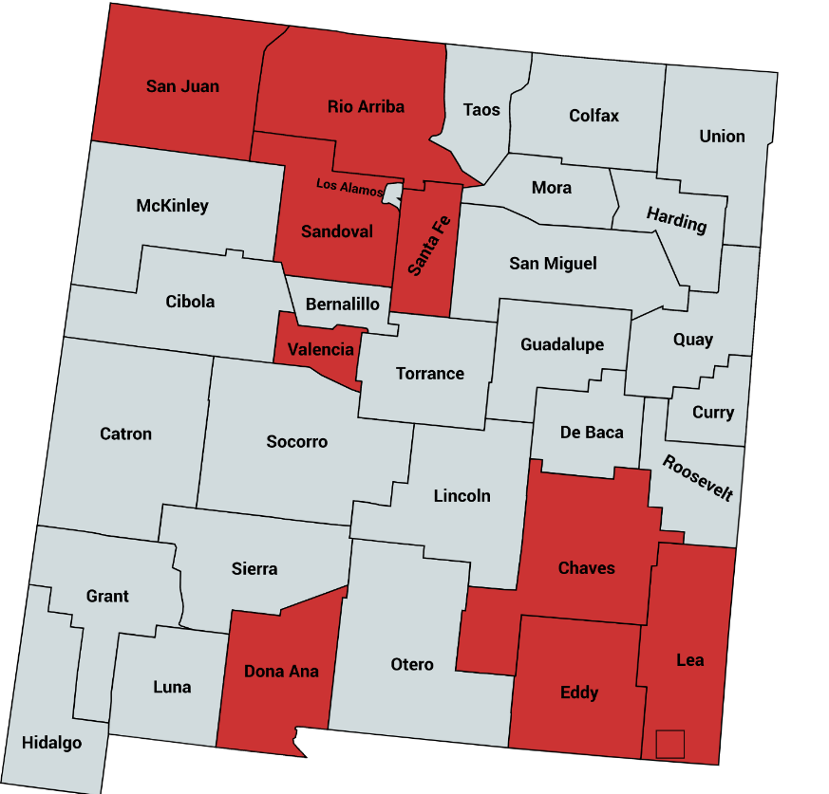
Ozone Advance Program
EPA Voluntary Program
95% NAAQS (.068 ppm O₃)
Works with unique needs of an area

Slide 15
Ozone Advance Program
Source Category | Chaves | Dona Ana | Eddy | Lea | Rio Arriba | San Juan | Sandoval | Santa Fe | Valencia
Nonpoint | 1,915 | 1,309 | 2,887 | 7,320 | 4,504 | 7,276 | 1,585 | 1,478 | 750
Non-Road | 339 | 1,828 | 241 | 289 | 162 | 243 | 487 | 337 | 2,428
On-Road | 1,202 | 4,966 | 1,265 | 1,500 | 916 | 2,688 | 2,675 | 3,842 | 1,396
Point | 1,335 | 944 | 5,690 | 6,405 | 9,561 | 30,028 | 285 | 16 | 22
Total | 4,791 | 9,048 | 10,083 | 15,514 | 1,543 | 40,234 | 5,032 | 5,673 | 4,596

Slide 16
PM in New Mexico

Slide 17
Nonattainment Areas
Particulate Matter
Anthony PM₁₀ Moderate Nonattainment Area (1987 NAAQS)

Slide 18
Exceptional Events 40 CFR 50.14
Recurring high-windblown dust PM₁₀ NAAQS exceedances
  Increasing wildfire smoke impacts
Southern Doña Ana and Luna Counties
Annual EPA demonstration submittals
  Prevent increased planning requirements for monitors exceeding NAAQS
Dust Mitigation Plan
  Minimize exposure to susceptible populations
  Revised November 2020

Slide 19
PM₁₀ Mitigation Plans
Public notification and education programs
  Advanced notice of event/forecasting
  Outreach and Education mechanisms
  Health advisories
Implement mitigating measures
  Minimize public exposure
  Measures to abate controllable sources
Fugitive Dust Rule
Consultation with air quality managers
Periodic review and evaluation
  Three-year schedule
CAA section 319
40 CFR 51.930
Required for Recurring Events
NMED’s Dust Mitigation Plan applies to Luna and Doña Ana Counties

Slide 20
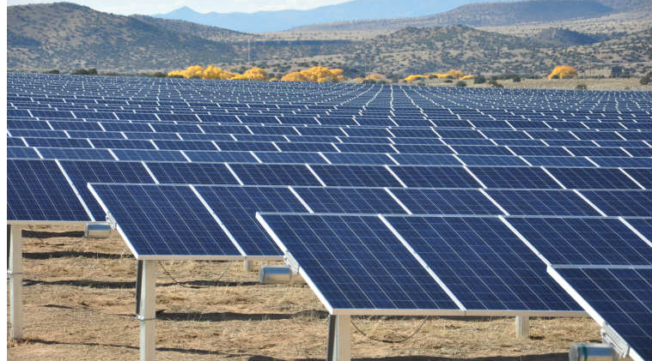
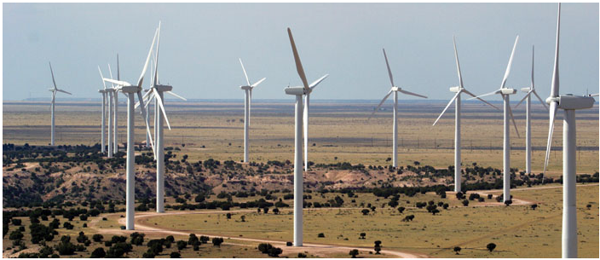
Energy Transition Act (ETA) Rulemaking
Senate Bill 489, the Energy Transition Act, legislation that sets statewide renewable energy standards and establishes a pathway for a low-carbon energy transition away from coal while providing workforce training and transition assistance to affected communities.
Transitions New Mexico away from coal and toward clean energy.

Slide 21
Rulemaking Required by Statute
NMSA 1978 74-2-5(B)(1)(b)
(b) develop standards of performance that limit carbon dioxide emissions to no more than one thousand one hundred pounds per megawatt-hour on and after January 1, 2023 for a new or existing source that is an electric generating facility with an original installed capacity exceeding three hundred megawatts and that uses coal as a fuel source;

Slide 22
Affected Electric Generating Facility
What is an Affected Electric Generating Facility?
Any electric generating facility, or electric power plant, that falls under the jurisdiction of the Environmental Improvement Board (EIB)
  NMED does not have jurisdiction over Tribal lands or Bernalillo County
has an original installed capacity exceeding 300 megawatts
uses coal as a fuel source.

Slide 23
Emission Standard
Affected facilities must limit carbon dioxide CO₂ emissions to 1,100 pounds per megawatt hour.
A megawatt hour (Mwh) is equal to 1,000 Kilowatt hours (Kwh). It is equal to 1,000 kilowatts of electricity used continuously for one hour.
In 2020, the average annual electricity consumption for a U.S. residential utility customer was 10,715 kilowatt hours (kWh), an average of about 893 kWh per month.*
*U.S. Energy Information Administration

Slide 24
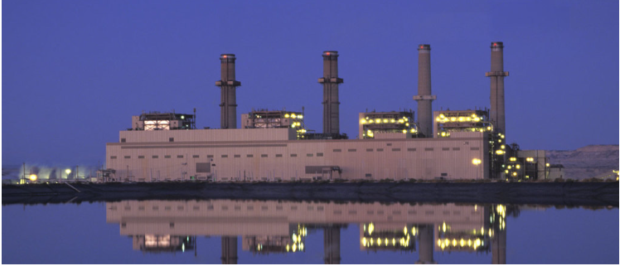
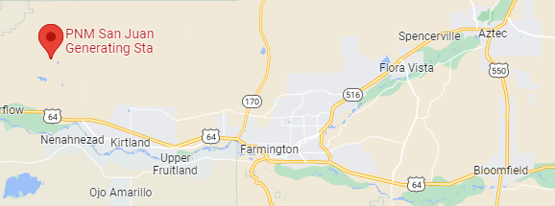
Applies to new and existing sources
San Juan Generating Facility
Unit 1(369 MW) slated for closure June 30, 2022
Unit 4 (555 MW) slated for closure September 30, 2022

Slide 25
ETA Draft Rule Overview
Informal Comment Period
June 15-29
Standards set through statute.
Draft rule development includes:
Monitoring requirements
Record keeping requirements
Reporting requirements

Slide 26
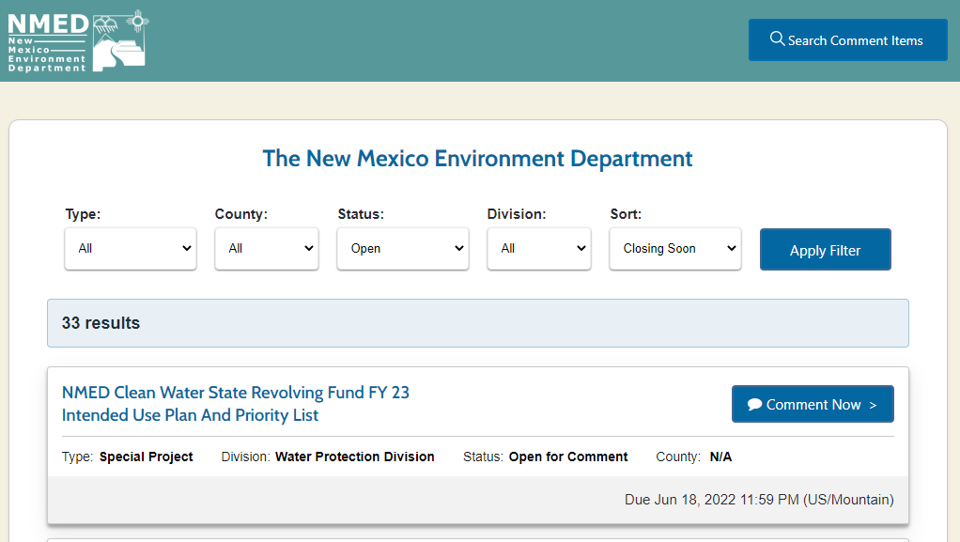
NMED’s SmartComment Portal
https://nmed.commentinput.com/comment/search

Slide 27
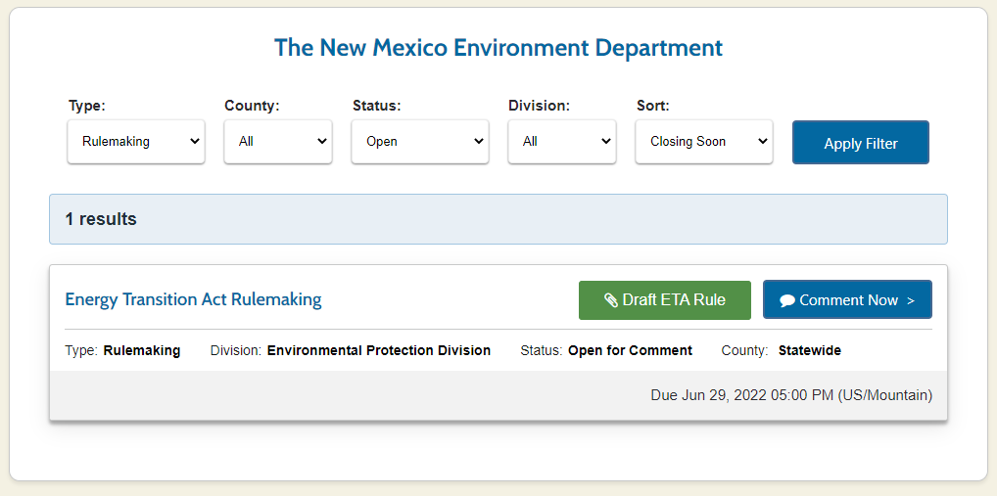
NMED’s SmartComment Portal Search Options
Type>Rulemaking>Apply Filter

Slide 28
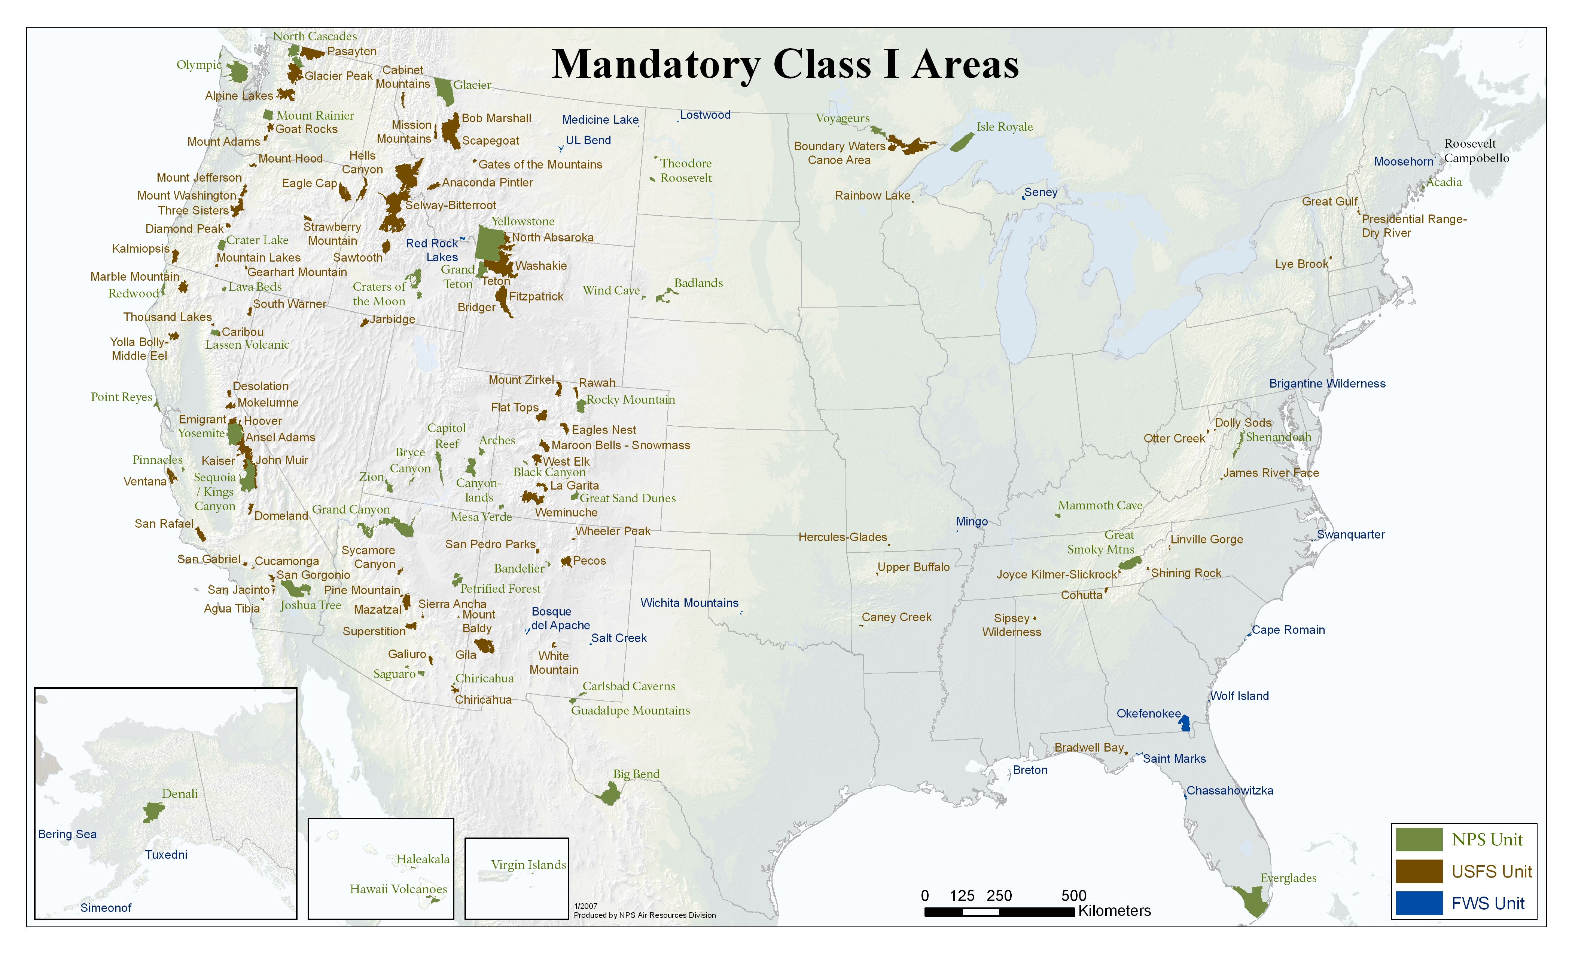
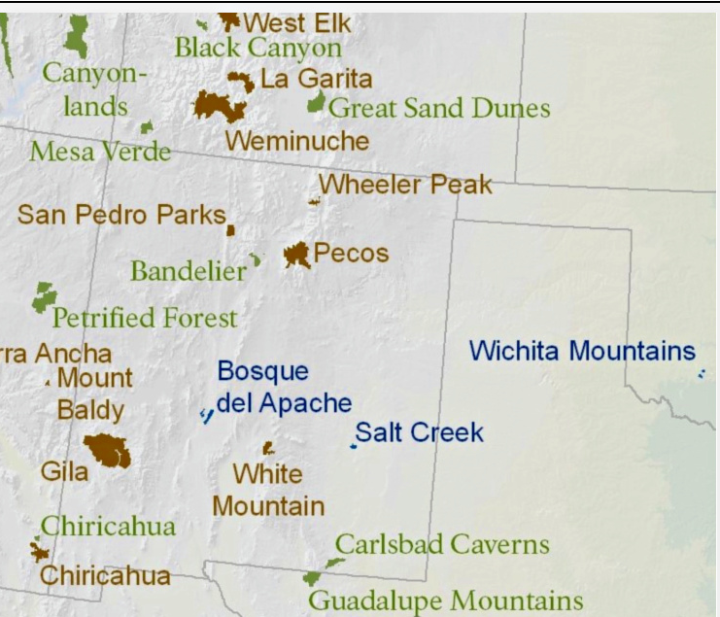
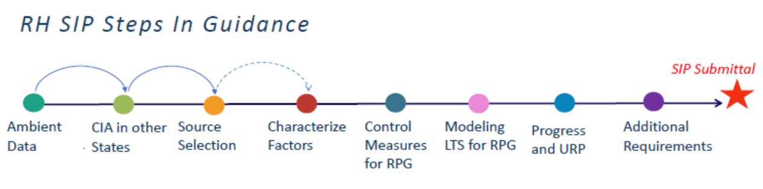
Regional Haze Program
“Regional Haze” = Visibility protection at federal Class I Areas (CIAs)
Class I Areas (CIAs) in New Mexico:
Bandelier Wilderness Area
Bosque del Apache Wilderness Area
Carlsbad Caverns National Park
Gila Wilderness Area
Pecos Wilderness Area
Salt Creek Wilderness Area
San Pedro Parks Wilderness Area
Wheeler Peak Wilderness Area
White Mountain Wilderness Area
We also have to evaluate impact of NM sources on nearby CIAs located outside NM; tribes/EPA and other states must evaluate their sources’ impacts on our CIAs
Notes:
MARK
“Regional haze” is defined at 40 CFR 51.301 as “visibility impairment that is caused by the emission of air pollutants from numerous anthropogenic sources located over a wide geographic area.”
The Regional Haze Rule (RHR or Rule) requires states to submit a series of State Implementation Plans (SIPs) to protect visibility in Class I areas and governs states’ obligations and EPA’s review of periodic SIPs.
In January 2017, EPA issued a final rule updating the regional haze program for the second and subsequent implementation periods, including revising portions of the visibility protection rule promulgated in 1980 and the Regional Haze Rule promulgated in 1999.
In the upper left of this slide we can see that the phrase “regional haze” is both capitalized and not capitalized. The lower case version means “visibility impairment from numerous, widespread human pollutant sources.” We’re talking here about the physical phenomena of pollutants obscuring our view of a landscape.
When we put the phrase “Regional Haze” in capital letters, we’re referring to something different. We’re referring to a regulatory process of visibility protection at certain places known as “federal Class 1 Areas,” which our slides will abbreviate as “C1As.” A Class 1 Area is a national park or wilderness area above a certain size that was in existence as of August 7, 1977. There are 156 of these in the United States. So it’s important to remember that the Regional Haze program, which we’ll also refer to as the “Regional Haze Rule,” doesn’t protect all public lands, it’s directed only at these 156 areas.
There are nine Class 1 Areas in New Mexico. You can see them listed here and placed on a map. Under The Regional Haze program, every state has to protect visibility in its own Class 1 Areas. Every state also has to evaluate how its own sources of pollutants affect visibility at Class 1 Areas in neighboring states.
I should add here that Indian tribes have the option under the Regional Haze program of adopting their own plans to protect visibility.

Slide 29
Four Corners Air Quality Group
Four Corners Air Quality Group (4CAQG) began in 2007 and is a forum for individuals interested in air quality and climate to meet, learn about current conditions, review progress on mitigation of air quality impacts, and generally contribute to clean air in the Four Corners area (NM, AZ, UT, CO).
  Convened by the states of New Mexico and Colorado with support of EPA, state, tribal and federal land manager partners.
Role is to allow agencies to report on trends and analysis and to receive broad input on addressing air quality issues.
Next meeting planned for Sept 21 – 22, 2022, at San Juan College School of Energy Merrion Rooms A & B.
  All are welcome to attend. (Hybrid format will allow for remote online access and participation).
  Be sure to sign up for listserv to be informed of annual meetings or visit website: https://www.env.nm.gov/air-quality/four-corners-air-quality-group/

Slide 30
Breakout and Round Robin
Energy Transition Act
  Recap of Discussion
  Topics/Themes of Interest
  Continued Dialogue/next steps/follow up items
Ozone Advance
  Recap of Discussion
  Topics/Themes of Interest
  Continued Dialogue/next steps/follow up items

Slide 31
Notes from Ozone Breakout session (part 1)
Questions about the Ozone Precursor O&G rule? Ozone Advance goes along with the OAI and O&G Ozone Precursor Rule towards working towards reducing Ozone in the state.
For Ozone Advance, want programs more customized and focused on the regional local communities / counties
There are some other NM initiatives / programs already in motion to reduce some VOC and/or NOx emissions
  Volkswagon Settlement
  Regional Haze plans
NMED AQB has proposed some ideas for a Path Forward and possible next step ideas. Provides for a lot of flexibility
  Public outreach and education
  Possibility for Community/University partnership focus projects
  Electric Bus Upgrades
  Improvements in public transit
  Alternative commuting programs.
  Plan on more meetings in the near future.

Slide 32
Notes from Ozone Breakout Session (page 2)
Brian Schath is the contact for NMED. EPA also has other info on possible Ozone Advance strategies that have been implemented in other States/localities/Tribal areas.
Open discussion / questions
  Would more Electric vehicles reduce VOC or NOx emissions in Sandoval County? Yes. And other transportation emissions reductions would most likely help.
  DERA funding is opportunity for reducing emissions from heavy duty diesel.
  Brian is processing info from the surveys! And would like to hear ideas / brainstorm topics

Slide 33
AQ Resource Library
NMED
  Homepage: https://www.env.nm.gov/
  AQB: https://www.env.nm.gov/air-quality/
    Planning: https://www.env.nm.gov/air-quality/planning-section/
      Proposed Rules and Plans: https://www.env.nm.gov/air-quality/proposed-regs/
      Ozone Advance/OAI: https://www.env.nm.gov/air-quality/o3-initiative/
      Regional Haze: https://www.env.nm.gov/air-quality/reg-haze/
      DERA: https://www.env.nm.gov/air-quality/diesel/
    Monitoring: https://aqi.air.env.nm.gov/
  EIB: https://www.env.nm.gov/opf/environmental-improvement-board/
  SmartComment Portal: https://nmed.commentinput.com/comment/search
EPA
  Clean Air Act: https://www.epa.gov/clean-air-act-overview
  NAAQS: https://www.epa.gov/criteria-air-pollutants/naaqs-table
  Nonattainment Areas: https://www.epa.gov/green-book
  NM SIP: https://www.epa.gov/sips-nm
  AirNow: https://www.airnow.gov/
  Fire and Smoke: https://fire.airnow.gov/
  Air Data: https://www.epa.gov/outdoor-air-quality-data
  Design Values: https://www.epa.gov/air-trends/air-quality-design-values

Slide 34
Contact Info
Control Strategies
Armando Paz; armando.paz@state.nm.us; (505) 629-3242
Brian Schath; brian.Schath@state.nm.us; (505) 629-5025
Mark Jones; mark.jones@state.nm.us; (505) 629-6626
Neal Butt; neal.butt@state.nm.us; (505) 629-2972
Robert Spillers; robert.spillers@state.nm.us; (505) 629-5668
Michael Baca; michael.baca1@state.nm.us; (505) 629-7891

Slide 35
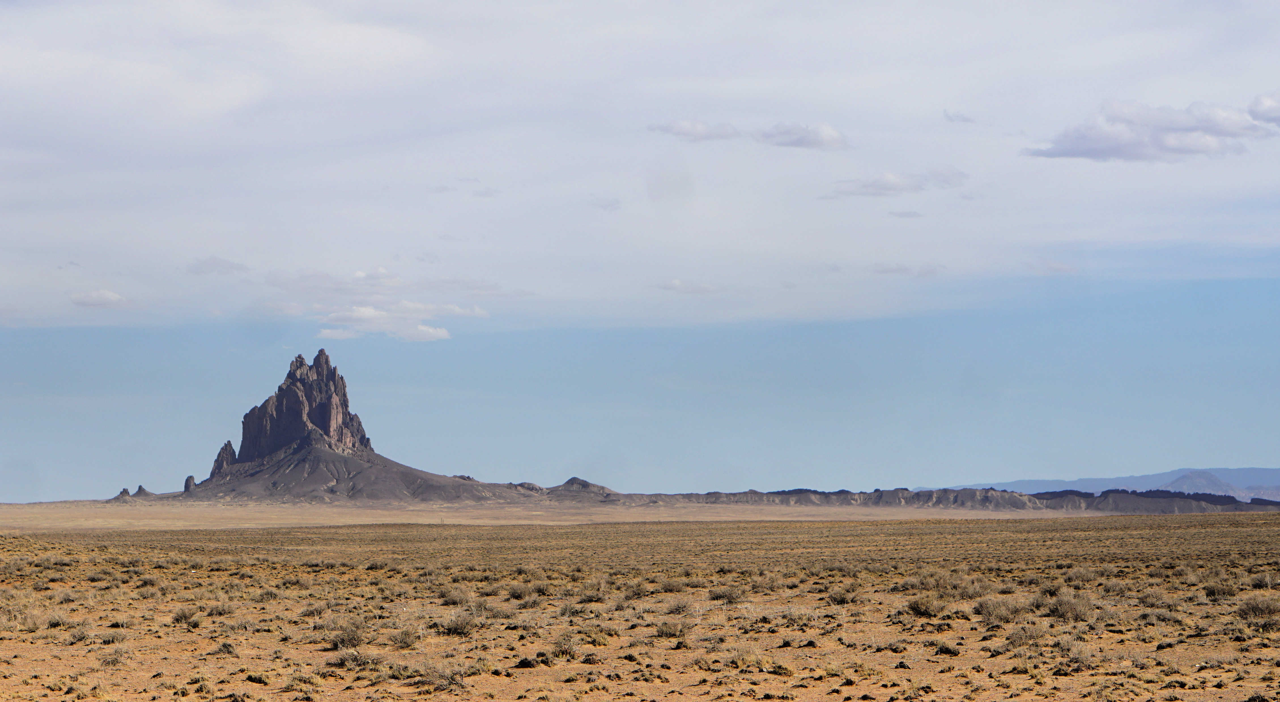
Questions

Slide 36
Air Quality Bureau
We are on a 5-minute break. Our Stakeholder Engagement Meeting will reconvene at 6:42 PM
Please take the Ozone Advance poll at the link provided in the chat.

