Slide 1
Diesel Emissions Reduction Act
Grant Funding
The presentation will begin shortly. . .
Audio is available through your computer or telephone.
Please keep your microphone muted to avoid background noise and feedback.
If you have a question during the presentation, please type it into the chat box. We will have a dedicated time to answer questions at the end of the presentation.
If you’re experiencing any technical difficulties, please contact us through the chat box and we will try to troubleshoot the issue.

Slide 2
New Mexico Environment Department
Diesel Emissions Reduction Act Grant Funding
Neal Butt, Environmental Analyst
March 18, 2026

Slide 3
DERA Funding Opportunity
The application period for DERA funding started on October 17, 2025, and will continue until the Grant funding is exhausted.
Applications will be evaluated, and successful applicants will be awarded funds, on a first-come first-served basis.
While projects from the entire state will be accepted, special consideration will be given to projects located in, or adjacent to those counties with levels of ozone at or above 95% of the NAAQS for ozone (i.e. Bernalillo, Doña Ana, Eddy, Lea, Sandoval, San Juan, and adjacent counties).
The vehicle being replaced (“donor”) must be an Engine Model Year 2009 or older, unless the new vehicle is zero emission or low-NOx, in which case the donor vehicle can be any EMY.
The available DERA funds consist of two separate grants.
  The FY22 grant is in the amount of $139,800. A project funded under this grant must be completed by August 31, 2027, to allow sufficient time to process reimbursement.
  The FY24 grant is in the amount of $389,000. A project funded under this grant must be completed by February 28, 2027
Applications should be sent to me at neal.butt@env.nm.gov

Slide 4
Diesel Emissions Reduction Act
Diesel engines manufactured today are cleaner than ever before. However, because engines can operate for 30 years or more, millions of older, dirtier engines are still in use.
Combustion of diesel fuel produces nitrogen oxides (NOx), fine particulate matter (PM_{2.5}) carbon dioxide and air toxics. Reducing exposure to diesel exhaust is especially important for human health and the environment. (e.g., asthma, ground-level ozone, acid rain, regional haze)
NMED provides grant funding through the New Mexico Clean Diesel Program, for projects that reduce harmful diesel emissions from existing heavy-duty diesel-fueled vehicles and equipment. This program is funded by EPA through the Diesel Emission Reduction Act or “DERA”.
2005 - Congress passed DERA amending the Energy Policy Act of 2005, authorizing EPA to administer a national and state-level grant and loan program to promote emissions reductions from legacy diesel engines. Designed to reduce diesel emissions from existing diesel fleets that did not meet the federal emission standards at that time.
EPA is responsible for overseeing and distributing the DERA funds to states, who administer the program. For more information visit EPA’s DERA Funding website https://www.epa.gov/dera

Slide 5
New Mexico Clean Diesel Program
  EPA has awarded funding to NMED, who in turn, serves as a pass-through agency providing sub-grant funding through its New Mexico Clean Diesel Program, for projects that reduce harmful heavy-duty diesel emissions. Since 2008, the Air Quality Bureau, which manages the program, has awarded over $2.3 Million in grant funding for qualifying diesel emissions reduction projects.
  Bernalillo County Fire & Rescue - Awarded $417,718 to replace a 1991 EMY diesel-fueled Class 8, Pierce Dash fire engine, with a Pierce Volterra battery electric fire engine. Engine is currently used in a supplemental role at stations across Bernalillo County in the event that a primary fire engine becomes inactive due to repairs, or a station requires additional response capacity.
  United Parcel Service – Replaced 22 older diesel-fueled package cars with 16 new Class 5, CARB-certified low NOx CNG -fueled package cars. UPS was awarded $473,222.75, which is 34% of the total project cost of $1,404,432. Under DERA, a replacement vehicle whose engine is certified to meet CARB’s optional low NOx emission standard can be reimbursed at 35%, compared to the 25% reimbursement for a replacement vehicle whose engine meets the EPA NOx emission standard. This project will remove harmful diesel emissions from Albuquerque, Santa Fe, Carlsbad, Silver City, Clovis, Hobbs and Farmington by relocating all of the new vehicles to operate out of Albuquerque, and by switching to CNG. UPS is committed to reducing its impact on the environment and supporting the communities they serve around the world. UPS operates one of the largest airlines and one of the largest fleets of alternative fuel vehicles under the global UPS brand.

Slide 6
DERA Grant - Eligibility
Public or private entity or nonprofit organization, in New Mexico for three consecutive years, and whose vehicles or equipment are registered in New Mexico. (or have an International Registration Plan if applicable)
Idle-reduction technologies, aerodynamic technologies, and the retrofit or replacement of diesel vehicles and equipment.
EPA or California Air Resources Board (CARB) verified/certified technologies or vehicle, engine or equipment replacement utilizing a zero-tailpipe emissions power source.
Buses (school and Class 5+ transit); Class 5 – Class 8 heavy-duty highway vehicles (e.g., refuse, commercial transportation); marine engines; locomotives; and nonroad engines, equipment, or vehicles such as those used in construction, handling of cargo (including at ports and airports), agriculture, mining, or energy production (including stationary generators and pumps).

Slide 7
DERA Grant - Eligibility (Continued)
Existing vehicle, engine, or equipment must be fully operational.
Own and operate the existing vehicle or equipment during the two years prior to upgrade.
Existing vehicle, engine, or equipment must have three years of remaining life at the time of upgrade.
    Remaining life is the fleet owner’s estimate of the number of years until the unit would have been retired from service if the unit were not being upgraded or scrapped because of this grant funding.
Replacement vehicle, engine or equipment should resemble the replacement in form and function.
Funding cannot be used for the purchase of vehicles, engines, or equipment to expand a fleet.

Slide 8
DERA Grant - Eligibility (Continued)
Highway Usage
  Existing on-road vehicle must have accumulated at least 7,000 miles/year during the two years prior to upgrade.
  Exception: If a recipient can demonstrate that a certified highway engine or vehicle is being used in a predominately nonroad application (e.g., firetrucks or utility trucks that idle for long periods to power auxiliary apparatus), engine operating hours as defined as “nonroad usage” may be used for application eligibility purposes.
Nonroad, Locomotive and Marine Usage
  Agricultural Pumps: Certified nonroad agricultural pumps must operate at least 250 hours/year during the two years prior to upgrade.
  All Other Nonroad Engines: Certified nonroad engines must operate at least 500 hours/year during the two years prior to upgrade.
  Locomotive and Marine Usage: The existing certified locomotive and marine engines must operate at least 1,000 hours/year during the two years prior to upgrade.

Slide 9
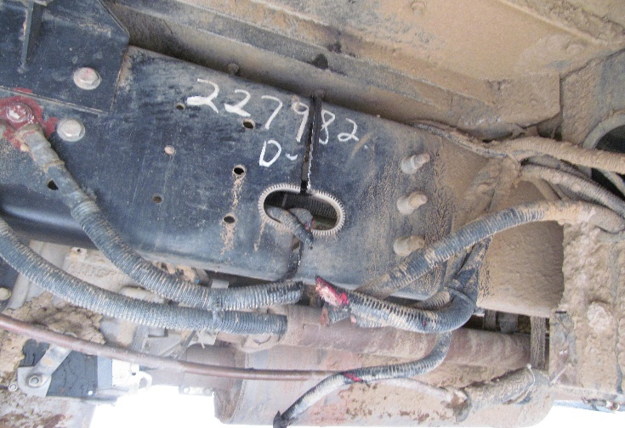
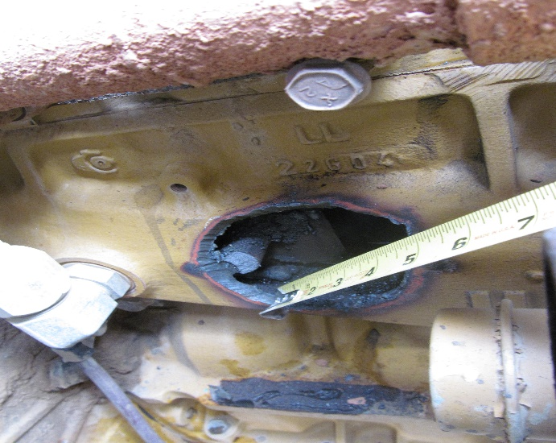
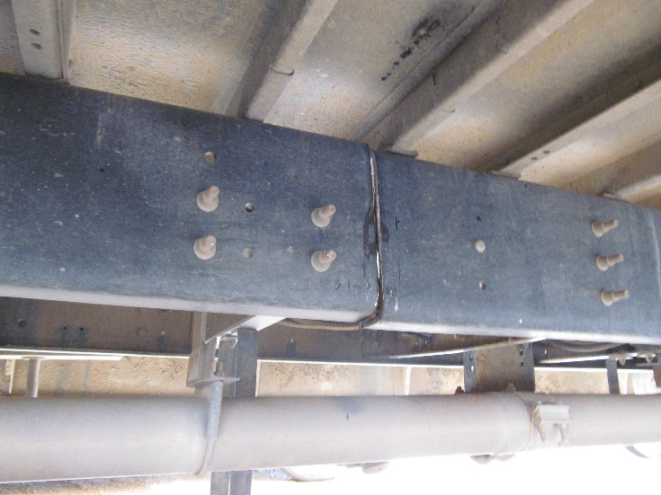
DERA Grant – Scrapping Vehicle, Engine or Equipment
Scrapped or disabled within 90 days of being replaced
Equipment and vehicle components not part of engine or chassis may be salvaged
Drill three-by-three-inch hole in engine block and disable chassis by cutting through the frame rails on each side
Scrappage statement signed by the vehicle owner and the dismantler is required

Slide 10
Preference and Special Consideration
Special consideration will be given to projects located in or adjacent to those counties with levels of ozone at or above 95% of the National Ambient Air Quality Standard (NAAQS) for ozone
  Bernalillo County
  Doña Ana County
  Eddy County
  Lea County
  Sandoval County
  San Juan County
  Adjacent counties
Information about these areas can be found in the NMED Clean Diesel Program Guidance Document posted on our website.

Slide 11
Application – Organization Information
Organization Information – 40 Points
Project Title | Windy City Solid Waste Vehicle Replacement Project
Number of Vehicles | #
Organization Name | Windy City Public Works Department
Responsible Official | Responsible for funding; Signature Authority; and oversight for the project |  |  | Title |  |  |  | Title | Title
Mailing Address
City, State, Zip |  |  |  | Phone Number
Cell Number |  |  |  | Email
Organization’s Unique Entity ID vs. D-U-N-S Number | Applicants for a DERA Grant must have an Active Registration on SAM.gov and be in good standing at the time of Award. You may apply for a DERA Grant while your SAM.gov registration is being processed if you do not already have a SAM.gov account.
Contact Person | Department’s primary contact. Can be the same as “Responsible Official”. |  |  | Title |  |  | Title
Phone Number |  |  |  | Email |  |  | Email
Organization Type | ☐ State ☒City ☐ County ☐School District ☐ Non-Government ☐ Other, list: Individuals are not eligible to receive funds unless they are applying on behalf of a public entity or private entity or nonprofit organization.
Fleet Address
City |  | County |  |  |  | Zip Code

Slide 12
Application – Description of Applicant’s Organization
Description of Applicant’s Organization – 10 Points
Describe your organization’s size and type of work performed. If the proposed vehicle(s) operate outside of the State¹, provide the percentage of time your organization will operate the affected equipment within New Mexico. Include other information, such as number of hours and/or miles traveled within the State. Also include any environmental measures utilized by the organization, such as anti-idling policies that reduce emissions.
Appendix A- Documentation Verifying the Operating Time in New Mexico. NMED does not have a standardized template, so by whatever means the applicant is able to document the estimated number of hours and/or miles traveled in the State showing that the equipment operates within the State at least 75% of the time will be acceptable. If your vehicle does not operate outside of New Mexico, then verification is not necessary.
1. Vehicles/equipment must operate within the State at least 75% of the time. The applicant MUST provide documentation verifying the operating time within the state as Appendix A.

Slide 13
Application – Project Funding
Project Funding – 5 Points
Funding Requested | $ 250,000
Cost Share + | $ 750,000 | %
Project Cost = | $1,000,000
Scrap Value - | $ 1,000
Total Project Cost* | $ 999,000
Will a funding waiver be requested ☐ Yes ☐ No If the applicant is unable to meet the specific required cost share for that type of project as stipulated by the guidance, and requests that the percentage contributed by EPA be increased. NMED will consider, on a case-by-case basis, and submit to EPA for approval, requests for waivers from programmatic requirements; only for non-statutory or non-regulatory requirements. The State must obtain EPA approval for any waiver request before commencing any work or the expenditure of funds on a project involving a waiver request.
If yes, the applicant will need to provide a detailed justification for the waiver if selected.
Is the applicant interested in the funding if a waiver request is denied? ☐ Yes ☐ No
*Total project cost for engine and vehicle replacements is the project cost minus scrap value from disabled engine or vehicle.

Slide 14
Application – Project Location
Project Location – 5 Points
Will the vehicle(s) reside within New Mexico? ☐ Yes ☐ No
Will the vehicle(s) permanently reside at the project address? ☐ Yes ☐ No
Will the vehicle(s) operate under an International Registration Plan? ☐ Yes ☐ No
If “No” to either of the first two questions above, or “Yes” to the third question, then provide a detailed explanation in the Project Location Summary below.
Details to address in the Project Location summary shall include: A detailed description of the primary area(s) where the affected vehicle/engine operates, or the primary area where the emissions benefits of the project will be realized; A description of the routes and estimated miles traveled; and A summary of whether the project will be sited in an area where all or part of the population is exposed to diesel emissions. For those fleets that travel statewide, provide a percentage of time spent in the various locations. A map of the project location is required to be included as Appendix B.

Slide 15
Application – Fleet/Equipment Description
Fleet/Equipment Description¹ – 5 Points
Provide Vehicle Information Sheet as Appendix C {standardized form posted on website} and the fleet’s vehicle replacement policy or schedule as Appendix D. Provide detailed summary of old equipment (make, model, year). Summarize the expected useful lifetime of the project-funded vehicle(s)/equipment and how it will be used by organization, including a description of how the applicant’s vehicle replacement procedures meet the attrition/fleet turnover requirements below. Describe why this project would not have occurred without these funds.
Appendix D- Fleet Replacement Schedule. NMED does not have a standardized template. Outline the company’s standard procedure for vehicle replacement (e.g., company document, explanation of when the specific vehicle type is normally replaced by the company). For public agencies, there are usually formalized retirement periods (e.g., statutory retirement of school buses).
1. Funds cannot be used for emission reductions that result from vehicle/equipment replacement or repowers that would have occurred through normal attrition/fleet turnover within three years of the project start date. Complete the Use of Funds Restrictions Form {standardized form posted on website} and attach to the application package as Appendix E. (1. Normal attrition/Fleet turnover; 2. Fleet expansion; 3. Vehicle scrappage)
Normal Attrition: Engine, vehicle, and equipment replacements that would have occurred through normal attrition are considered to be the result of normal fleet turnover and are not eligible for funding under this program. Normal attrition is defined as a replacement that is scheduled to take place within 3 years of the project start date; and typically defined by the vehicle or fleet owner’s budget plan, operating plan, standard procedures, or retirement schedule.

Slide 16
Application – Expected Environmental Outputs from Project
Expected Environmental Outputs from Project– 70 Points
Provide a detailed summary of expected environmental outputs associated with this project. The term “output” means an environmental activity, effort and/or associated work product related to an environmental goal and objective that will be produced or provided over time or by a specified date. Outputs may be quantitative or qualitative but must be measurable during an Assistance Agreement funding period. Specify the proposed technologies that will be used for this project, including why the specific technology was selected. With the exception of all-electric technologies, grant funding may only be used for EPA or CARB verified or certified technologies. Review the NMED CDP Guidance for: a complete listing of eligible equipment (i.e., Eligible Diesel Emissions Reductions Solutions); additional project outputs to be included in the summary (Include the number of years that the technology will remain in the fleet); and for a list of project outputs.

Slide 17
Application – Project Outcomes/Project Benefits
Project Outcomes/Project Benefits – 60 Points
Total Project Lifetime Emission Results (tons)¹ and Cost Effectiveness
Pollutant or Fuel | NOx | PM_{2.5} | HC | CO | Fuel(s)
Amount reduced after upgrades | # Tons | # Tons | # Tons | # Tons | # Gallons
Cost Effectiveness | $$$ | $$$ | $$$ | $$$
1. Applicants must use the EPA Diesel Emissions Quantifier (DEQ). The DEQ will calculate Cost Effectiveness ($/short ton reduced) based on your inputs. Include a copy of the DEQ report as Appendix F.
NMED requires that all applicants use the USEPA Diesel Emissions Quantifier (DEQ) for the emission calculation and cost effectiveness, this can be found at: https://cfpub.epa.gov/quantifier/index.cfm?action=main.home . The applicant must provide a copy of the DEQ report as Appendix F. The applicant must complete the Total Lifetime Results and Cost Effectiveness table. The information provided in this table is for the total project, not for the individual units.

Slide 18
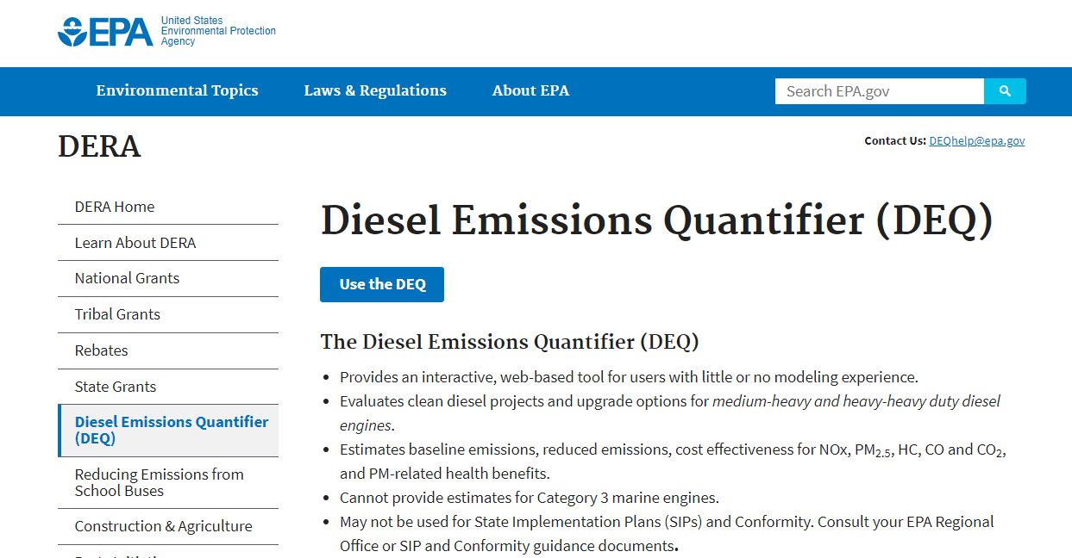
Demonstration of Diesel Emissions Quantifier tool

Slide 19
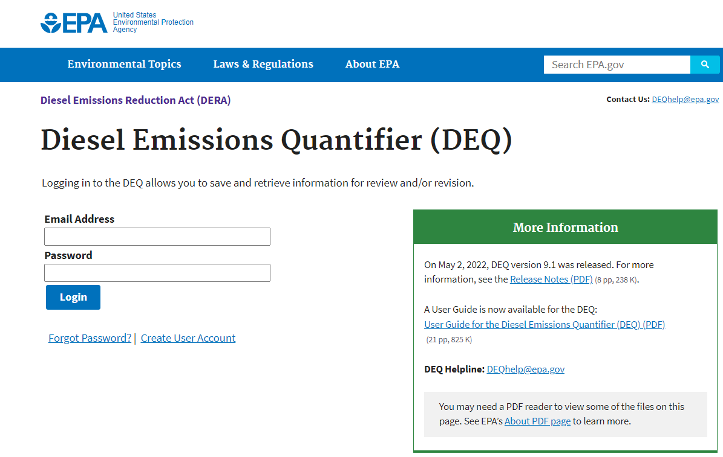
Demonstration of Diesel Emissions Quantifier tool

Slide 20
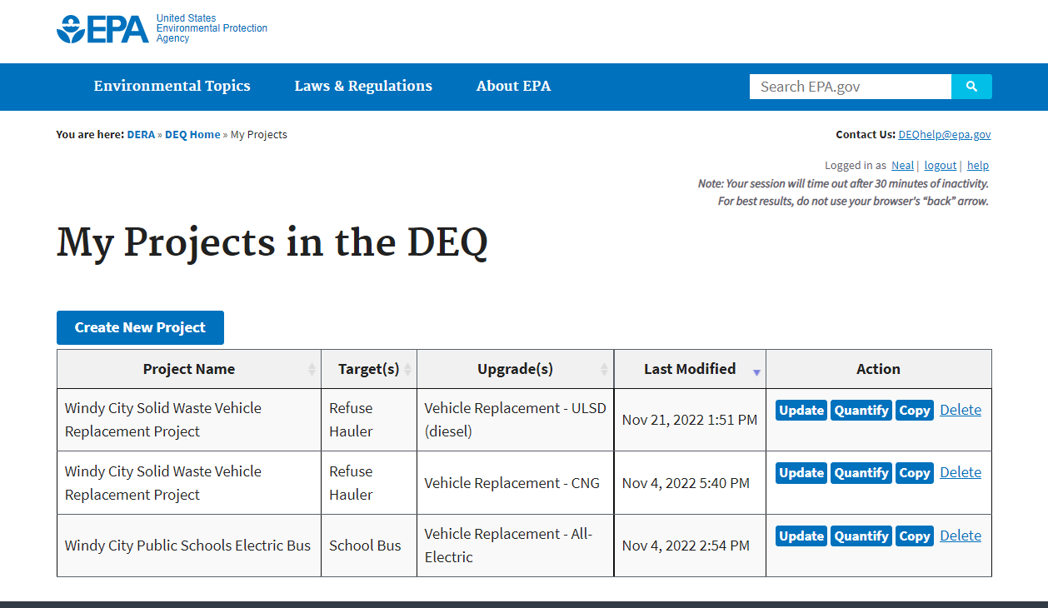
Demonstration of Diesel Emissions Quantifier tool

Slide 21
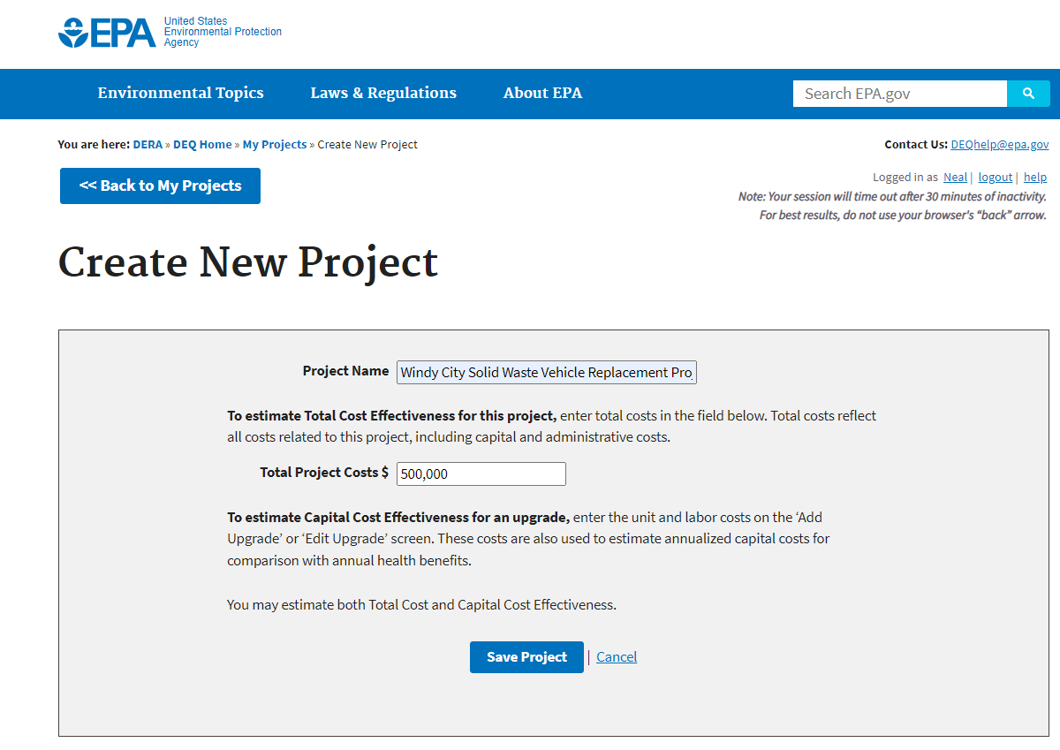
Demonstration of Diesel Emissions Quantifier tool

Slide 22
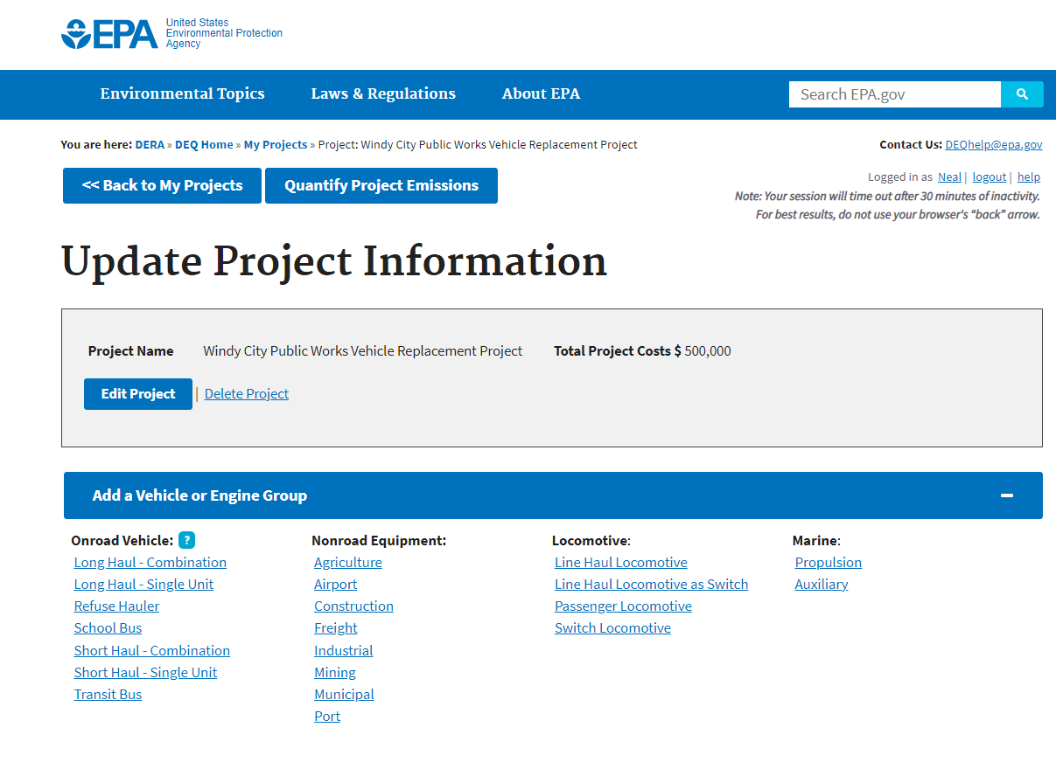
Demonstration of Diesel Emissions Quantifier tool

Slide 23
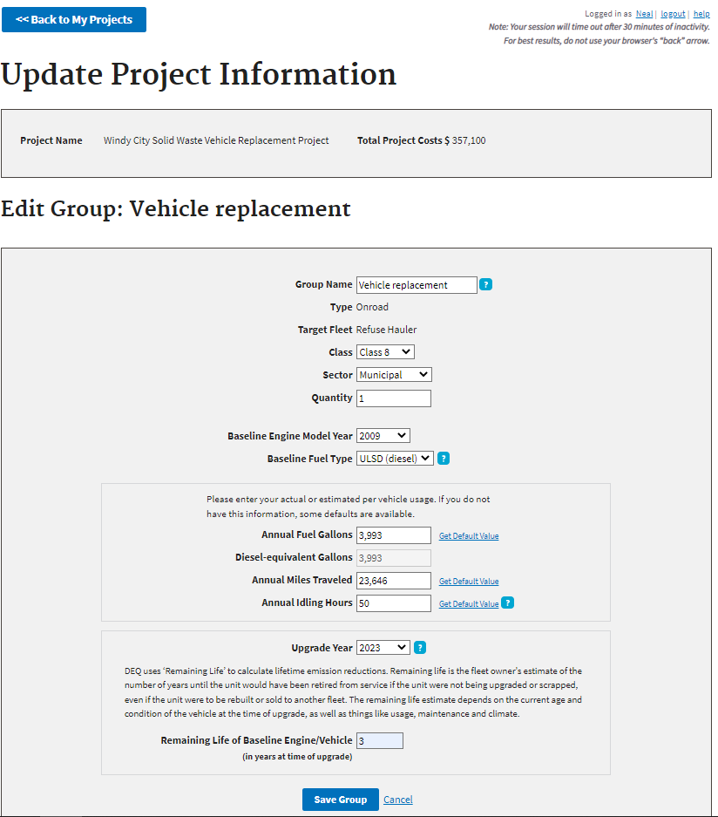
Demonstration of Diesel Emissions Quantifier tool

Slide 24
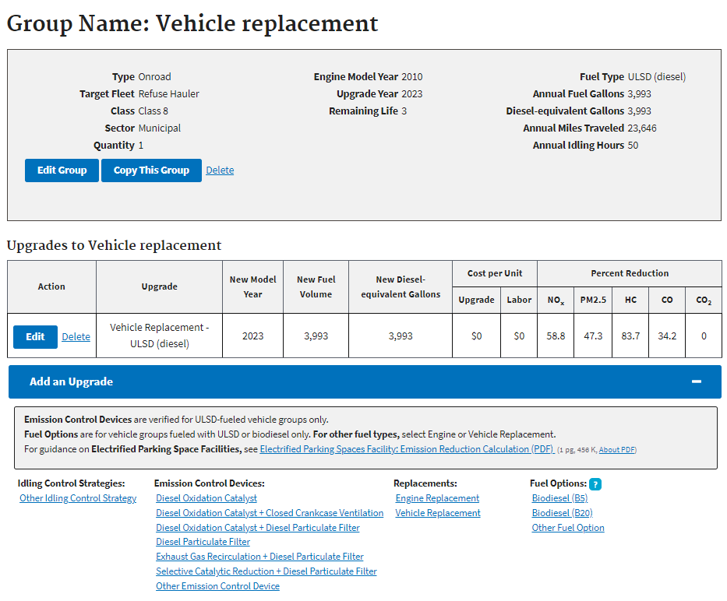
Demonstration of Diesel Emissions Quantifier tool

Slide 25
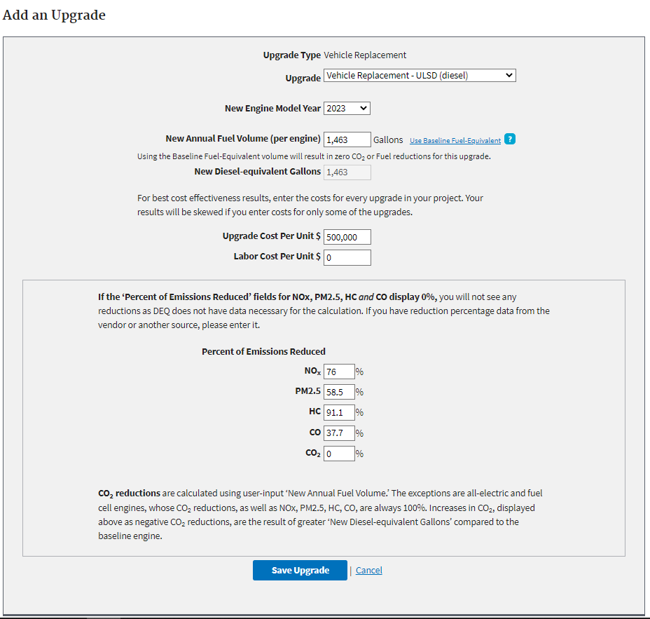
Demonstration of Diesel Emissions Quantifier tool

Slide 26
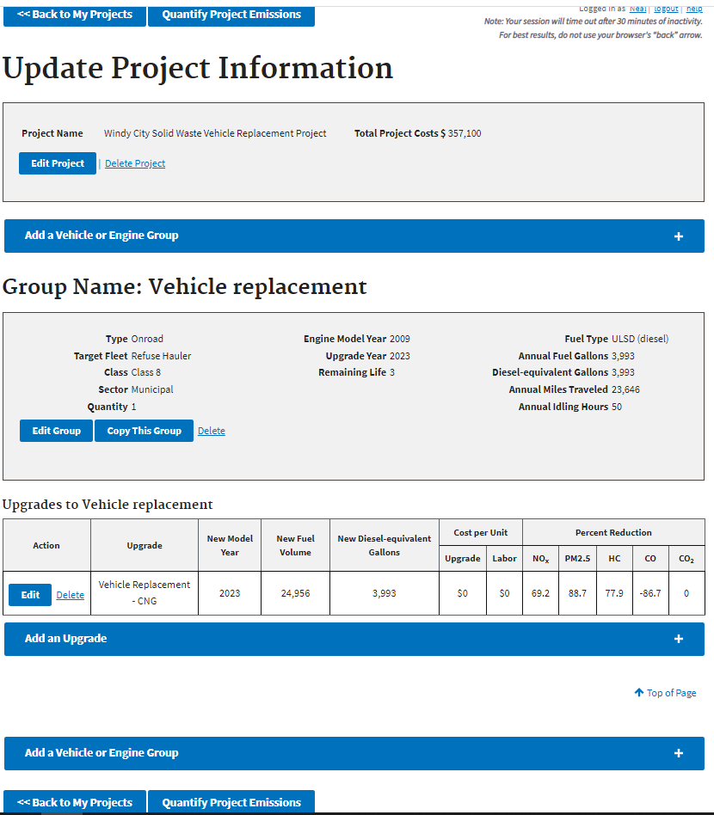
Demonstration of Diesel Emissions Quantifier tool

Slide 27
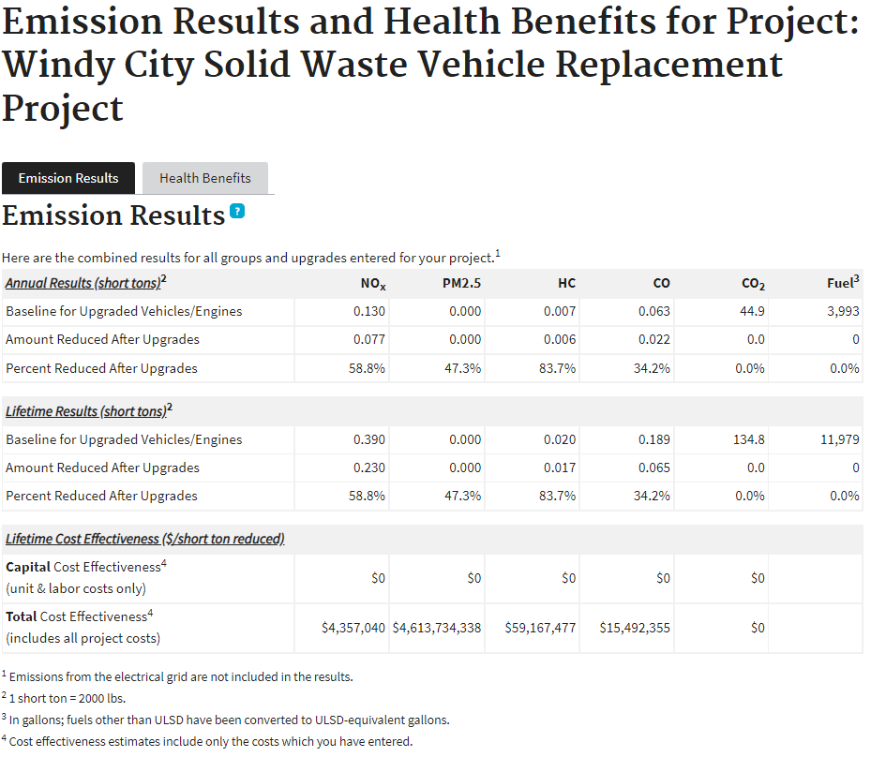
Demonstration of Diesel Emissions Quantifier tool

Slide 28
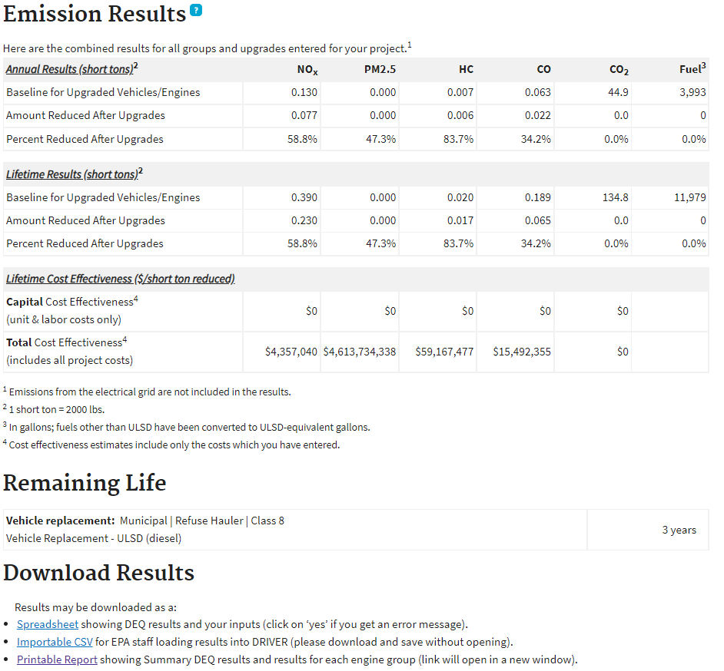
Demonstration of Diesel Emissions Quantifier tool

Slide 29
Application – Public Health Benefits
Public Health Benefits – 30 Points
Describe how project will: Meet requirements of DERA by reducing environmental risks to the public; sensitive populations; and economically disadvantaged and other populations with disproportionately high and adverse human health or environmental impacts. Include impacted communities including total population, percent minority, percent low-income (defined as $25,000 annually, or less), and proximity to hospitals, medical, elderly facilities, and school(s), including daycare. Include map showing locations of these facilities relative to the project area. You can use the United States Census Bureau website to find demographic data (e.g. minority populations and low-income data). [ https://data.census.gov/ ]. Attach a screen print of each webpage that displays the required demographic data as Appendix G, and the map that shows the affected area as Appendix H. Low-income is derived from the Office of the Assistant Secretary for Planning and Evaluation Poverty Guidelines, using data for a family of four with an annual income of $26,200 or less.
For fleet projects that service multiple areas throughout the State, provide a detailed summary of the route; screen prints as Appendix G; and a map for each area serviced as Appendix H; along with the percentage of time the fleet spends in the affected area

Slide 30
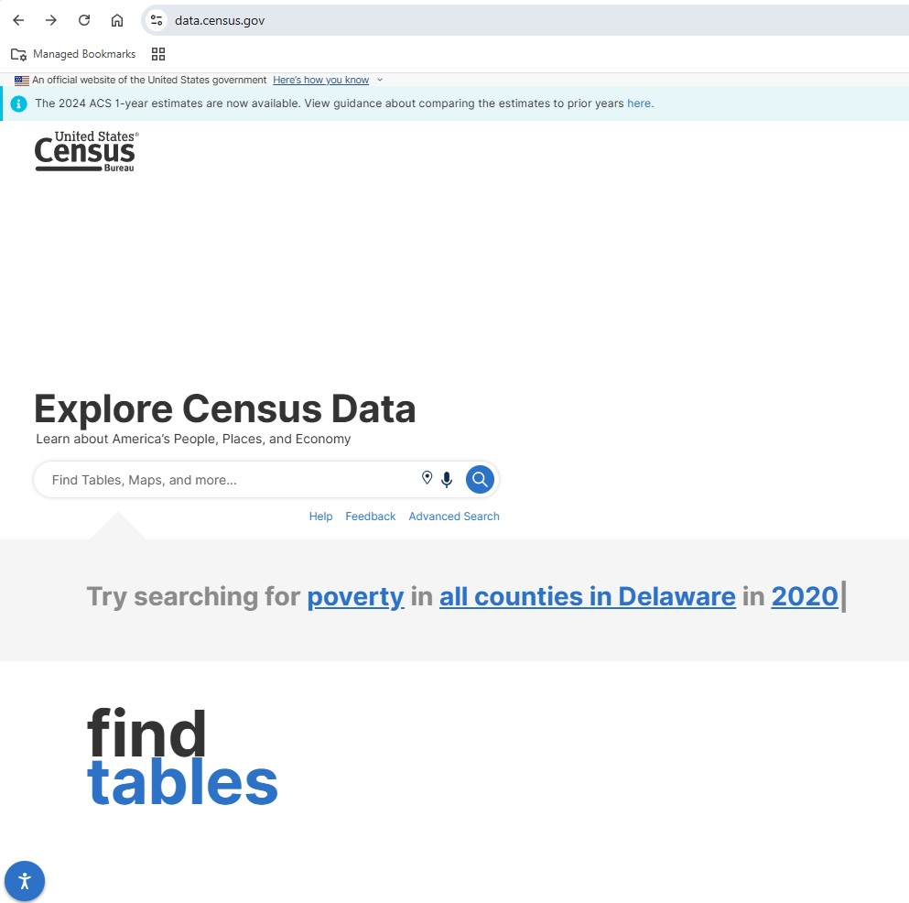
Demonstration of US Census Bureau Data

Slide 31
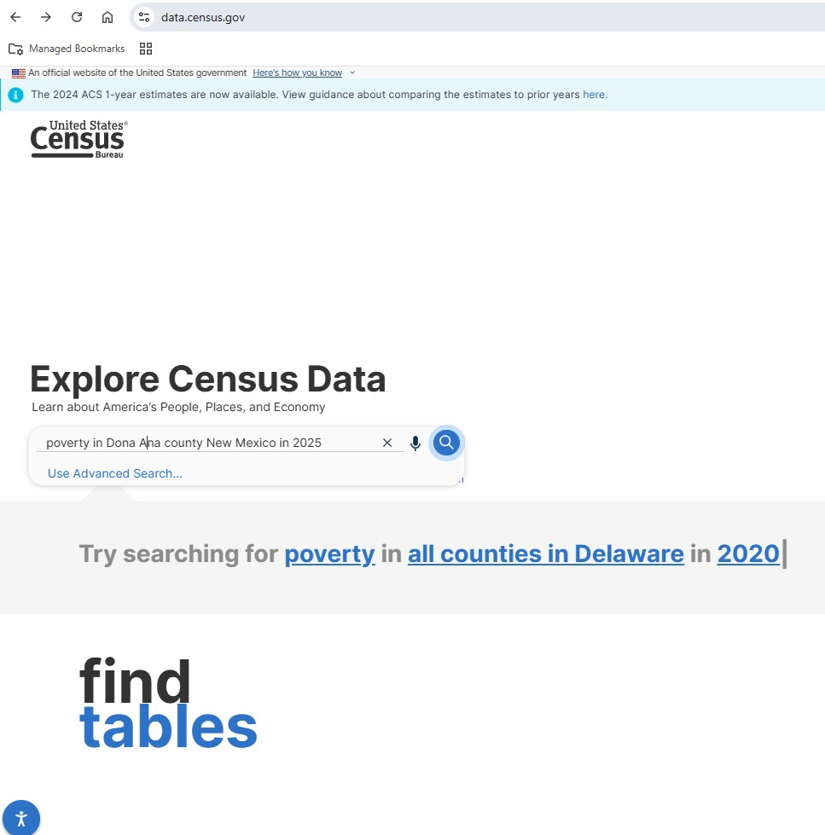
Demonstration of US Census Bureau Data
2
1

Slide 32
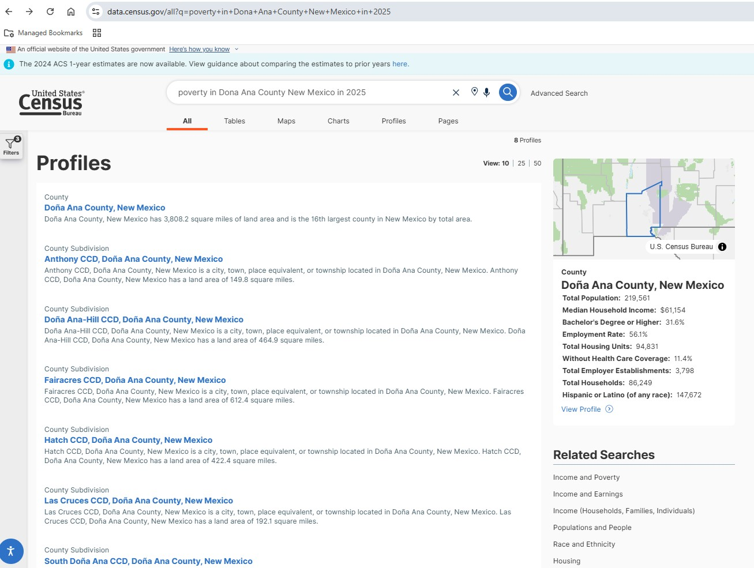
Demonstration of US Census Bureau Data
3

Slide 33
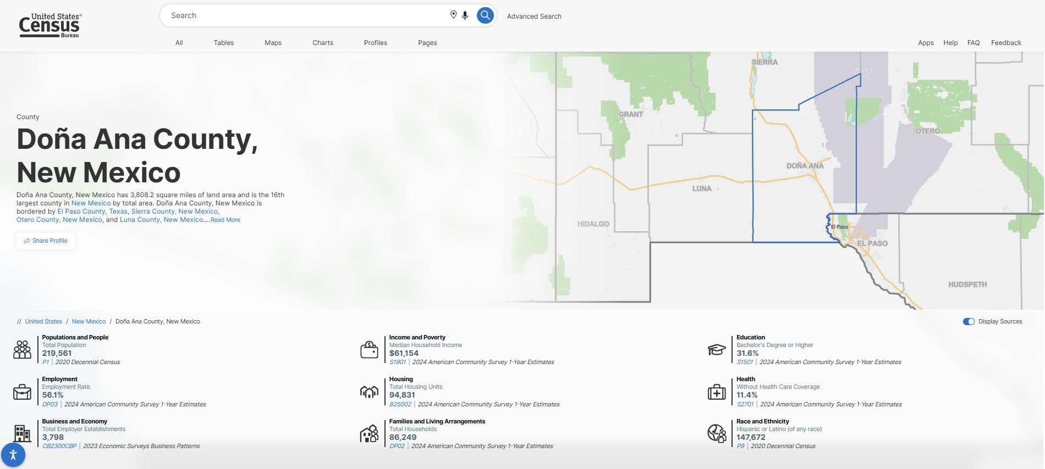
Demonstration of US Census Bureau Data
4

Slide 34
Demonstration of US Census Bureau Data
5

Slide 35
Demonstration of US Census Bureau Data
6

Slide 36
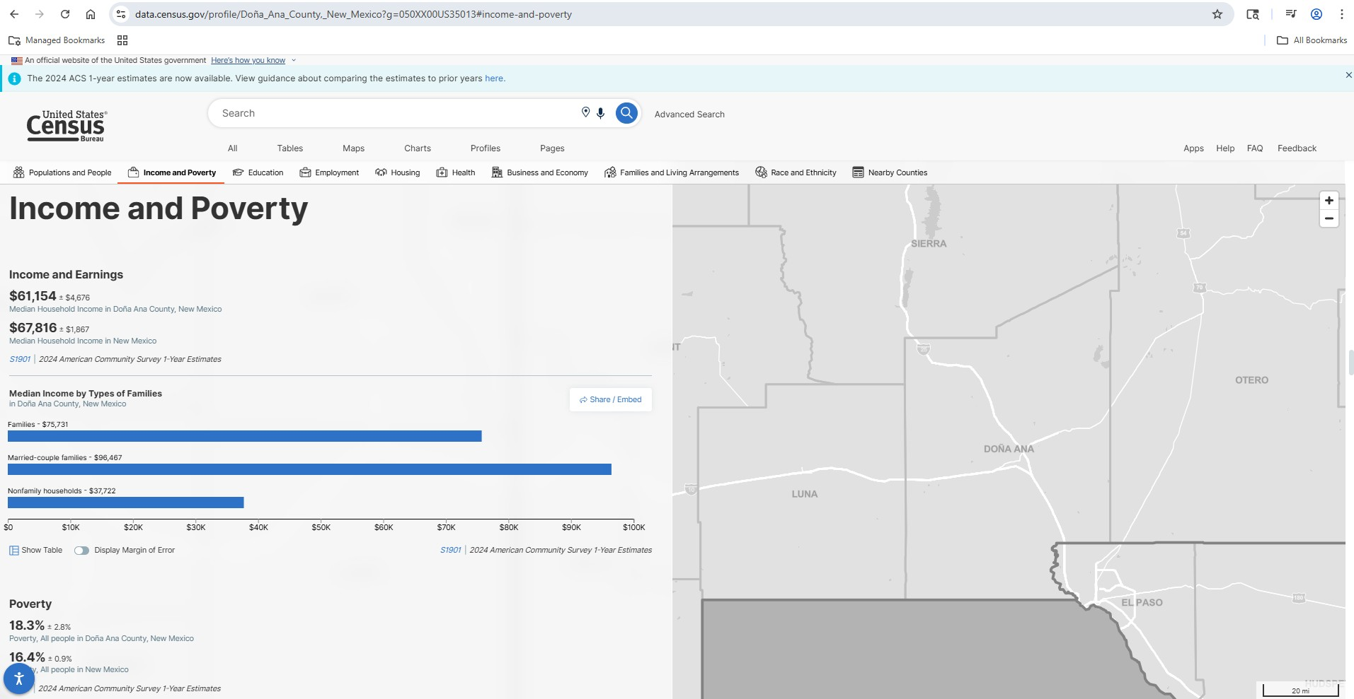
Demonstration of US Census Bureau Data
7
8

Slide 37
Demonstration of US Census Bureau Data
9

Slide 38
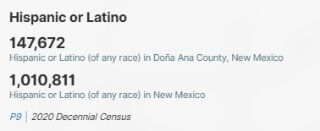
Demonstration of US Census Bureau Data
10
147,672/219,561 = 67%

Slide 39
Application – Air Quality in the Project Location
Air Quality in the Project Location – 30 Points
Describe any special air quality concerns within or in close proximity to, the project area (e.g., located in an ozone nonattainment area, nearby Federal Class I areas, EPA designated priority counties) and include a qualitative description of the area’s diesel emissions due to high impact features (e.g., truck stops, railroad yards, distribution centers, interstates, etc.).
Describe how the project will reduce environmental impacts in the project location as it pertains to the air quality standards and proximity to Class I Areas. Indicate whether the project is located: Within or adjacent to a non-attainment area for the NAAQS for ozone (currently Sunland Park in Doña Ana County); Within or adjacent to a county whose ozone design value is equal to or greater than 95% of the NAAQS for ozone (currently Doña Ana, Lea, Eddy, San Juan, Sandoval, and Bernalillo); or Within or near a designated priority county listed in the NMED Clean Diesel Program Guidance Document Describe the proximity (in miles) to the nearest Class I Area. If there are additional Class I Areas within 100 miles, list all of them. A map of the Federal Class I Areas within the State and in surrounding areas can be found at: [ https://www.env.nm.gov/air-quality/reg-haze/ ] and [ https://www.env.nm.gov/wp-content/uploads/sites/2/2017/01/NM_ClassIAreas_Map.pdf ]. Include a map, showing proximity to Federal Class I Areas relative to the project area as Appendix I.

Slide 40
Application – Community Engagement and Partnership
Community Engagement and Partnership – 5 Points
List any government entities, school districts or organizations involved in this project, including their roles in the project.
Provide a summary that outlines project partners involved in this project and any community activities associated with this project. Project partners include government entities, school districts or community organizations.

Slide 41
Application – Fuel Type
Fuel Type – 30 Points
Fuel Type of Proposed Vehicles: ☐ ULSD ☐ CNG/LNG ☐ Propane ☐ Near zero CNG ☐ Electric ☐ Hydrogen Fuel Cell
Are additional fueling infrastructure developments or improvements needed for this project? If yes, describe below. | ☐ Yes ☐ No
Select all applicable fuel types for the proposal. Projects are not limited to using one fuel type; projects can use multiple fuel types such as compressed natural gas (CNG) or electricity (electric vehicles - EV). Should the project, as proposed, require additional fueling infrastructure, provide a detailed summary of the infrastructure that will be needed for this project including dates of completion that correspond to the project completion date.

Slide 42
Application – Ability to be Deployed in a Timely Manner
Ability to be Deployed in a Timely Manner – 5 Points
Provide a detailed description, including estimated time of delivery and the purchasing process.
Provide a description/summary discussing the estimated time of delivery for equipment or vehicles to include a brief discussion of the applicant’s purchasing procedures.

Slide 43
Application – Purchasing Procedures
Purchasing Procedures – 5 Points
Provide a detailed summary of the applicant’s purchasing procedures ensuring that all vendors will be selected in accordance with state public contracting and procurement regulations and federal procurement regulations.
The applicant must follow state purchasing procedures, as applicable, found at: www.generalservices.state.nm.us/statepurchasing/ ; New Mexico Procurement Code, Sections 13-1-28 through 13-1-199 NMSA 1978, as applicable; and the applicable requirements contained at 2 CFR 200, Office of Management and Budget Guidance – Uniform Administrative Requirements, Cost Principles, and Audit Requirements for Federal Awards; in particular Procurement Standards at 2 CFR 200.317 – 200.326, found at https://www.ecfr.gov/current/title-2/subtitle-A/chapter-II/part-200/subpart-D . This must include price agreements in place, bidding processes or other purchasing procedures.

Slide 44
Application – Previous Grant Experience
Previous Grant Experience – 5 points
Provide a brief summary of previous grant experience, including the year awarded, the funding organization, and the purpose of the grant funding. Also indicate whether any funded projects were not completed and provide an explanation of why these projects were not completed.
If all projects were completed, please indicate this in one sentence.

Slide 45
EPA Clean School Bus Program
Awarded $2.8 billion of a five-year (FY2022-2026), $5 billion program created by the Bipartisan Infrastructure Law. 98% of these funds have gone towards purchasing electric school buses. The EPA stopped accepting applications to the 2024 CSB Rebate Program on January 14th, 2025, but anticipates awarding up to $965 million to fund new, zero-emission and clean-fuel school buses in the future.
Phasing out diesel engines will ensure cleaner air for students, bus drivers, and school staff working near the bus loading areas, and the communities through which the buses drive each day. Diesel air pollution is linked to asthma and other conditions that harm students’ health and cause them to miss school, particularly in communities of color and Tribal communities.
Reducing greenhouse gas emissions (esp. CO₂) from bus replacements will help address outsized role of the transportation sector in fueling climate change.
Upgrading bus fleets will save money for school districts as they replace older, heavily polluting buses with new clean school buses, while freeing up needed resources for schools.

Slide 46

EPA Provided Clean School Bus Funding for School Districts in New Mexico
Electric Buses
  Las Cruces $1,975,000
  Dora Municipal Schools $610,000
  Dulce Independent Schools $790,000.00
  Lake Arthur Municipal Schools $790,000.00
  Pecos Independent Schools $395,000.00
Students at Los Ranchos Elementary had a front-row seat as APS Superintendent Gabriella Blakey and Senator Martin Heinrich announced the district will be getting 20 electric buses, thanks to $6.9 million in federal funding

Slide 47
Questions?
Neal T. Butt
Senior Environmental Scientist
NMED - Air Quality Bureau
Santa Fe Office
525 Camino de los Marquez, Suite 1
Santa Fe, NM 87505-1816
(505) 629-2972
(505) 476-4375 (FAX)
Neal.Butt@env.nm.gov
www.env.nm.gov
Twitter @NMEnvDep | #iamNMED

