Slide 1
New Mexico Environment Department
Military and Veterans Affairs Committee
JD Nance, Hazardous Waste Bureau Chief
Eric Chapman Ph.D., Science Coordinator
November 5, 2025

Slide 2
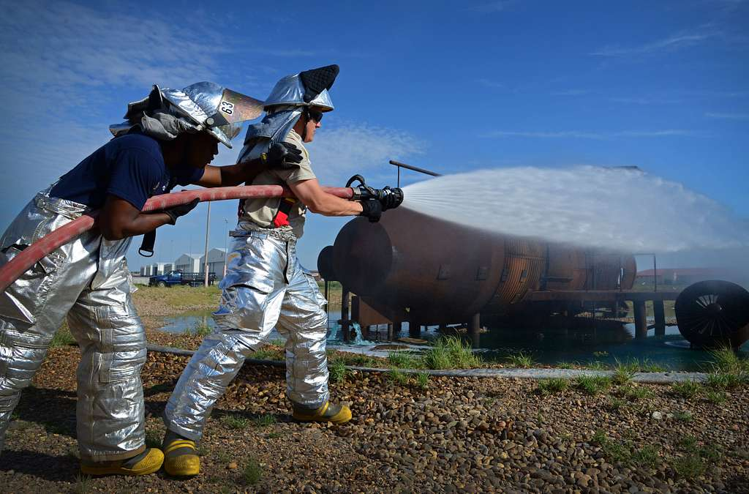
What are PFAS?
Per- and Polyfluoroalkyl Substances​
Thousands of synthesized compounds​
Used in industrial processes, fire fighting foams, and consumer products since the 1950s​
Break down very slowly over time ("forever chemicals")​
Service members and veterans and occupational exposure
Cannon AFB Courtesy of U.S. Air Force/Staff Sgt. Alex Mercer

Slide 3
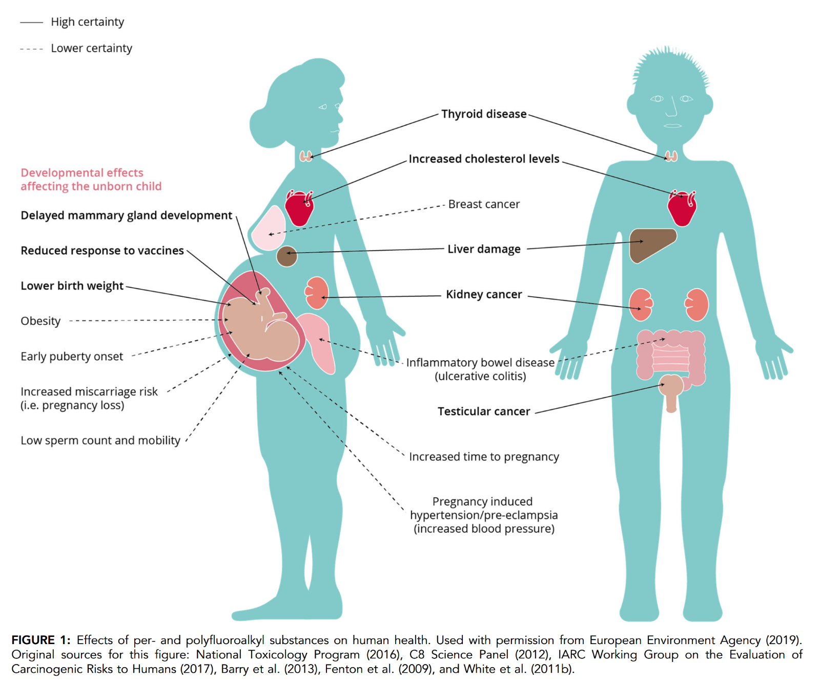
Health Effects of PFAS Exposure
  Some cancers including kidney and testicular​
  Liver disease​​
  Thyroid disease ​​
  Elevated cholesterol ​​
  Pregnancy complications, lower birth weight​​
  Reduced vaccine antibody response ​
Fenton et al. 2020

Slide 4
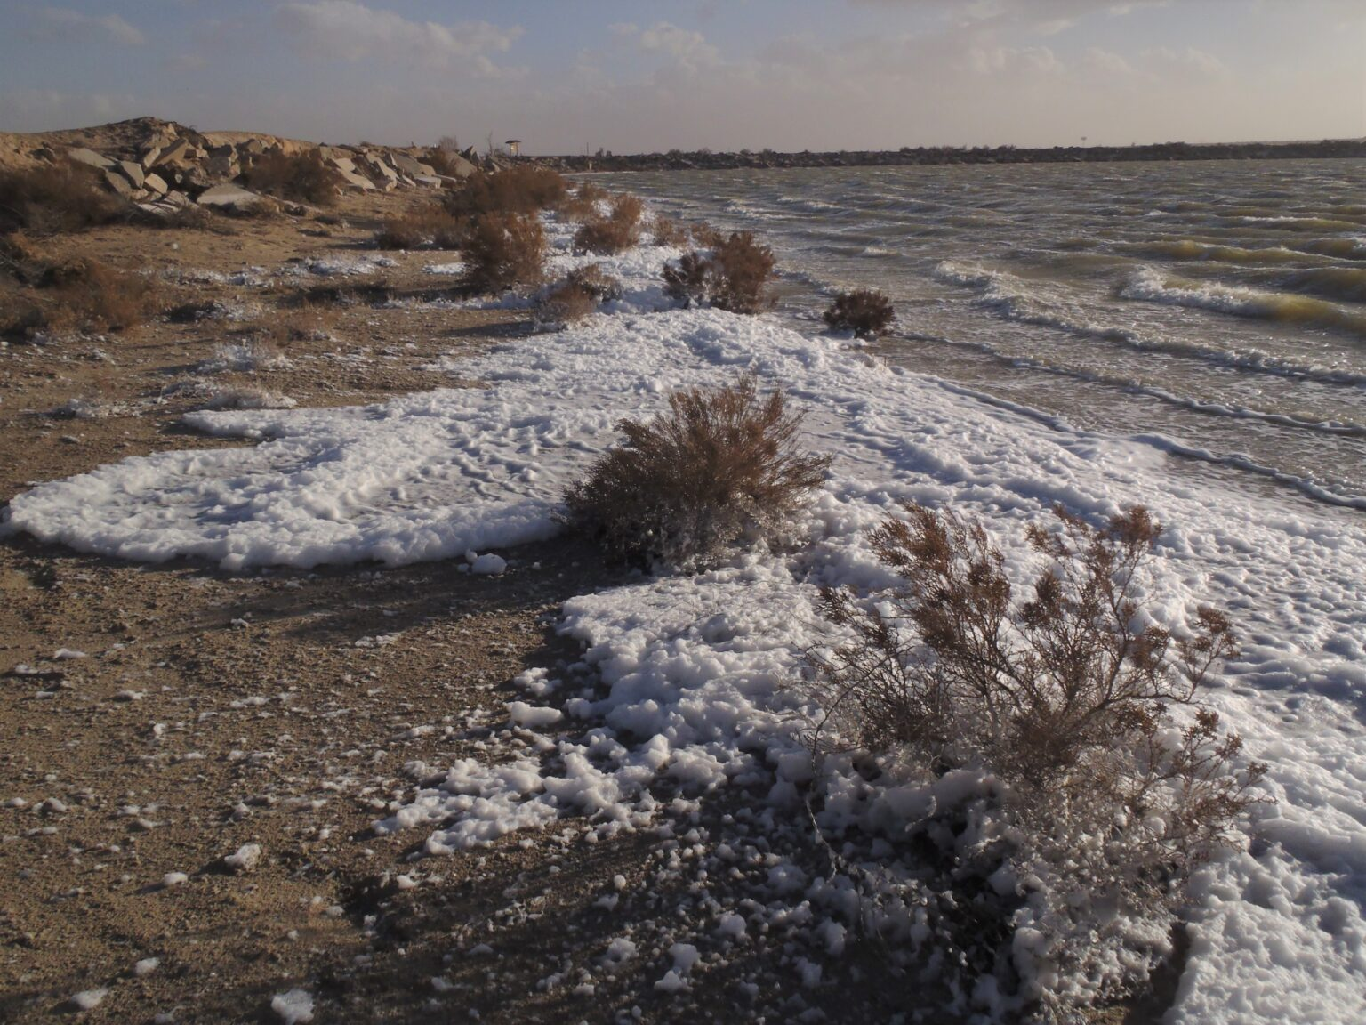
PFAS Exposure Pathways
https://sourcenm.com/2025/01/27/new-mexico-wildlife-and-plants-around-holloman-lake-have-highest-pfas-contamination-on-record/

Slide 5
What actions has the State taken to date?
2025 Session –
  HB140 amended the Hazardous Waste Act by:
    Adding discarded aqueous film-forming foam containing intentionally added PFAS to hazardous waste definition.
    Provides the EIB authority to adopt rules pertaining to AFFF containing PFAS under the Hazardous Waste Act.
    EIB petition in December 2025, final rules by Summer 2026.

Slide 6
What actions has the State taken to date?
2025 Session –
  Appropriations:
    Short Term Assistance: $2M to address private well water contamination from PFAS in Curry County and other areas of the state for expenditure in fiscal year 2026.
    Long Term Assistance: $12M to connect rural Curry County private drinking water sources to public water.

Slide 7
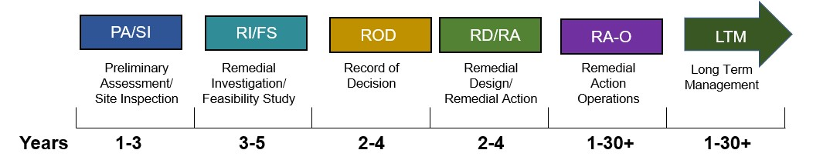
Federal Military Installations
Nationally, Department of Defense is investigating the extent of PFAS contamination at 723 installations
March 2025: Preliminary assessments/site inspections complete at 703 installations
117 installations, no further action needed
586 proceeding through federal Comprehensive Environmental Response, Compensation, and Liability Act (CERCLA) process
https://www.acq.osd.mil/eie/eer/ecc/pfas/pfas101/cercla.html

Slide 8
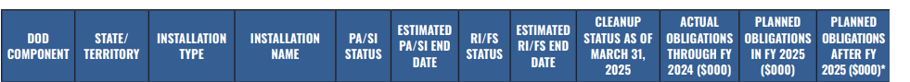
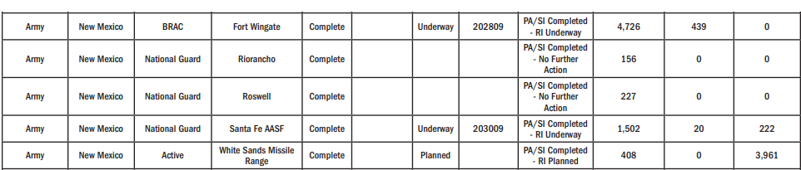

Remediation on Military Installations in NM
https://www.acq.osd.mil/eie/eer/ecc/pfas/pfas101/cercla.html

Slide 9
Air Force Installations
Cannon AFB
Contamination confirmed off site and impacting local communities and industries
In the Remedial Investigation (RI) phase of CERCLA, which evaluates the nature and extent of PFAS contamination in all environmental media.
NMED has not received the Phase I Remedial Investigation
Off site investigation by AF is not occurring
Melrose Range
No data collected, investigation needed

Slide 10
Air Force Installations
Holloman AFB
In the Remedial Investigation (RI) phase of CERCLA
Investigation sampling is ongoing on 3 of 5 sites identified
  Site Inspection (CERCLA) identified five locations of AFFF release sites
  Only three locations retained for the RI phase.
Does not have an RI report available yet.
Contamination confirmed off site and impacting local communities
  (Holloman Evaporation Pond, aka Holloman Lake or Raptor Lake)
Off site investigation is not occurring by AF

Slide 11
Air Force Installations
Kirtland AFB
In the Remedial Investigation (RI) phase of CERCLA
Investigation sampling is ongoing on 2 of 4 sites identified
  Site Inspection (CERCLA) identified four locations of AFFF release sites
  Only two locations retained for the RI phase.
Does not have an RI report available yet
No contamination confirmed off site; however, further investigation is warranted
Off-site investigation is not occurring by AF

Slide 12
Army Installations
Fort Wingate
In the Remedial Investigation (RI) phase of CERCLA
Investigation sampling is planned on 5 of 6 sites identified
  Site Inspection (CERCLA) identified six locations of AFFF release sites
  All but one of the locations are retained for the RI phase.
Does not have an RI report available yet
No contamination confirmed off site; however, further investigation is warranted. Current groundwater flow paths likely prevent any off-site migration.

Slide 13
Army Installations
White Sands Missile Range
RCRA Permit recently renewed (June 2025)
Incorporated language to address PFAS
No data or information received regarding
Preliminary Assessment(s)
Fort Bliss
Small portion of Installation resides in New Mexico
No data or information received regarding Preliminary Assessment(s)

Slide 14
NASA Installations
White Sands Test Facility
Completed the PA in July 2023 and the SI in October 2024
Submitted RCRA Facility Investigation Work Plan to investigate 9 of 12 sites identified.
  Site Inspection (CERCLA) identified 12 locations of potential AFFF release sites
  9 of 12 locations retained for the RCRA Investigation
  (soil and groundwater)
No contamination confirmed off site; initial sampling does not indicate any off-site contamination.

Slide 15
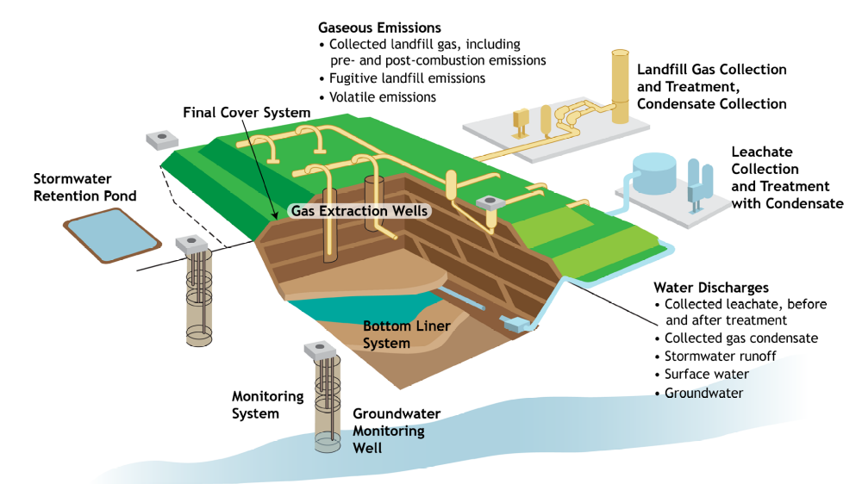
PFAS Disposal and Destruction
Landfills, Underground Injection, Thermal Destruction

Slide 16
High Level Recommendations
NMED is supporting Curry County, La Cienega, La Cieneguilla residents with private drinking water testing and the installation of home filtration systems.
NMED is beginning off-site remediation efforts around Cannon AFB and may need Legislative support (funding) for this effort until we recover funds from the United States.
NMED will continue to support NMDOJ litigation against the United States.
The State should offer New Mexico veterans a PFAS exposure screening at least once every five years.

