Slide 1
Comments on Cumulative NOx Reductions from Compressors
Doug N. Blewitt
Certified Consulting Meteorologist
Air Quality Resource Management (AQRM)
September 15, 2021

Slide 2
Compressor NOx Emissions
My rebuttal testimony provided detailed comments indicating that continuously achieving the emission limits specified in the Draft Regulation will be difficult (if not impossible) and expensive to implement based on an engineering analysis conducted for IPAMS
A sensitivity analysis was conducted to evaluate the cumulative reduction of NOx emissions from well head compressor engines regarding the proposed 0.2 g/hp-hr emission limit on engines greater than 500 hp but less than 1000 hp compared to current engine technology (2.0 g/hp-hr)
Higher horsepower and more engines for a well with gas lift technology are needed at the onset of production and as production declines over time, engines will be removed or de-rated
The analysis utilized a typical three well pad gas lift technology currently used on some wells in the San Juan Basin
This example represents an upper bound of well head compression and most new development will instead utilize engines smaller than those used in this example
The actual magnitude of the NOx emission reduction from the implementation of a 0.2 g/hp-hr emission limit will be less than presented in this example

Slide 3
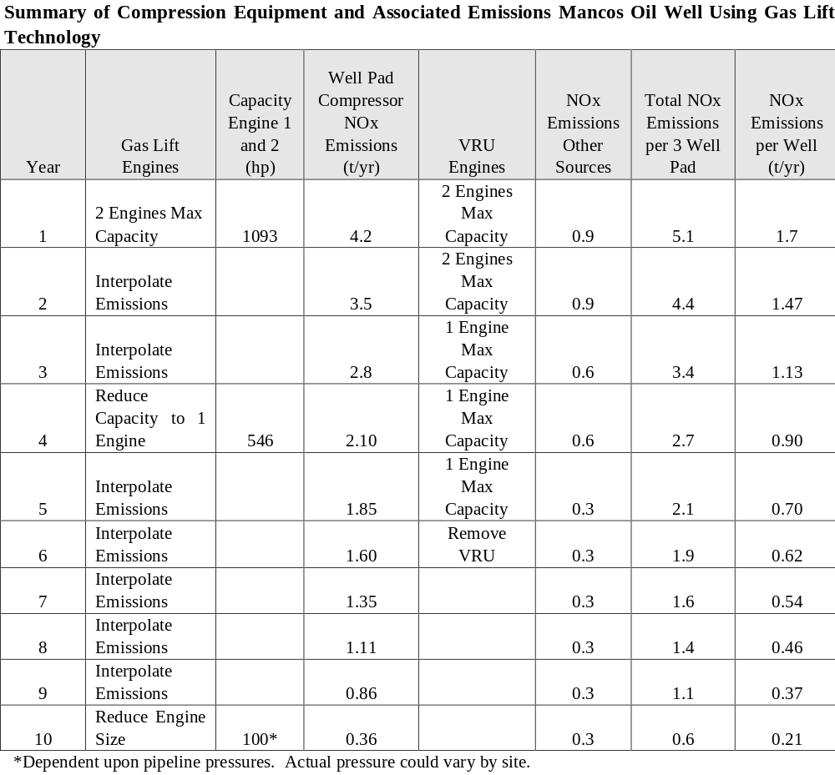
Page 25 of Doug N. Blewitt Rebuttal Testimony

Slide 4
Cases Considered
Annual emissions from a single well over a 10-year production window were calculated for the following cases:
  1) Based on an emission profile presented in the previous slide and correlated to annual production
  2) Using the compressor and emission profile presented, but controlling emissions for engines greater than 500 hp but less than 1000 hp at a level of 0.2 g/hp-hr as well as 2.0 g/hp-hr (current technology) at 100 percent load
  3) Calculating emissions based on a constant rate of production
  4) Cumulative emissions were computed with a development rate of 200 new wells per year as outlined in the Mancos EIS

Slide 5
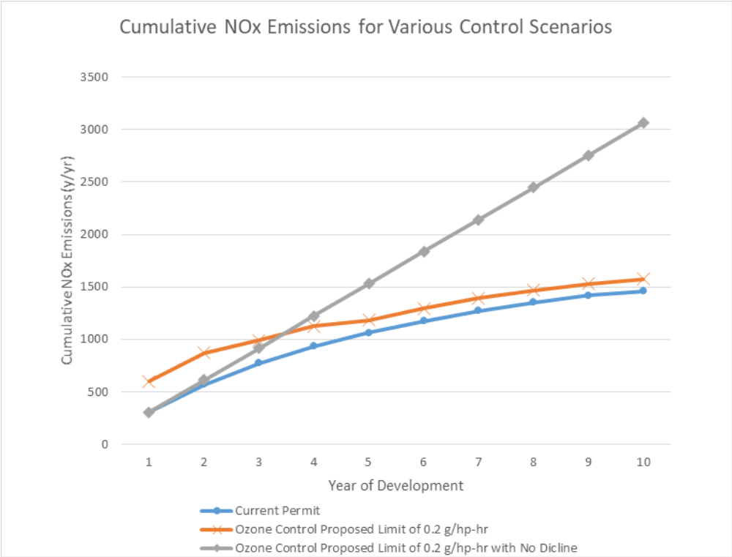
Cumulative NOx Emission Calculations for 0.2 g/hp-hr With Decline and 2.0 g/hp-hr With Decline and
0.2 g/hp-hr Without Decline
Page 26 of Doug N. Blewitt Rebuttal Testimony

Slide 6
Cumulative NOx Emission Results for 0.2 g/hp-hr With Decline, 2.0 g/hp-hr With Decline and 0.2 g/hp-hr
During the first year of development (200 wells drilled) there was a cumulative decrease of 295 tons per year of NOx emissions by implementing an emission limit of 0.2 g/hp-hr compressor engines compared to 2.0 g/hp-hr engines (approximately a 1.5 tons per year reduction per well by the implementation of the proposed regulation)
After 5-years the reduction in NOx emissions for the 0.2 g/hp-hr compressor engines compared to the 2.0 g/hp-hr compressor engines is 122 tons per year or 0.61 tons per year per well (the smaller reduction is associated with reduction in engine capacity in older wells related to production decline)
Over the 10-year production window, total cumulative NOx emissions from compressor engines (summed over the 10-year period) for 0.2 g/hp-hr were 10,329 tons/10-year period and for the 2.0 g/hp-hr case were 12,034 tons/10-year period
The net reduction by implementing the lower emission limit over a 10-year period was approximately 1,700 tons or a 16 percent reduction
These cases reflect the actual reductions that would occur from implementation of the 0.2 g/hp-hr standard - the projected reductions are very modest, the cost to control is greater than reported and the data do not support implementation

Slide 7
Comparison of Cumulative Reduction from the 0.2 g/hp-hr Case With No Decline to the 2.0 g/hp-hr Case With Decline
After 4 years with compressors employing a 0.2 g/hp-hr emission limit assuming no decline, emissions are slightly greater than the 2.0 g/hp-hr case
After 10 years, the no decline case (0.2 g/hp-hr) is 1,500 tons per year greater than the 2.0 g/hp-hr case (approximately a 50 percent increase in computed emissions)
This example demonstrates that computing compressor emissions without decline is not representative of actual compressor emissions
The cost of NOx control is likely much higher than reported because the magnitude of NOx reductions will be lower
Emission reductions used in the modeling analysis are over-stated.
If emissions for the 0.2 and 2.0 g/hp-hr cases are compared without decline, the results are inaccurate and overstate the actual reduction in emissions

