Slide 1
CRRUA Compliance Update
Tim Willy, Compliance Officer
Water Protection Compliance and Enforcement Bureau

Slide 2
System Background
The aquifer supplying CRRUA’s wells contains naturally high levels of arsenic.
Untreated water has arsenic values ranging from ~10 ppb to ~40 ppb depending on the well.
  8 active wells supply distribution
  Each well is treated at 1 of 4 arsenic treatment facilities
The system is comprised of 4 interconnected service areas
  Border Service Area
  Sunland Park Community Service Area
  Santa Teresa Community Service Area
  Santa Teresa Industrial Park Service Area

Slide 3
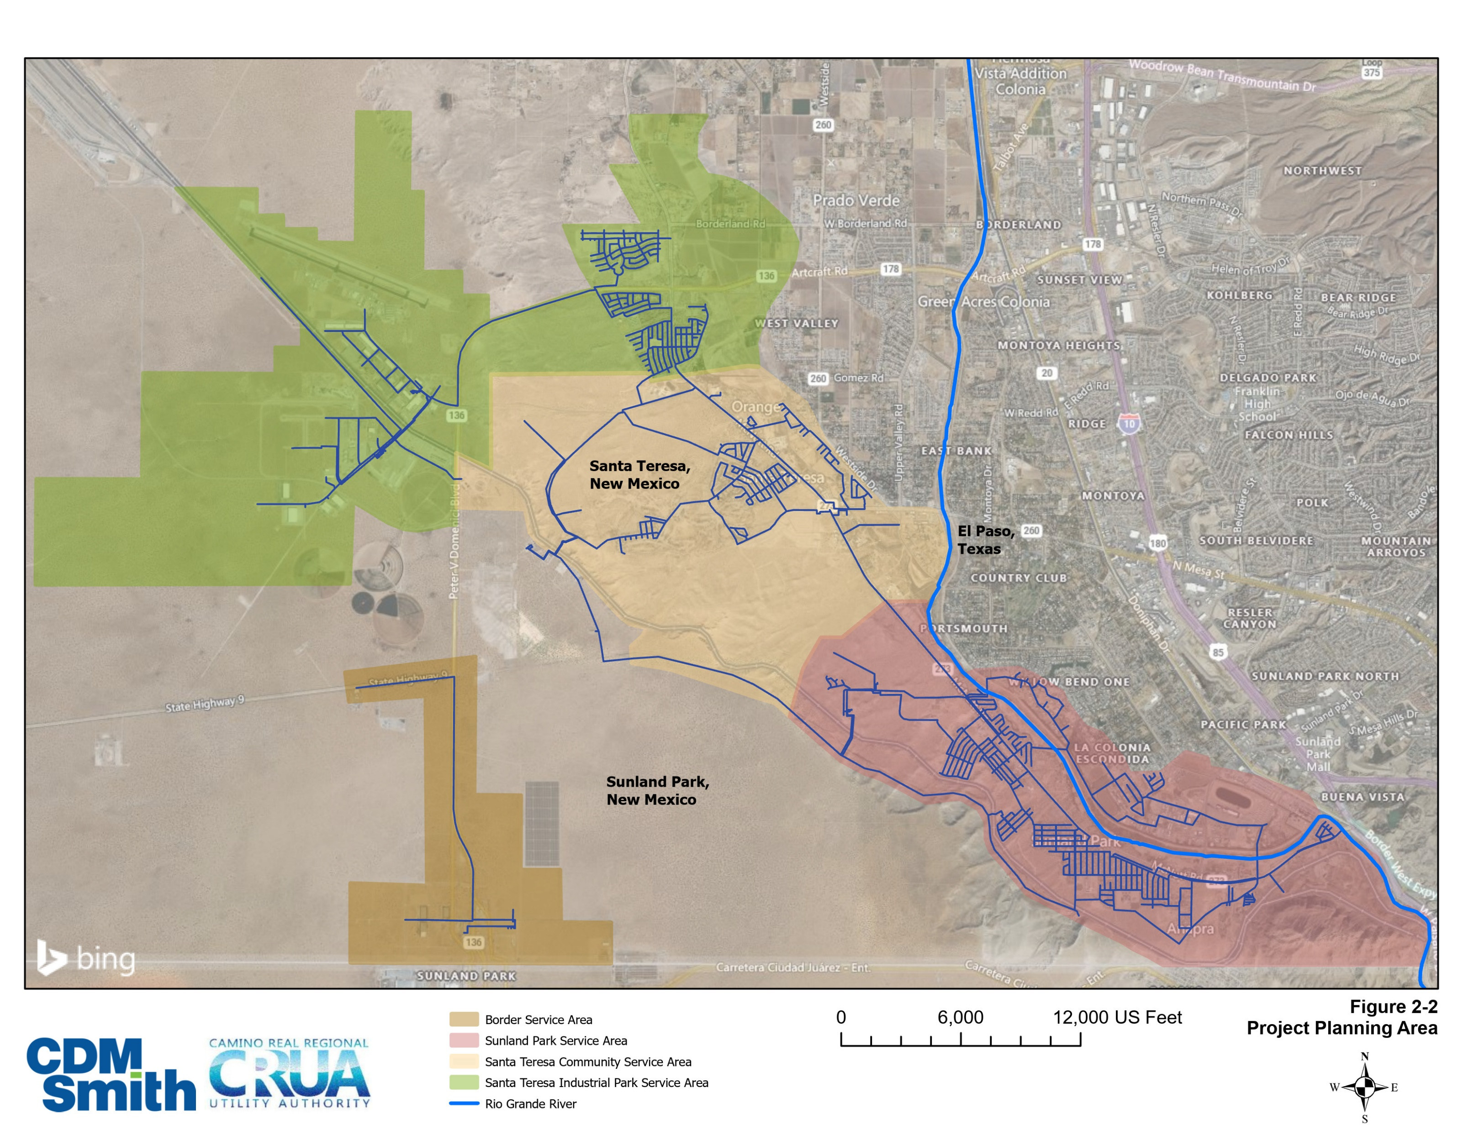
CRRUA Service Areas

Slide 4
Regulatory Framework
The Safe Drinking Water Act (SDWA) is the primary federal statute that protects public health by regulating public water systems.
Regulatory Authority:
  The US Environmental Protection Agency (EPA) sets national standards.
  The EPA delegates compliance monitoring and enforcement to the state level.

Slide 5
How is Arsenic Sampled?
The US EPA has established 0.010 mg/L (10 ppb) as the Maximum Contaminant Level (MCL) for arsenic in drinking water.
  Arsenic samples are collected at the entry point to the distribution system (EP) – The final product before delivery to customers.
  Arsenic samples are collected by a certified NMED sampler and sent to an independent lab certified by NMED utilizing EPA approved analytical methods.
Water systems with arsenic levels below the MCL are sampled once per 3 years.
If a water system has a sample exceeding the MCL, the facility that had the MCL exceedance is placed on quarterly sampling.

Slide 6
How is Compliance Calculated?
Compliance with the MCL is determined by a running annual average (RAA) of the 4 most recent quarters.
  A single high sample does not automatically trigger an MCL violation.
  An MCL violation occurs If the average of the 4 most recent quarterly samples exceeds 10 ppb.

Slide 7
Arsenic Compliance Data
Border Area
Industrial Park
Sunland Park
Santa Teresa
Monitoring Period | Result (ppb As) | RAA (ppb As) |  | Result (ppb As) | RAA (ppb As) |  | Result (ppb As) | RAA (ppb As) |  | Result (ppb As) | RAA (ppb As)
1Q2023 | 13 | 16.75 |  | - | - |  | - | - |  | - | -
2Q2023 | 13 | 15.25 |  | 36 | * |  | - | - |  | - | -
3Q2023 | 15 | 14.5 |  | 34 | 17.5* |  | - | - |  | - | -
4Q2023 | 4 | 11.25 |  | 33 | 25.75* |  | 14 | * |  | 10 | *
1Q2024 | 12 | 11 |  | 36 | 34.75 |  | 17 | * |  | 11 | *
2Q2024 | 3 | 8.5 |  | 7 | 27.5 |  | 5 | * |  | 6 | *
3Q2024 | 3 | 5.5 |  | 4 | 20 |  | 9 | 11.25 |  | 5 | 8
4Q2024 | 6 | 6 |  | 6 | 13.25 |  | 6 | 9.25 |  | 5 | 6.75
1Q2025 | 3 | 3.75 |  | 8 | 6.25 |  | 3 | 5.75 |  | 7 | 5.75
2Q2025 | 3 | 3.75 |  | 15 | 8.25 |  | 7 | 6.25 |  | 5 | 5.5
3Q2025 | 4 | 4 |  | 3 | 8 |  | 3 | 4.75 |  | 4 | 5.25
4Q2025 | 5 | 3.75 |  | 2 | 7 |  | 4 | 4.25 |  | 3 | 4.75
1Q2026 | 5 | 4.25 |  | 3 | 5.75 |  | 4 | 4.5 |  | 4 | 4
2Q2026 | 5 | 4.75 |  | 3 | 2.75 |  | 3 | 3.5 |  | 4 | 3.75
3Q2026 | 5 | 5 |  | 5 | 3.25 |  | 7 | 4.5 |  | 4 | 3.75
Arsenic RAA MCL Exceedance and Violation
Single sample exceeding Arsenic MCL

Slide 8
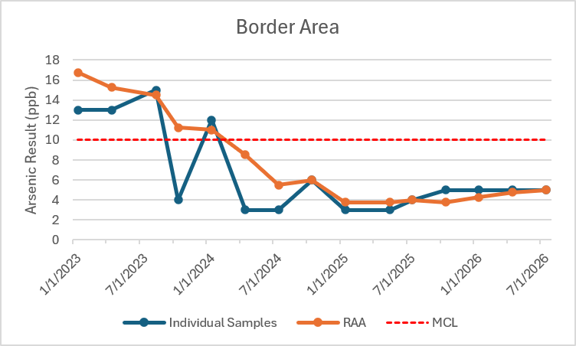
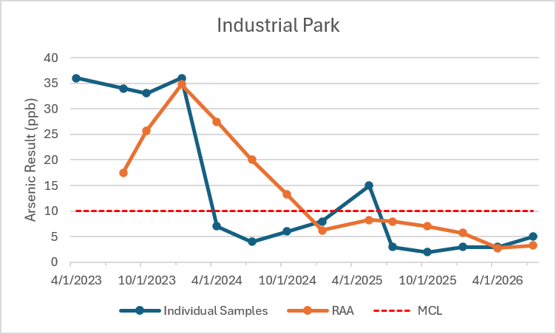
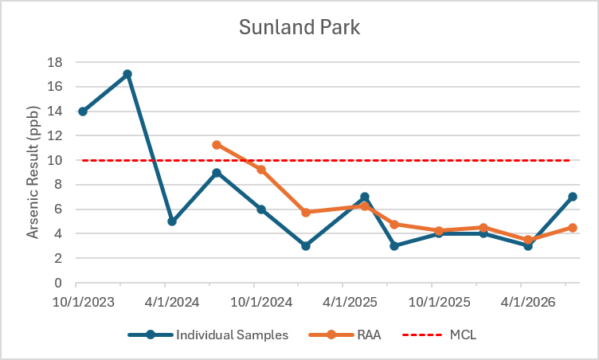
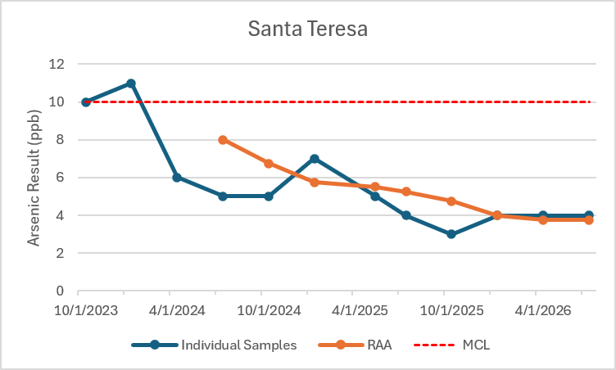
Arsenic Compliance Data

Slide 9
Key Takeaways and Current Status
CRRUA received 12 arsenic MCL violations from 1Q2023 to 4Q2024.
CRRUA has been in compliance with the arsenic RAA at all facilities since 1Q2025 (7 consecutive quarters).
In the past 10 quarters of compliance sampling (40 total samples starting 2Q2024), CRRUA has exceeded the arsenic MCL once.
NMED will continue to monitor arsenic quarterly to ensure CRRUA remains in compliance with the arsenic standards.

