Slide 1
WEG Proposed Changes to Definition of "PTE"
Doug N. Blewitt
Certified Consulting Meteorologist
Air Quality Resource Management (AQRM)
September 15, 2021

Slide 2
Application of Potential to Emit for Oil and Gas Sources
EPA Definition of Potential to Emit
“Potential to emit” is the maximum capacity of a stationary source to emit under its physical and operational design. ….”
For oil and gas wells the application of Potential to Emit (PTE) is problematic
Many emission sources associated with oil and gas wells are directly related to production rate
Production rate is not determined by design (rather by reservoir properties) and production rate decreases over time – thus for some sources emissions will decrease over time
The definition of PTE is applicable to stationary sources implying a single location
Because of decline after the first year of production, it is impossible to have emissions equal to the original level of PTE and thus PTE will be moot

Slide 3
WEG Suggests Drilling and Fracking Emissions Be Included in PTE Determination
Drilling and fracking engines are not stationary sources and emissions are regulated by EPA through Non-Road Engine Regulations which utilize prescribed control requirements
Drilling and fracking engines are temporary emission sources at a specific well site and are only utilized for 2-3 months and then moved to a new location
  Drilling and fracking engine emissions would be spread over an entire year in any PTE calculation)
After completion of a well the engines are moved to a new well location where the new well drilling and fracking emissions would be reset to 0
Emissions from drilling and fracking engines are included in regional air quality modeling analyses

Slide 4
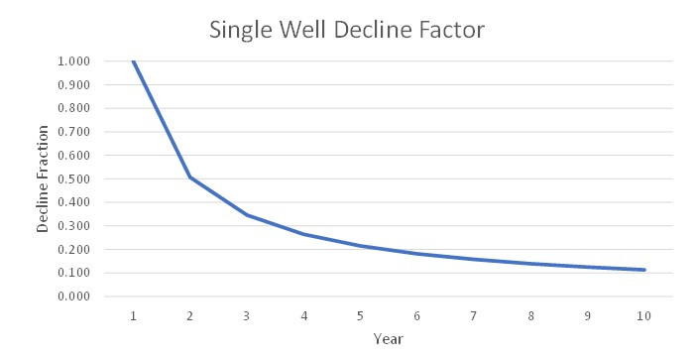
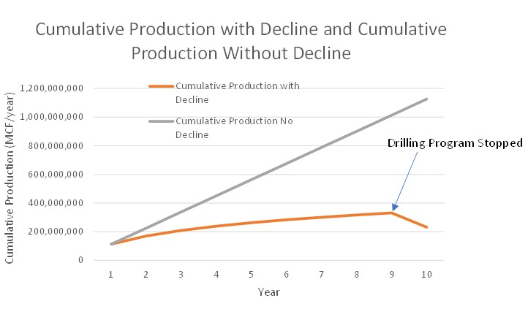
Example of Production Decline
New wells are drilled in a basin to replace declining
production in existing wells
Emissions from sources which are dependent on production
rate will be reduced as production declines (compressors,
dehys, tank emissions, liquid unloading, etc.)
Source: 2020, D.N. Blewitt, Technical Review of the Farmington Mancos-Gallup Draft Resource Management Plan Amendment and Environmental Impact Statement
The decline curve for a single well indicates a 20 percent drop in production over the first year and a 50 percent drop in production over the second year
Cumulative basin production depends on the rate of development for new wells
The cumulative plot indicates that for a development rate of 200 wells per year, after 9 years cumulative basin production is approximately 300,000,000 MCF/yr
and for the non decline case cumulative production is erroneously estimated to be 1,000,000,000 MCF/yr.
From IPAMS Exhibit 8, page 21/33

Slide 5
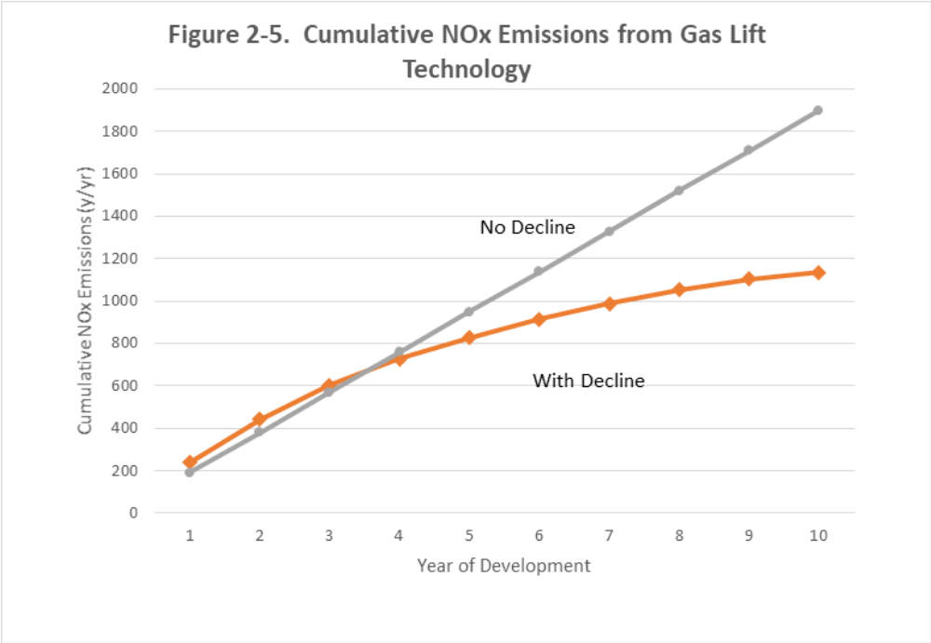
Difference between no decline case and with decline case in 2028 is
800 tons/yr
Source: 2020, D.N. Blewitt, Technical Review of the Farmington Mancos-Gallup Draft Resource Management Plan Amendment and Environmental Impact Statement
From IPAMS Exhibit 8, 23/33

Slide 6
Conclusions
The determinization of PTE for oil and gas wells is complicated because of production decline
The inclusion of drilling and fracking engines into PTE calculations is not appropriate since these engines are non-road sources that are temporary in nature

