Slide 1
Comments on Modeling of Ozone from Oil and Gas Production Emissions in New Mexico
Tammy M. Thompson
Senior Air Quality Scientist, Environmental Defense Fund
September 22, 2021

Slide 2
Ozone VOC Sensitivity is often highest in areas of relatively higher ozone
We are most interested in areas with high ozone concentrations, and especially areas that overlap with O&G regions, so let’s talk about the NOx/VOC sensitivity of those areas, not the state “on average”
The modeling (NMED Exhibit 17, pp 158 – 184) shows, on high ozone days, the areas with highest MDA8 ozone are often co-located with the highest VOC sensitivity.

Slide 3
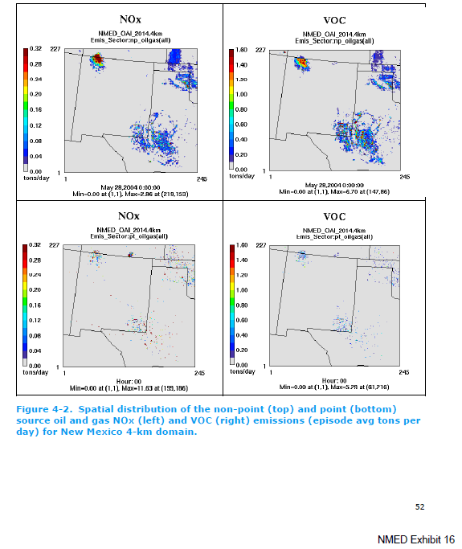
Location of modeled Oil and Gas emissions:
NMED Exhibit 16 pp 52

Slide 4
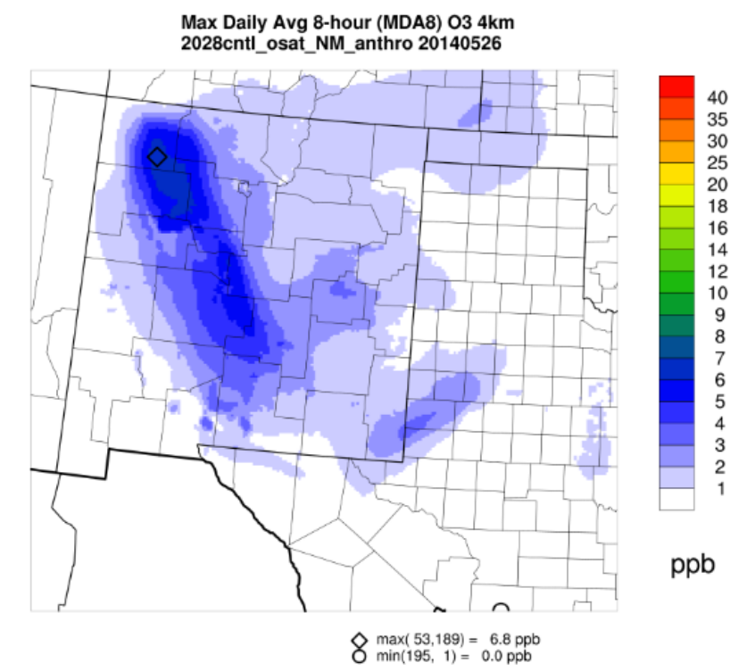
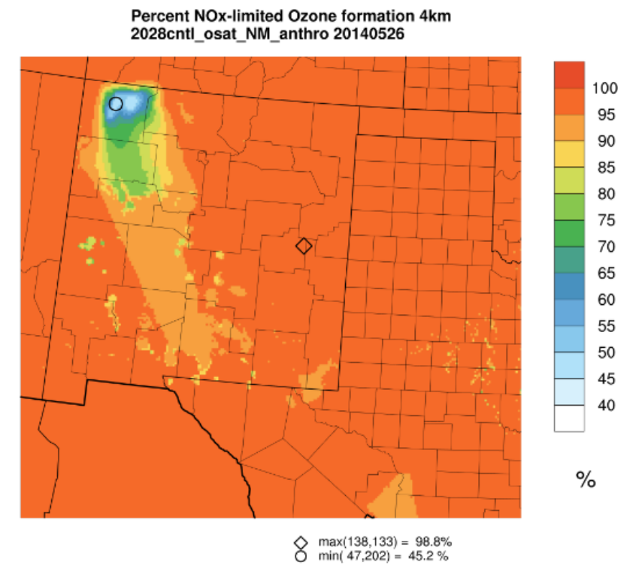
The San Juan region shows both high contribution of NM emissions to ozone (left) and high VOC sensitivity (right)
May 26, 2014 (pp 163)

Slide 5
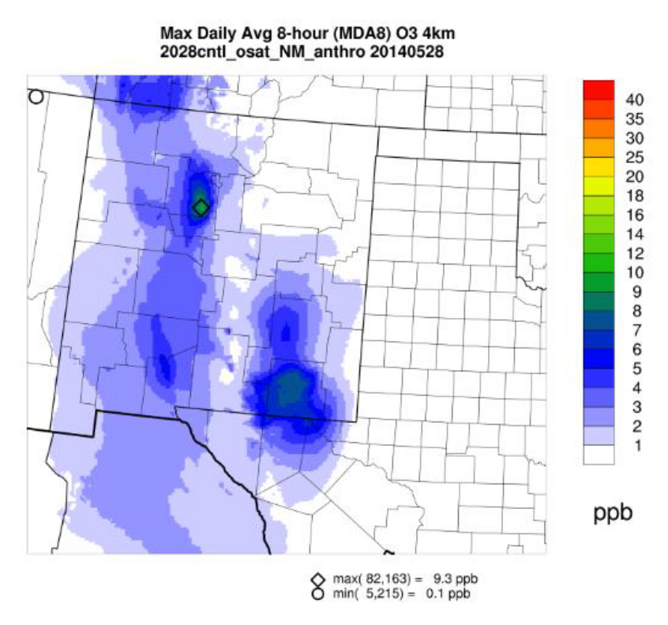
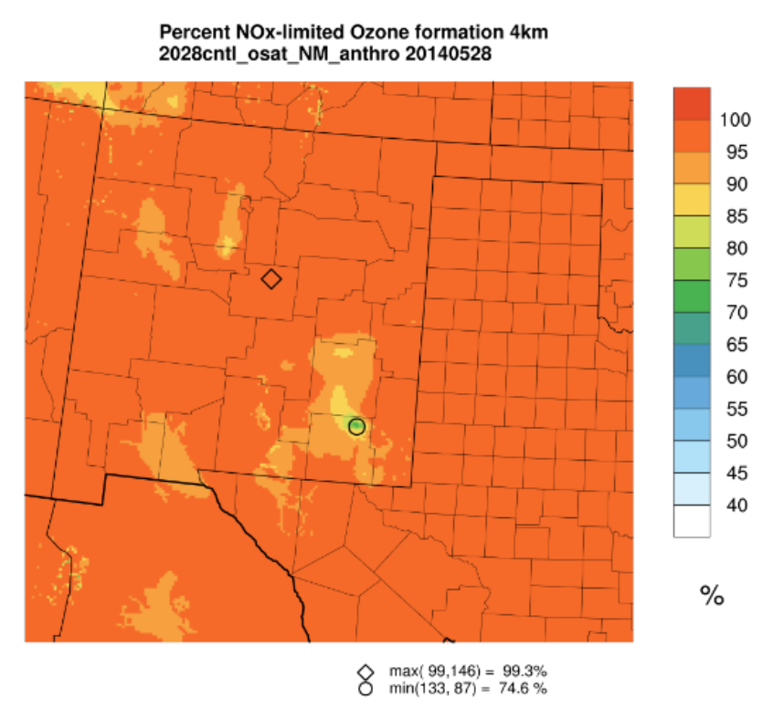
Southeast NM shows both high contribution of NM emissions to ozone (left) and higher VOC sensitivity (right)
May 28, 2014 (pp 164)

Slide 6
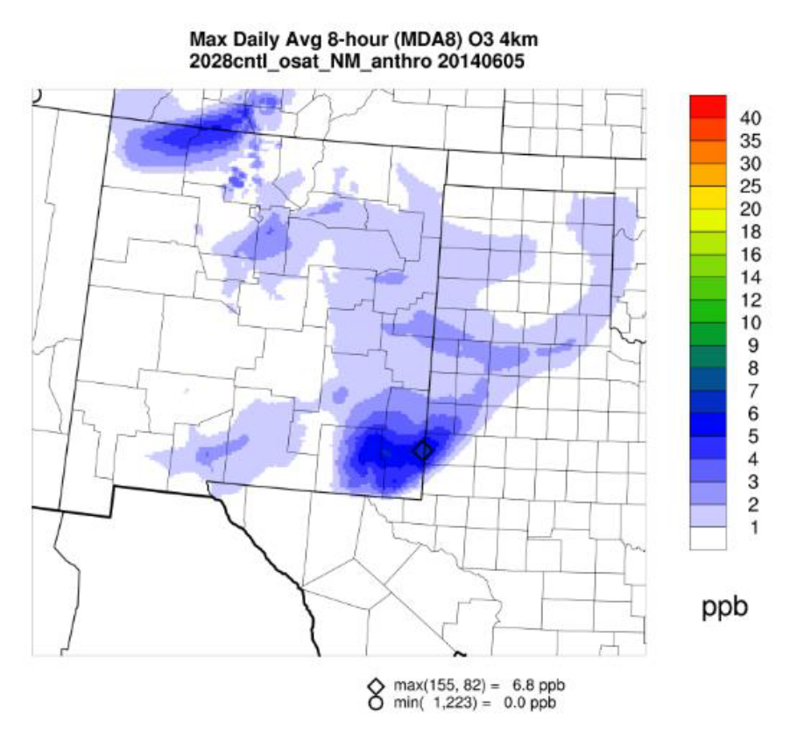
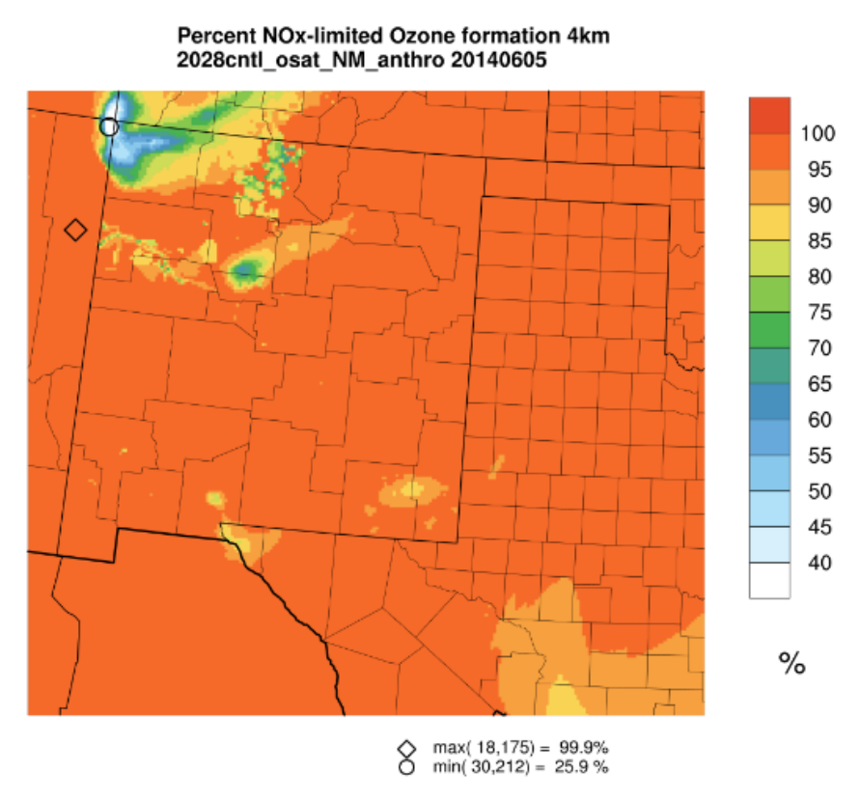
The San Juan region shows both high contribution of NM emissions to ozone (left) and high VOC sensitivity (right)
June 5, 2014 (pp 166)

Slide 7
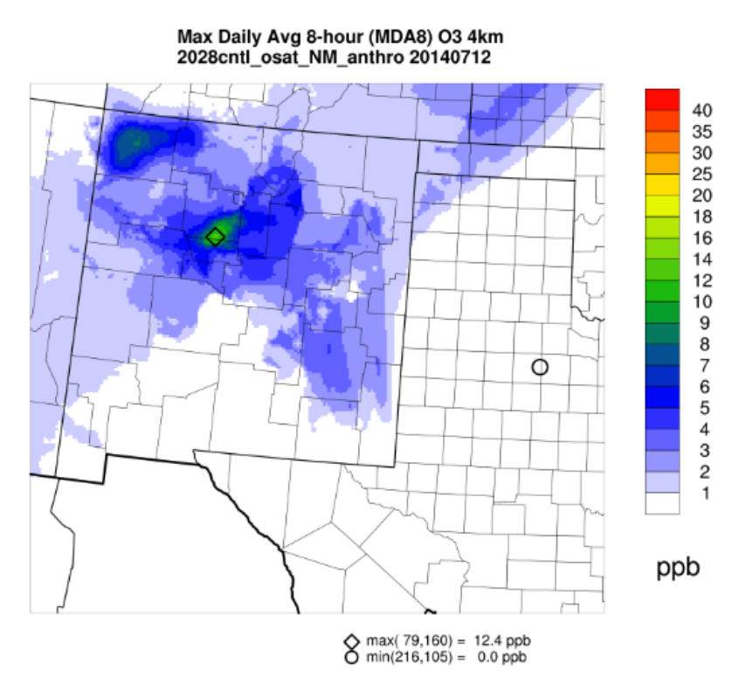
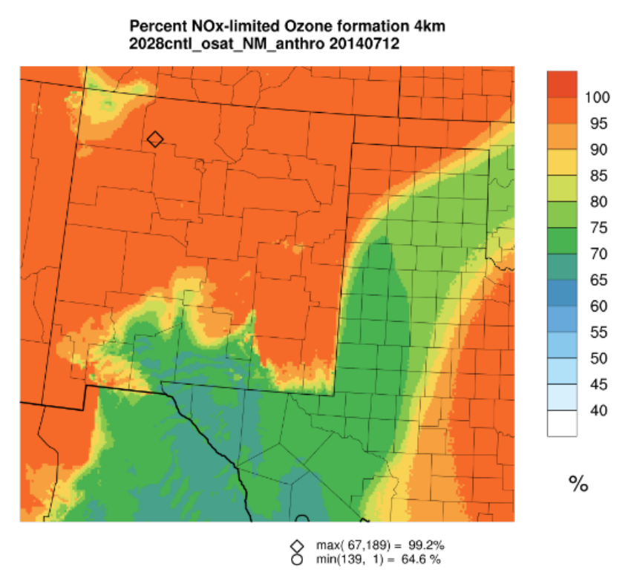
The San Juan region shows both high contribution of NM emissions to ozone (left) and high VOC sensitivity (right)
July 12, 2014 (pp 167)

Slide 8
VOC emissions from Oil & Gas Production will produce ozone SOMEWHERE
Often, especially in the San Juan region, ozone production from VOCs will occur locally
And further downwind, VOC emissions from New Mexico Oil and Gas production will increase background ozone concentrations for everyone (in the Northern Hemisphere).

