Slide 1
New Mexico Environment Department
Safe Drinking Water Starts at the Source:
Source Water Protection Planning
Andy Jochems
NMED Drinking Water Bureau
Santa Teresa, NM
September 30, 2026

Slide 2
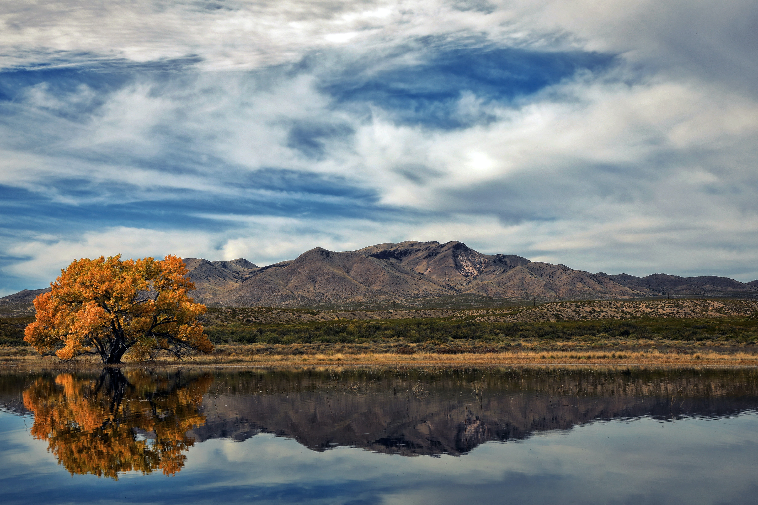
What is Source Water Protection?
Source water is the raw supply of surface or groundwater used for current or future drinking water.
Source water protection reduces the risk of water getting contaminated.
Preventing loss of drinking water quality and quantity
Notes:
• SWP is a voluntary process laid out by the Safe Drinking Water Act.
• Public water utilities are not out of compliance if they don’t have a SWP Plan.

Slide 3
Source Water Protection Process
Safe Drinking Water Act
Multi-Barrier Approach:
Source Water
Protection
Treatment
Distribution
Monitoring,
Public Outreach
Notes:
• Monitoring and public communication might also be considered separate components of the multi-barrier approach.
• SWP is a never-ending process – SWP Plans provide the most solid foundation for evaluating new risks to drinking water sources.
• The next part of this presentation describes how we develop Source Water Protection Assessments and Plans.

Slide 4
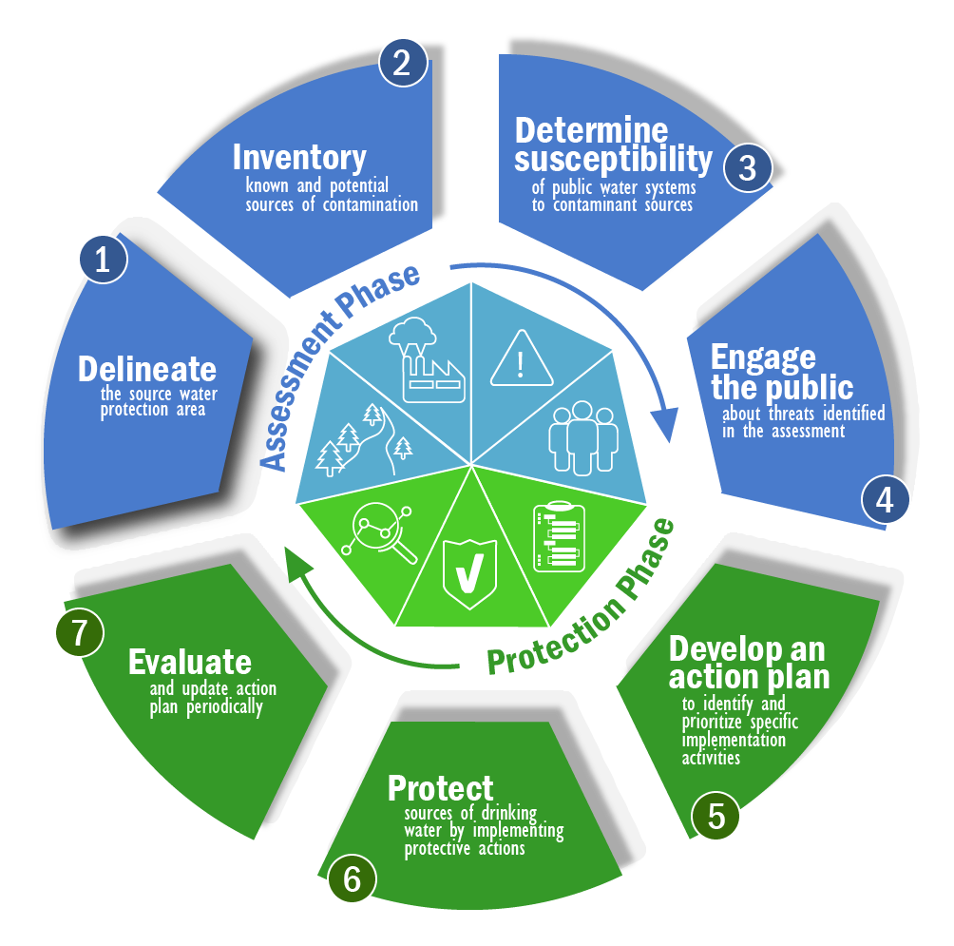
Source Water Protection Process
Source Water Assessment & Protection:
Safe Drinking Water Act
Multi-Barrier Approach:
Source Water
Protection
Treatment
Distribution
USEPA
Monitoring,
Public Outreach
Notes:
• Monitoring and public communication might also be considered separate components of the multi-barrier approach.
• SWP is a never-ending process – SWP Plans provide the most solid foundation for evaluating new risks to drinking water sources.
• The next part of this presentation describes how we develop Source Water Protection Assessments and Plans.

Slide 5
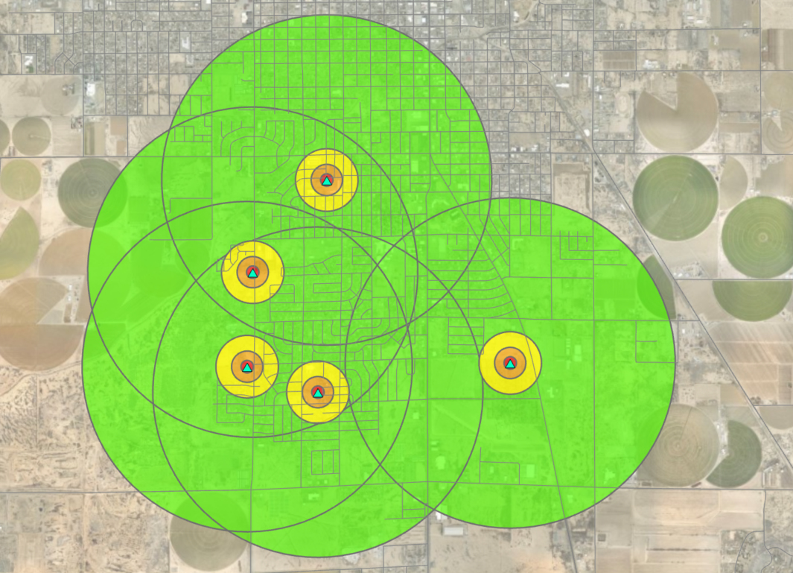
Step 1: Map Source Water Protection Areas
Zone A: 0-200 ft
Zone B: 200-500 ft
Zone C: 500-1,000 ft
Zone D: 1,000 ft to 1 mi
N
0 1000 2000 Feet
Public Water Supply Well
Notes:
• Step 1: Delineate SWP Areas around drinking water sources.
• This example is from Roswell, NM.

Slide 6
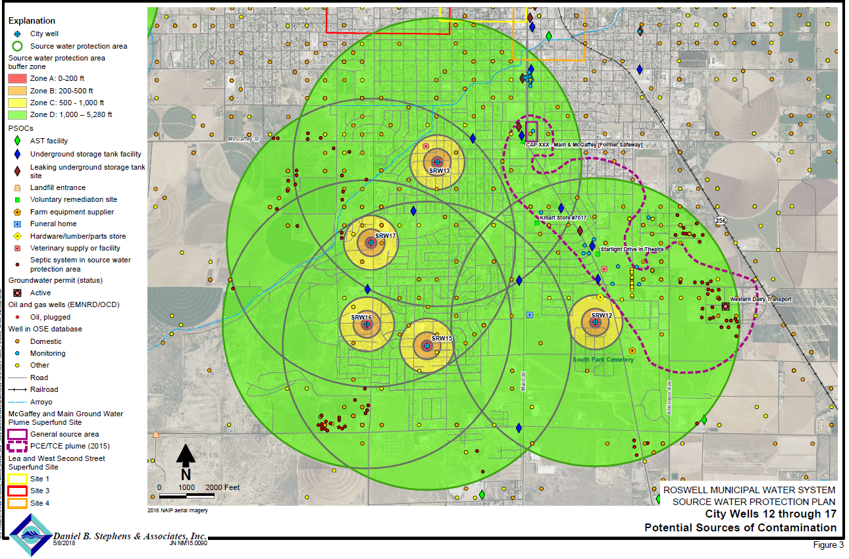
Step 2: Determine Sources of Contamination
Notes:
• Step 2: Create an inventory of potential and, in some cases, actual sources of contamination to drinking water sources.
• Note the many individual PSOCs/ASOCs in these SWP Areas. A similar density may be expected for southern Doña Ana County.
-Note also that what is not necessarily shown are naturally occurring contaminants. More on this at the end.

Slide 7
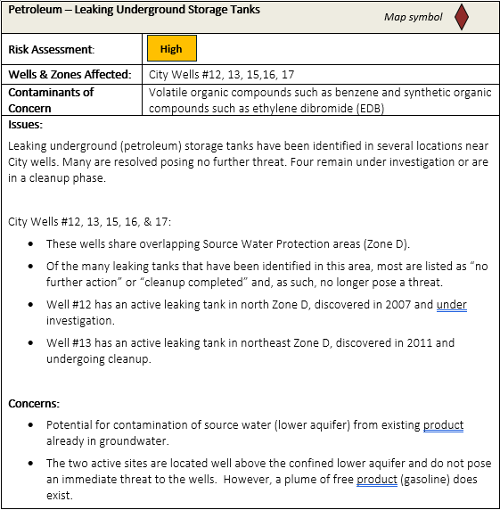
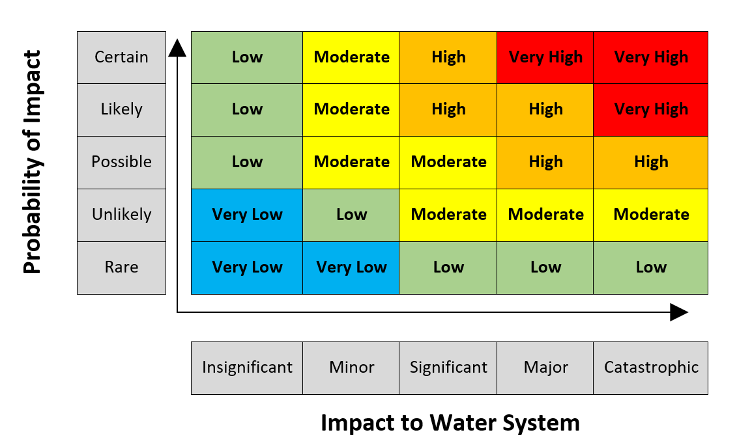
Step 3: Evaluate Risk to Water Sources
Notes:
• Step 3: Determine and describe the risk that each individual PSOC/ASOC poses to a drinking water source.
• NMED uses a “risk matrix” approach developed for public water utilities in Colorado:
-Probability of impact: How likely is it that a PSOC will impact a drinking water source?
-Impact to PWS: If a PSOC does impact a source, how bad will it be?

Slide 8
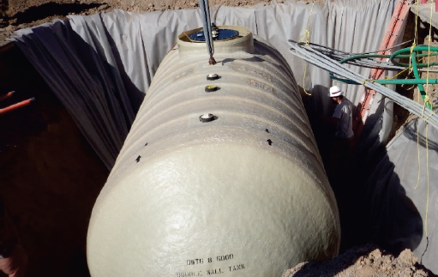
Step 4: Develop an Action Plan
The “Plan” part of the Source Water Protection Plan
SWP management strategies for leaking underground tanks:
  Coordinate with regulators for notification of new releases
  Review status of existing sites and cleanup actions
  Ensure that required setbacks are observed
NMED-PSTB
Notes:
• Step 4: Develop an Action Plan based on SWP Areas and PSOC/ASOC risk assessment (i.e., the Source Water Assessment phase).
• SWP Management Strategies often involve:
-Regular and consistent communications between stakeholders
-Connecting utilities to funding sources to address source water threats
• Other recommended strategies could include municipal or county SWP ordinances.

Slide 9
Source Water Protection Committee
Public Water Utility or Utilities
Boards
Operators
NMED-SWP team
Non-Profit Organizations
Community
Environmental
Land
Managers
Water
Managers
Federal
State
Federal
State
Private
Local
Commercial
Partners
Community Members
Notes:
• Community members and advocates have a major seat at the table.
• SWP Committee participation is either through:
-Direct attendance and feedback throughout SWP Plan development
• Most effective is to have a community advocacy group in this case; and/or
-Public participation and feedback at meetings such as this.

Slide 10
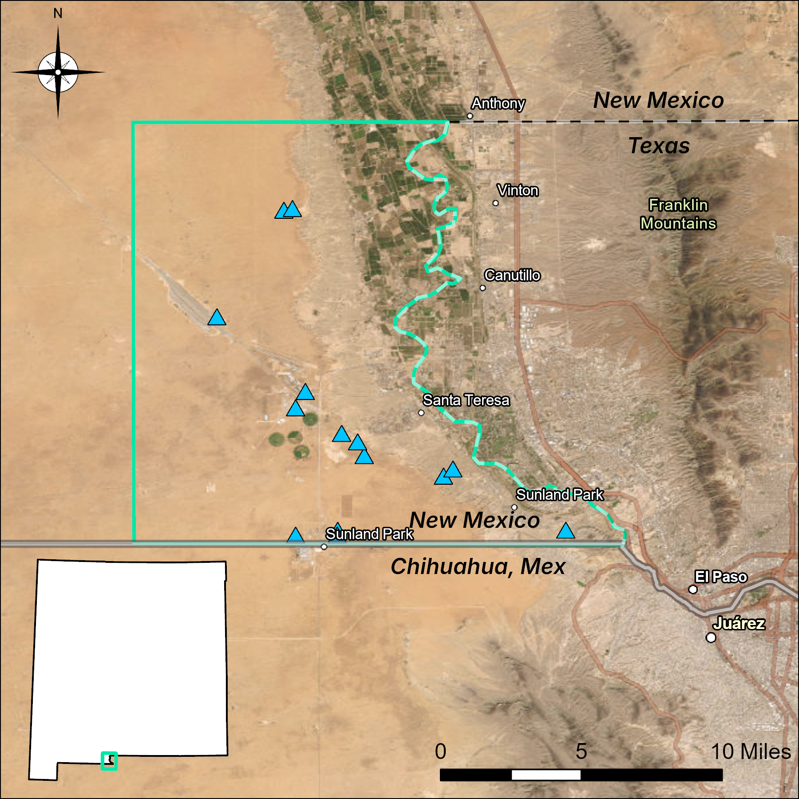
Santa Teresa-Sunland Park
Regional Source Water Protection Plan
August 2026
First stakeholder meeting
Fall 2026
Mapping, contaminant inventory, and risk analysis
Winter 2026–27
SWP Plan drafting
Spring 2027
Public meeting and feedback
Late Spring 2027
Complete SWP Plan
Notes:
• Star shows our location this evening.
• Project area extends to but does not include Anthony because their utility (and most others up to Las Cruces) already has a SWP Plan.
• Arsenic is a naturally occurring contaminant with the following management strategies: monitoring, mapping/modelling groundwater quality, treatment, and/or new source(s).
• NMED and utilities are still early in the SWP process – there is plenty of time for engagement and feedback.

Slide 11
Thank You
dw.sourcewaterprotection@env.nm.gov
Andy Jochems
NMED-Drinking Water Bureau
Source Water Protection Team Lead
505-205-6964
Andy.Jochems@env.nm.gov

