Slide 1
National Park Service Technical Comments
20.2.50 NMAC Oil and Gas Sector-Ozone Precursor Pollutants Rulemaking (EIB No. 21-27 (R))

Slide 2
Synopsis
Ozone concentrations exceed the level of the National Ambient Air Quality Standards (NAAQS) for ozone at Carlsbad Caverns National Park (NP) in New Mexico
Volatile Organic Compounds (VOCs) measured at Carlsbad Caverns NP indicate the main sources of VOCs affecting ozone formation are from oil and gas activities
Nitrogen oxide (NO_{X}) emissions that affect high ozone concentrations at Carlsbad Caverns NP are from local sources
The measures proposed in this rule will help to reduce high ozone concentrations – more measures or more stringent measures are likely necessary to get below the NAAQS – this is a necessary step
NO_{x} and VOC control measures are necessary to reduce ozone

Slide 3
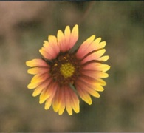
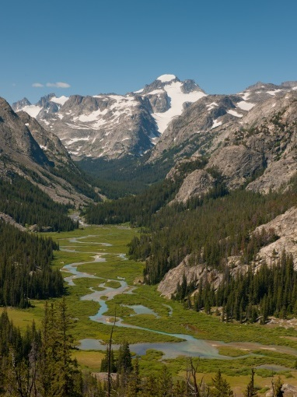
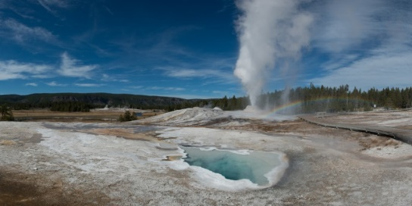
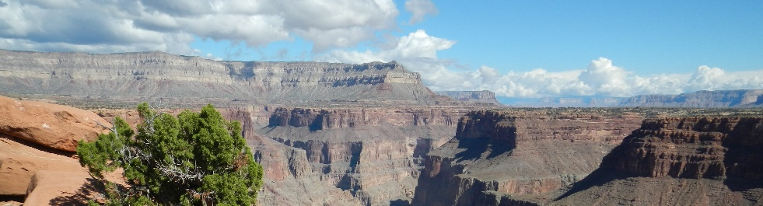
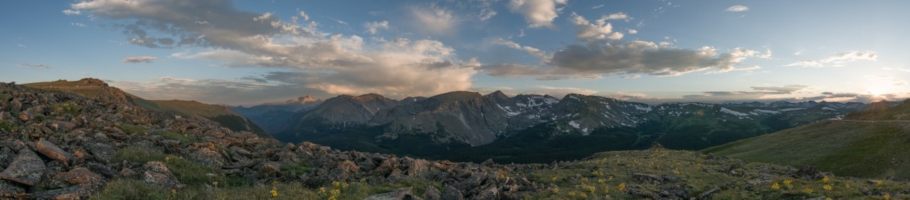
The NPS and Air Resources—Why we Care
“…which purpose is to conserve the scenery and the natural and historic objects and the wild life therein and to provide for the enjoyment of the same in such manner and by such means as will leave them unimpaired for the enjoyment of future generations.” (NPS Organic Act)
“Wilderness areas…shall be administered…in such a manner as will leave them unimpaired for future use and enjoyment as wilderness…” (Wilderness Act of 1964)
“…preserve, protect and enhance the air quality in national parks, national wilderness areas, national monuments, national seashores…” (Clean Air Act as amended in 1977)
Regional Haze Rule, 1999
Requires state and federal agencies to work together to improve visibility in all 156 federal Class I national parks and wilderness areas
“In cases of doubt the land manager should err on the side of protecting the air quality-related values for future generations.” (Senate Report No. 95-127, 95th Congress, 1977)
Notes:
I will first go over some general information about air quality and national parks. A variety of laws require the protection of air resources at national parks and wilderness areas. The National Park Service relies on States and the EPA to implement air quality regulations that can protect park resources.

Slide 4

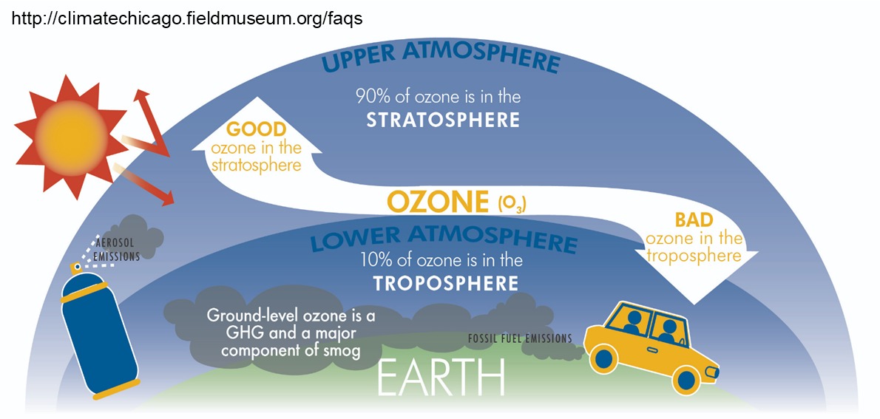
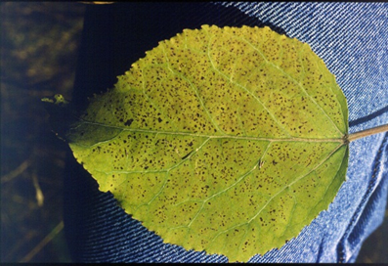

Ground Level Ozone
Lung Function
Foliar Injury
Formed by reactions of NO_{x} and VOCs in the presence of sunlight
Impacts vegetation and human health
EPA Regulated Pollutant
Notes:
Our comments today are focused on the effects of NOx and VOCs on ozone formation of ground level ozone. High ozone concentrations affect the health of staff and visitors to parks and can affect plant health.

Slide 5
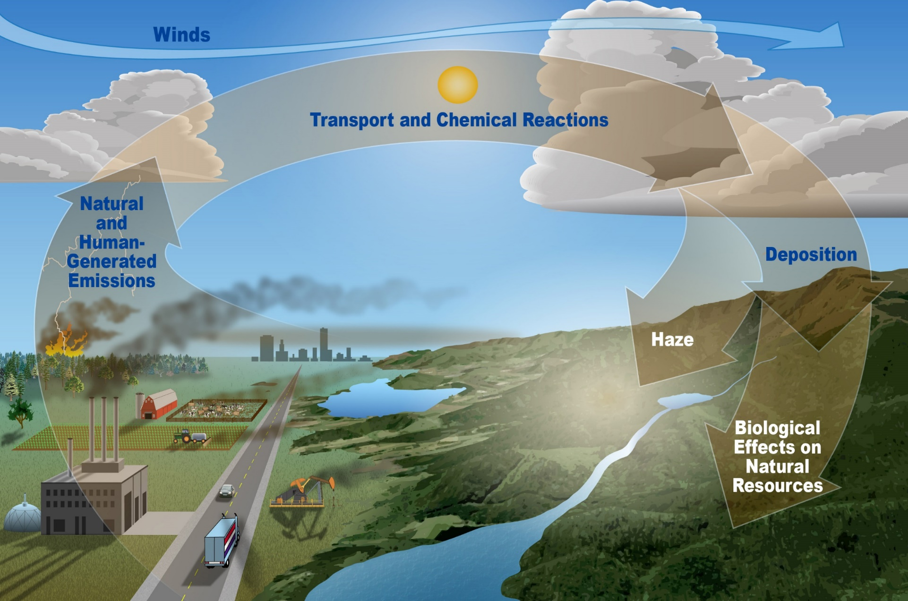
Pollutants Come from Outside Parks
Notes:
This schematic illustrates that air pollutants are transported into parks, leading to effects on park resources, staff and visitors

Slide 6
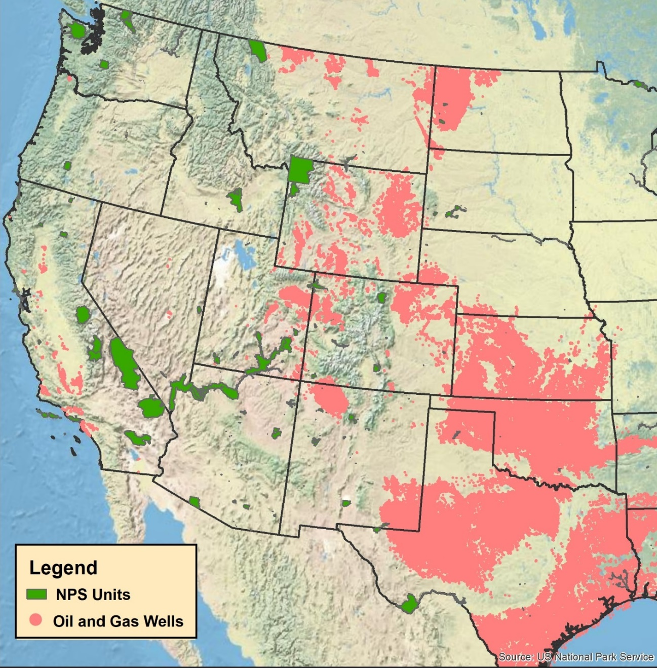
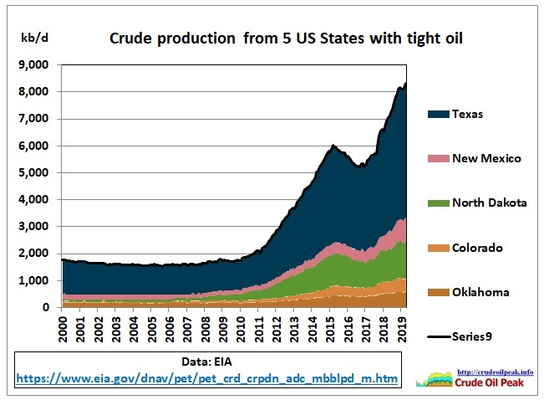
Extensive Oil & Gas Activities throughout Midwest and West
Notes:
There has been an increase in oil and gas development in many areas of the country, including in the areas affected by the proposed rule we are discussing here. Several parks are located near and are affected by this development including Carlsbad Caverns National Park, Guadalupe Mountains National Park, Chaco Culture National Historical Park, and Mesa Verde National Park in Colorado. Most of the data presented today are focused on studies at Carlsbad Caverns National Park.
Oil and gas development brings heavy industry to once remote regions of the country near national parks which can negatively impact park air quality. The Carlsbad Caverns special study was designed to help identify emissions and source sectors impacting air quality in the park.

Slide 7
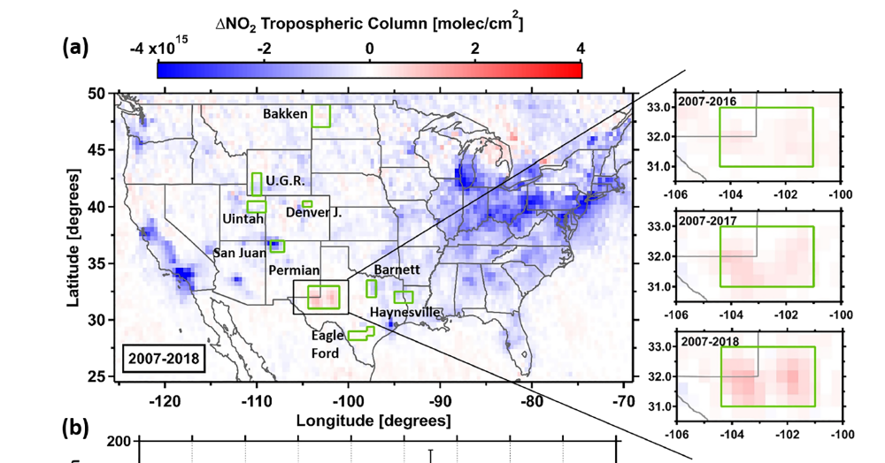
Increases in NO_{x}* and Ozone at Carlsbad Caverns National Park
*NOx = NO + NO₂
Carlsbad Caverns Ozone
Trends in NO_{x},
from satellite data
(Dix et al., 2020)
70 ppb is the national standard
Year | # Exceedance Days | Years | 8-hr 4th high O₃
2016 | None | 2014-2016 | 67
2017 | None | 2015-2017 | 66
2018 | 10 | 2016-2018 | 71
2019 | 6 | 2017-2019 | 74
2020 | 9 | 2018-2020 | 73
Notes:
The figure in the upper part of this slide shows that contrary to trends in most regions of the country, NOx emissions in southeastern New Mexico are increasing. The ozone concentrations at Carlsbad Caverns National Park have been increasing and are exceeding the ozone standard.

Slide 8
Measuring VOC markers (70+) to better understand sources affecting parks
Oil & Gas
  NMHCs: light alkanes C2-C6, i-butane/n-butane, i-pentane/n-pentane
Biomass Burning
  acetonitrile, methyl halides (CH₃Cl, CH₃Br, CH₃I), OVOCs (MeOH, acetone)
Urban
  industrial: benzene, toluene, xylenes
  solvent evaporation: halocarbons (CH₂Cl₂, C₂Cl₄, C₂HCl₃, CHCl₃, CH₃CCl₃)
  Waste water treatment: CHCl₃, CHBr₃
Agriculture
  crops: alkenes (hexenes, ethene, propene), DMS, CHBr₂Cl
  animal husbandry: methanol, ethanol, acetaldehyde
Transportation
  Fuel Evaporation: i-pentane/n-pentane
  fuel combustion: ethyne, ethene, propene, benzene,
  exhaust: i-butane/n-butane, i-pentane/n-pentane, alkenes, ethyne
Biogenic/natural emissions:
  isoprene, monoterpenes
Stratospheric Intrusion:
  OCS, CFCs, HCFCs
Ocean/Marine:
  MeONO₂, CH2Br₂, CHBr₃, CH₂ClI, DMS, OCS
Oxidation/photochemical processing:
  RONO₂, OVOCs
Notes:
Ozone formation takes place from reactions of VOCs and NOx in the presence of sunlight. Different VOCs have varying reactivities and in turn affect ozone formation to varying degrees. The different types of VOCs and the mix of VOCs are also markers for identifying source types/emission origin. In the remainder of the presentation, we will show that markers indicating a dominance of oil and gas sources are found at Carlsbad Caverns National Park.

Slide 9
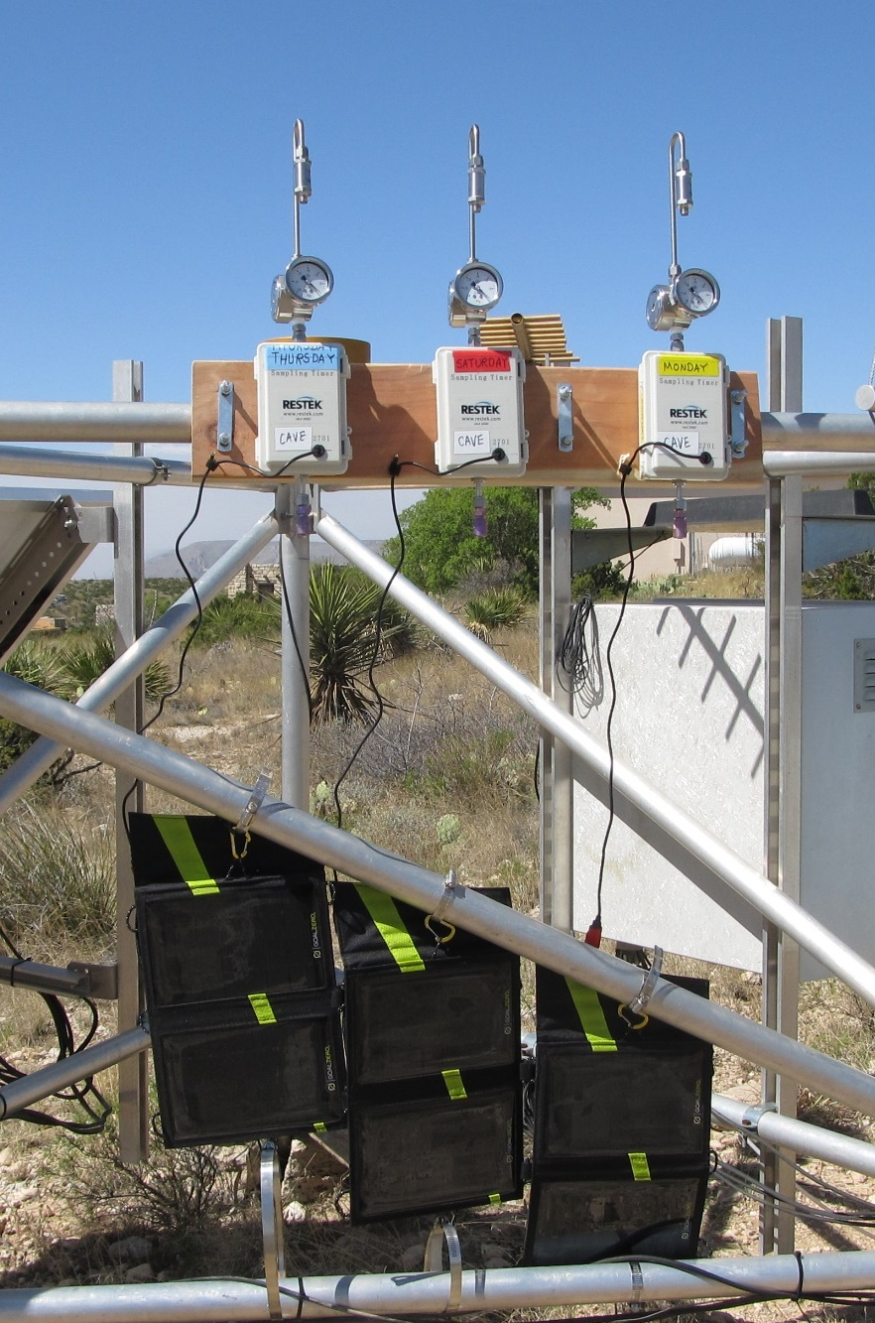
VOC Survey Study
April – September 2017
Mix of VOCs collected tell us about the sources impacting the parks.
Park Natural Resource Staff at four parks collected VOC canisters over 5-month period.
  Carlsbad Caverns NP (CAVE)
  Great Basin NP (GRBA)
  Grand Canyon NP (GRCA)
  Joshua Tree NP (JOTR)
Notes:
In 2017 the NPS carried out a survery study at four national parks that periodically measure high ozone concentrations to determine the mix of VOCs at these disparate areas. (The abbreviations for these parks will appear in some of the graphs that follow.)

Slide 10
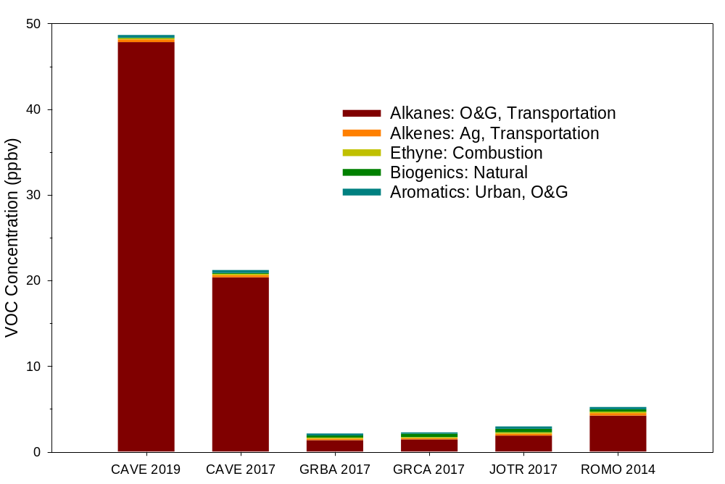
Average VOC Concentration
Carlsbad Caverns NP
VOC Mix Dominated by Oil &Gas
Carlsbad Caverns NP Sampling Notes
2017: Daytime only
2019: Hourly diurnal
Notes:
Park Abbreviations: CAVE, Carlsbad Caverns NP, GRBA, Great Basin NP, GRCA, Grand Canyon NP, JOTR, Joshua Tree NP, ROMO, Rocky Mountain NP Note that Total VOCs and especially the Alkanes associated with oil & gas are up to 5 to 10 times higher at Carlsbad Caverns than at the other parks.

Slide 11
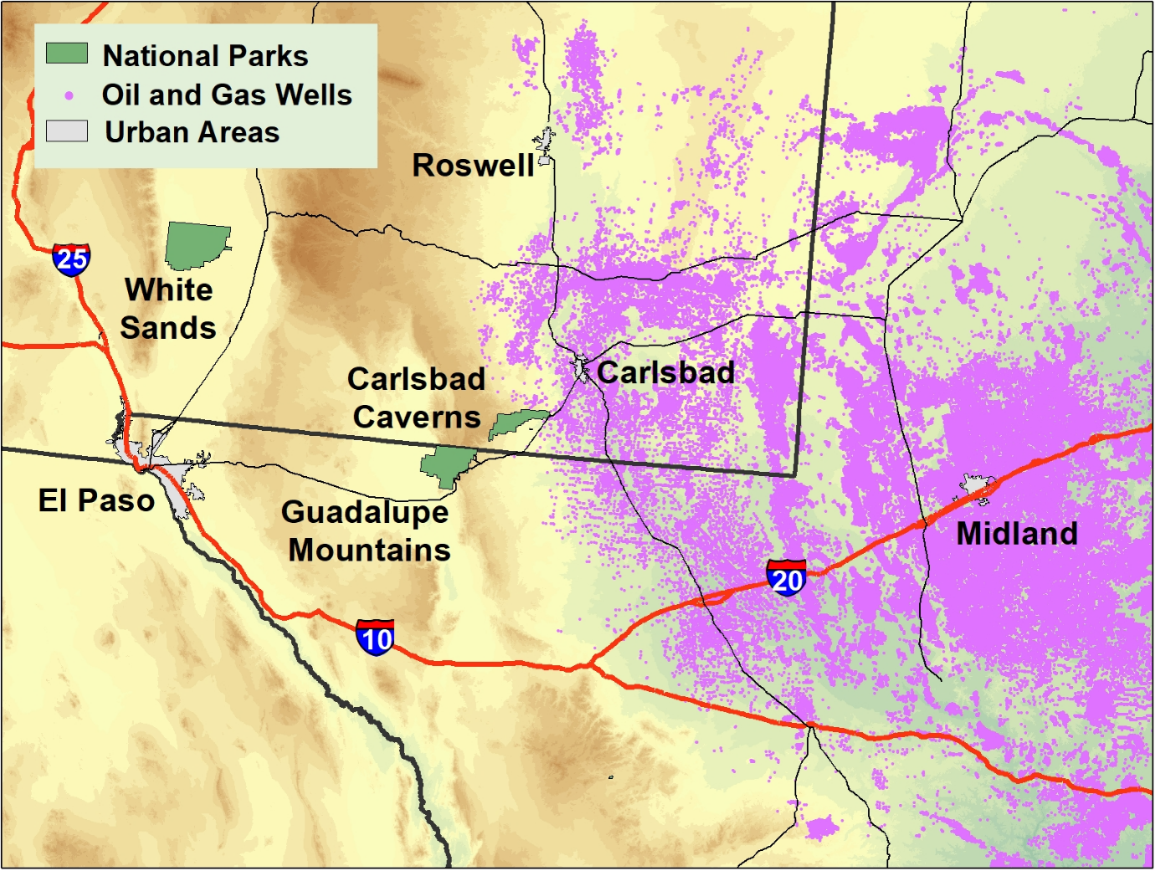
Extensive Oil and Gas Development near Carlsbad Caverns NP
Where does air come from during periods of high ozone?
Notes:
There is extensive oil and gas development in the areas east of Carlsbad Caverns. It raises the question: Where does the air come from during periods of high ozone?

Slide 12
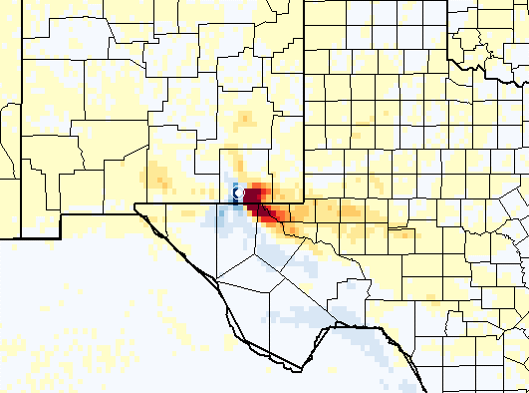
Where the Air Comes From When Ozone is High
Warm colors: More likely to come from these areas during high concentrations.
Cool colors: Less likely to come from these areas during high concentrations.
Notes:
During the 2017 study high ozone corresponded to air flow from the east and southeast.

Slide 13
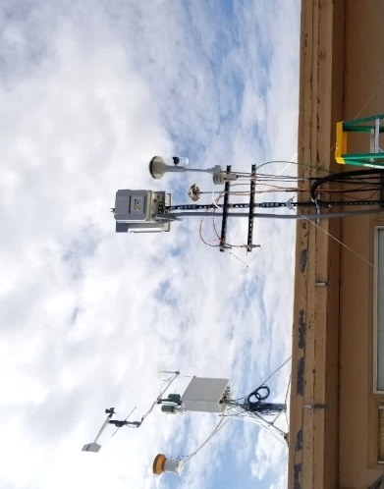
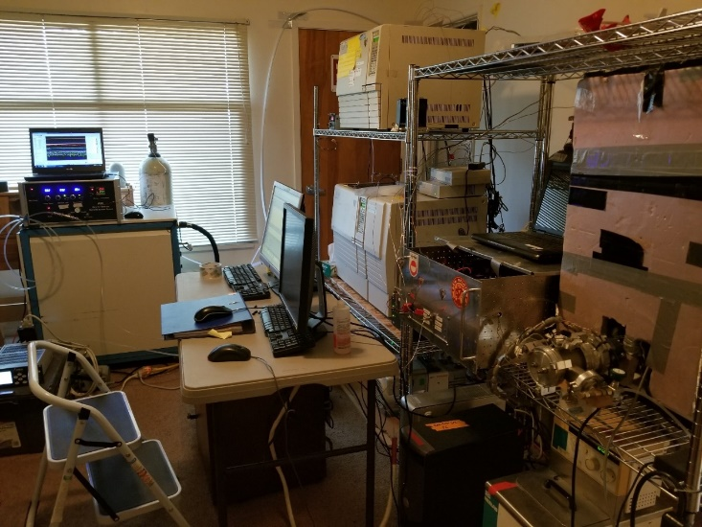
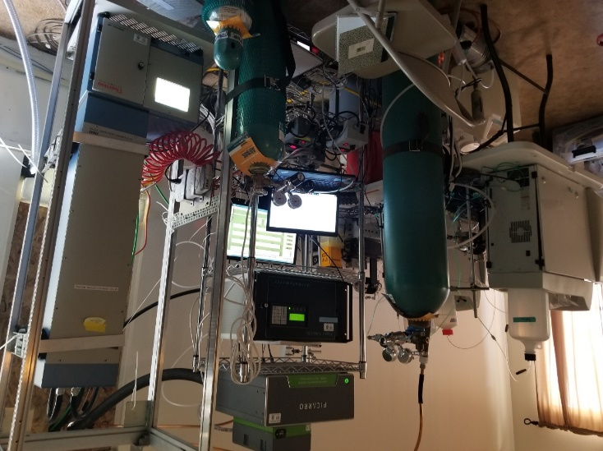
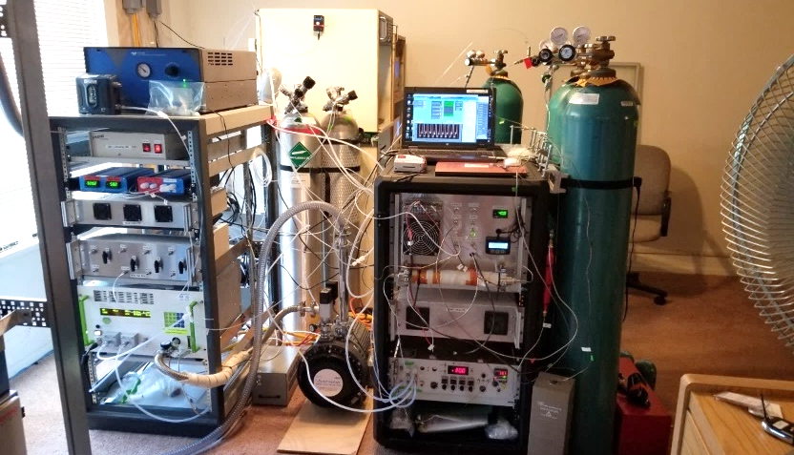
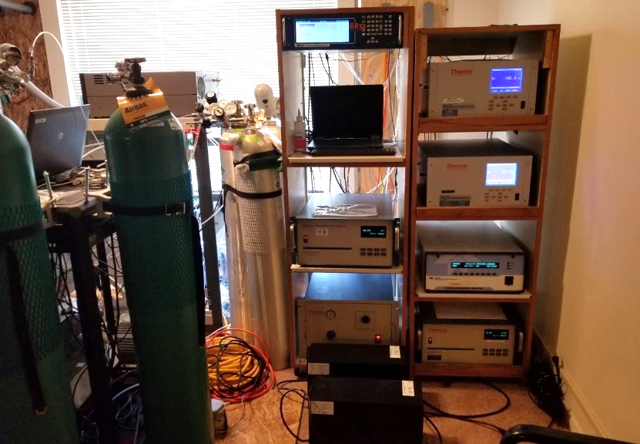
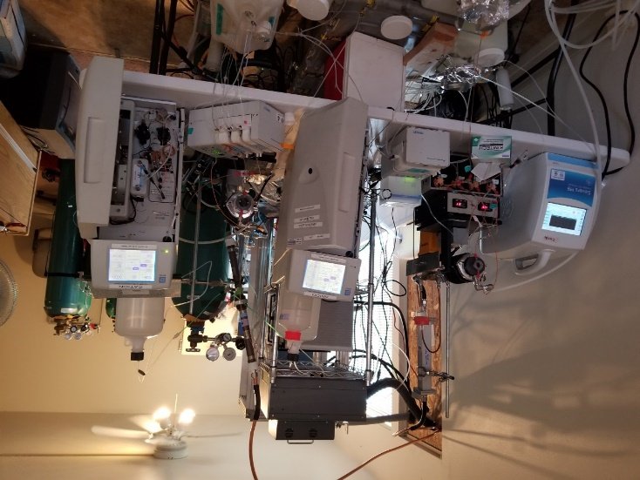
Carlsbad Caverns National Park 2019
Intensive 6-week study characterizing aerosol and gases at Carlsbad Caverns NP, with additional measurements in surrounding areas, including Guadalupe Mountains NP.
Most extensive dataset to date
13
Notes:
As shown in the picture earlier, the 2017 study used evacuated, clean sampling canisters. Those were used for some parts of the 2019 study, but many, additional specialized research grade instruments were used at Carlsbad Caverns NP in 2019 to obtain high time resolution measurements of VOCs and nitrogen compounds.

Slide 14
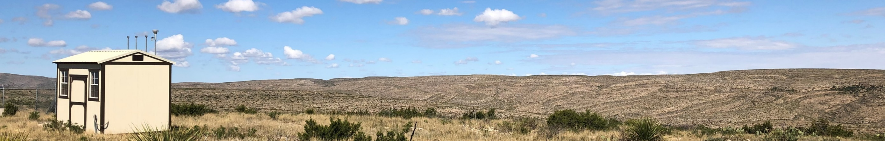
Carlsbad Caverns National Park Study 2019 - Objectives
What are the primary VOC drivers of regional ozone formation and how might future changes in VOC emissions affect peak ozone at Carlsbad Caverns National Park?
What is the nitrogen budget in the region and how sensitive is ozone formation to changes in NO_{x} concentrations?
What species, e.g. NO_{x}, H₂S, and VOC, contribute to or limit aerosol formation (which affects health standards and visibility)?
Notes:
The 2019 study produced very extensive data. We are still analyzing many aspects of it. But as we’ll show in the following slides, oil and gas emissions are driving the formation of ozone at Carlsbad Caverns National Park.

Slide 15
How do VOCs and NO_{X} interact?
The next slide shows the average concentrations of ozone, NO, and VOCs during the 2019 study
Each figure shows the average ozone and the sunlight intensity for each hour of the day
The three charts show the diurnal (daily) patterns of different compound classes:
  How NO (unreacted NO_{X}) and ethane, one of the most abundantly emitted VOCs, build up and are reacted away
  The formation of alkyl nitrates, one of the classes of VOCs formed through VOC + NO_{x} reactions in the atmosphere, has a similar pattern to ozone

Slide 16
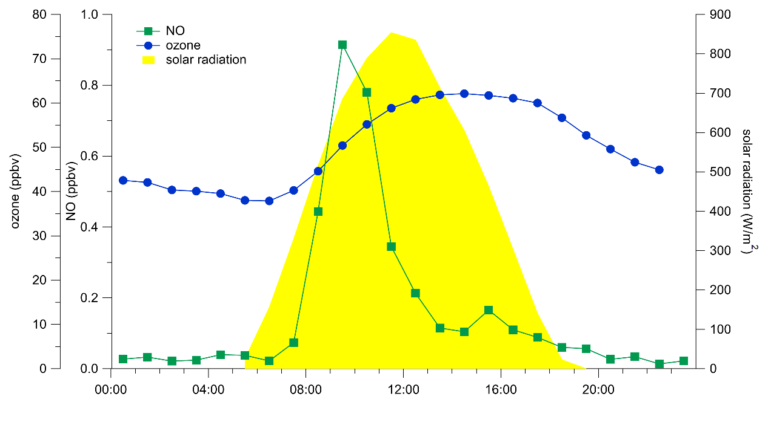
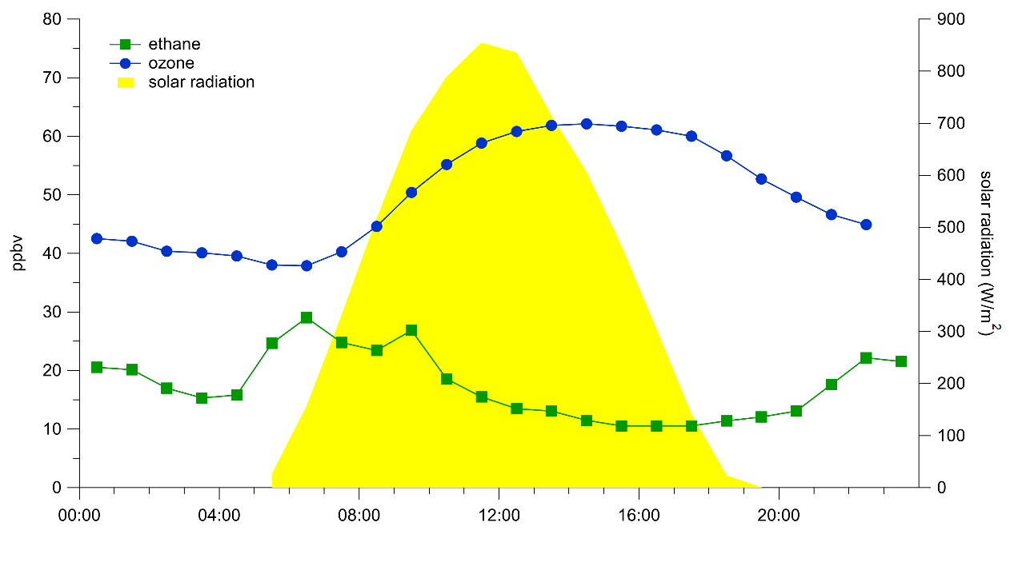
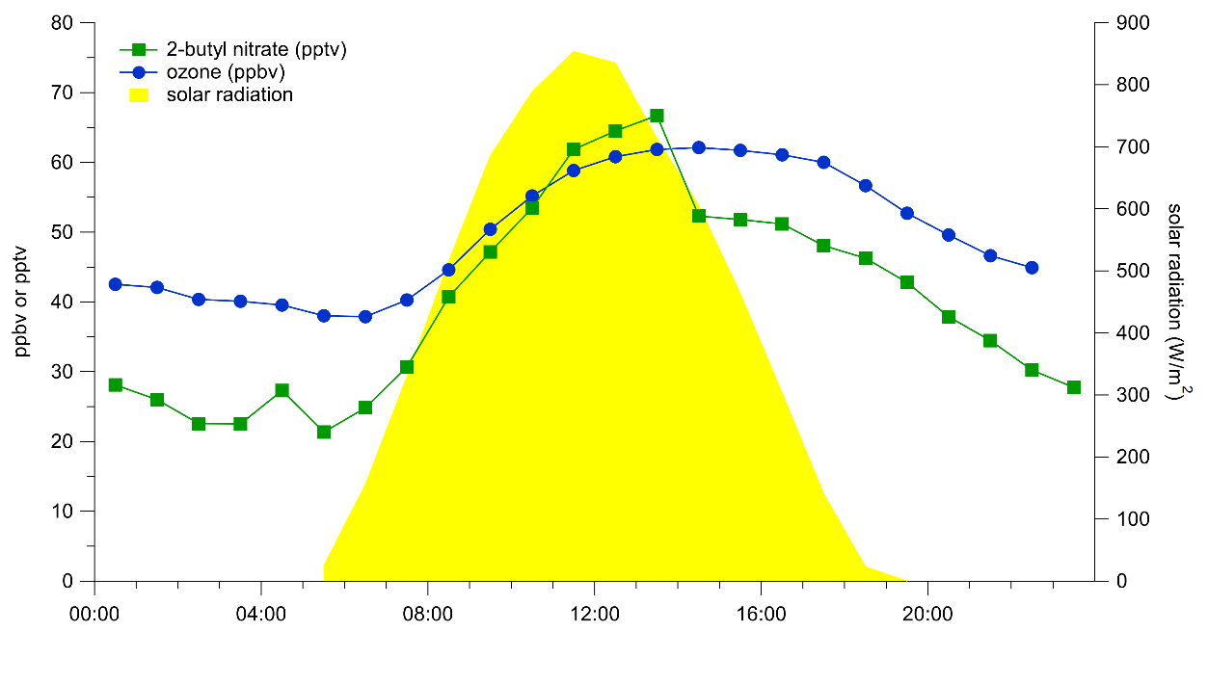
Diurnal Averages from 2019
Ozone peaks in the late afternoon
NO has a morning spike and emissions throughout the day
VOCs (e.g., ethane) build up overnight and are reacted away during the day + mixing & dilution
Secondary chemistry products, such as the alkyl nitrates (e.g., 2-butyl nitrate), have a similar diurnal distribution as ozone
Alkyl nitrates are formed from parent n-alkane in the presence of NOx – high levels indicate abundant sources and local photochemistry
Notes:
These 3 charts show the average concentrations of NO, the VOCs ethane and 2-butyl nitrate, and ozone throughout the day. Concentrations are plotted along with daily solar radiation.
You can see that ozone peaks in the later afternoon. There is a spike in “fresh” NOx emissions in the morning that tapers off as it reacts during the daylight hours. Similarly, there is more ethane peaking in the morning that subsequently reacts in the ozone forming process. The 2-butyl nitrate which is a reaction product peaks around the time of the ozone peak, indicating that reactions of the ozone forming pollutants occurred during that day and that the ozone wasn’t transported to the area from afar.

Slide 17
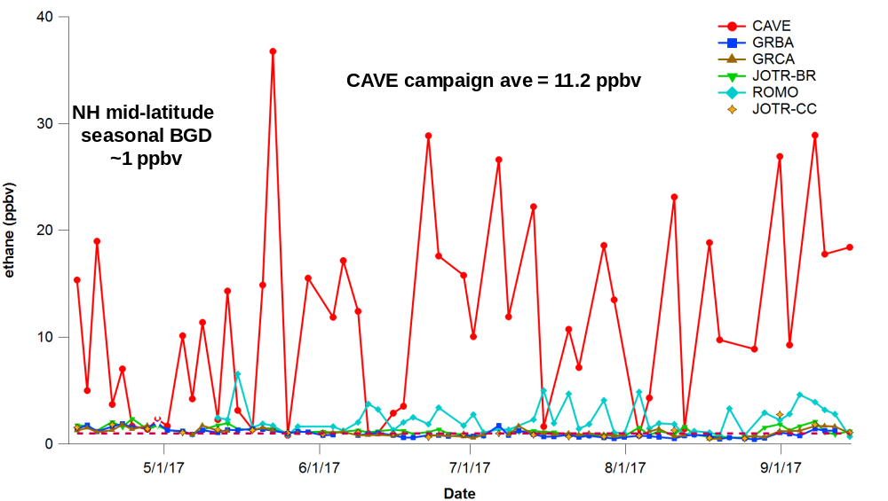
2017 and 2019 studies showed similar results at Carlsbad Caverns
Ethane avg 2019 = 17.3 ppbv
Hourly sampling exhibited higher diurnal variability
Regularly observed levels >100 ppbv
High VOC concentrations are all from oil and gas emissions.
Notes:
Ethane is a distinctive indicator of emissions from oil and gas operations. It can be seen that Carlsbad Caverns during the 2017 study stands out from the other parks. In most areas, when ethane is measured the background would be around 1ppbv. In 2016 the average for the six-week study was 16ppbv and some hourly values exceeded 100ppbv.

Slide 18
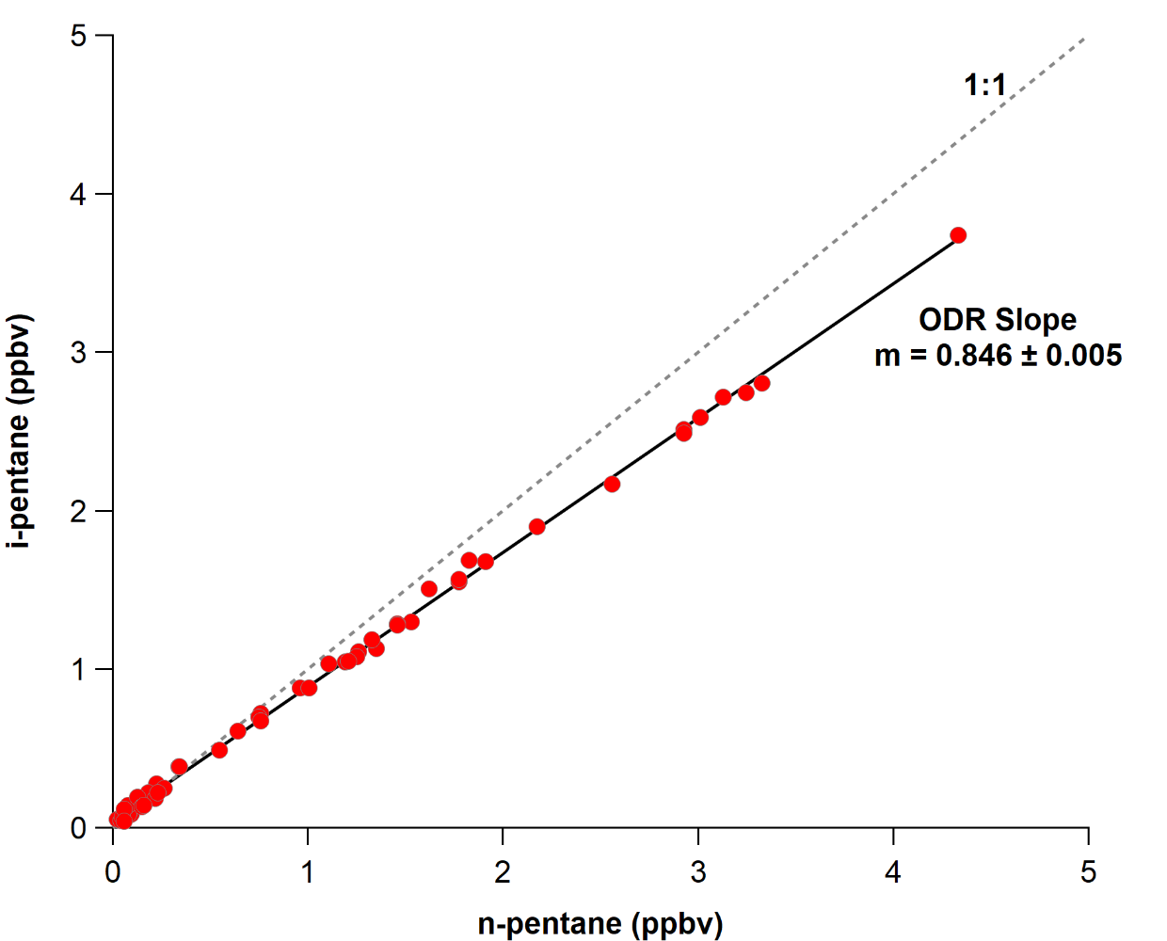
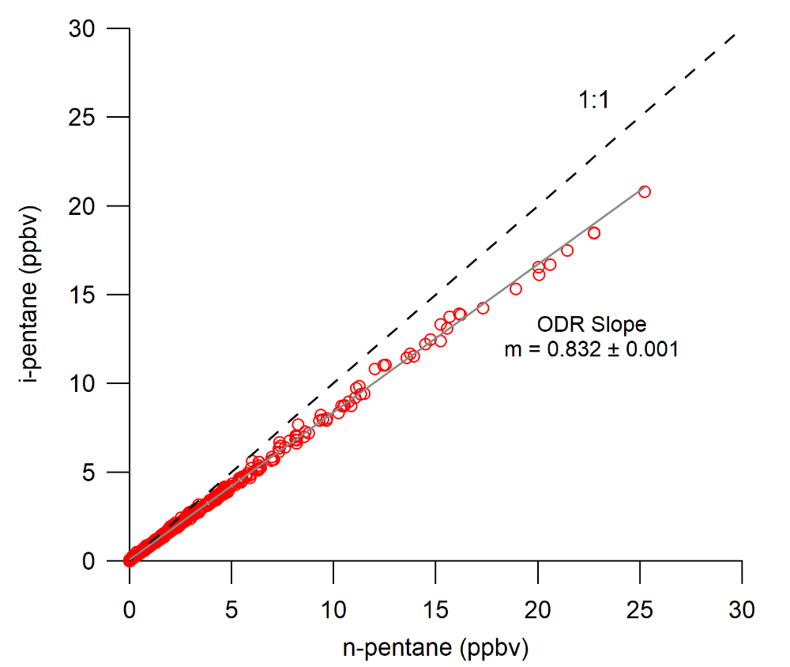
Oil & Gas Emissions Tracers
The Pentane Ratio
Carlsbad Caverns National Park 2017 & 2019
2017
2019
Gasoline: ~1.5-3
Fuel evaporation: ~1.8-4
Vehicular exhaust: ~2.2-3.8
Gasoline: ~1.5-3
Fuel evaporation: ~1.8-4
Vehicular exhaust: ~2.2-3.8
18
Notes:
The i-pentane to n-pentane ratio is a good marker for different types of emissions. A ratio less than 1 indicates oil and gas operations. The ratio is constant between 2017 and 2019. The actual concentrations in 2019 are higher because they cover all hours of the day, whereas 2017 samples were only taken in the afternoon.

Slide 19
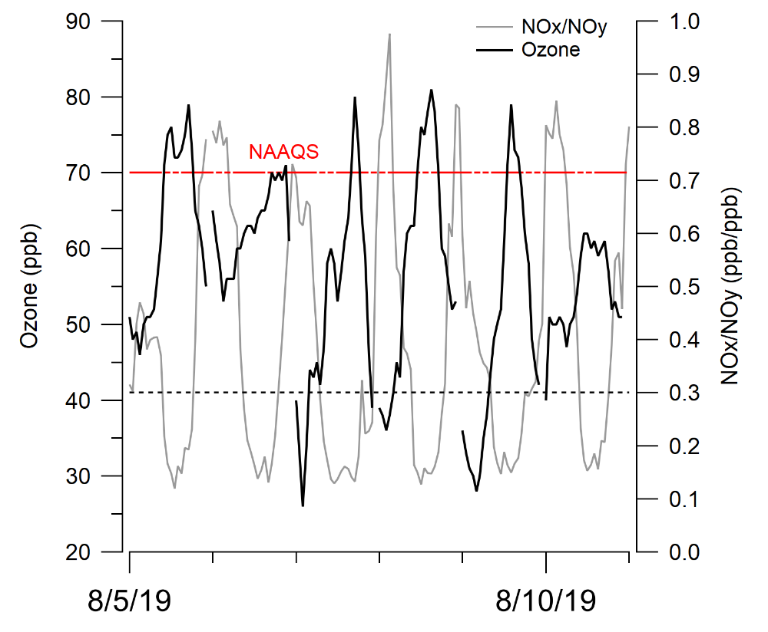
Fresh NO_{x} builds up at night and then reacts to form ozone
NOx/NOy > 0.3 → fresh pollution
NOx/NOy < 0.3 → photochemically aged (processed) air
FRESH
19
Notes:
This chart shows that there is fresh buildup of NOx at night which is then processed through the VOC/NOx/Sunlight reactions to form ozone. The NOx is generated in the vicinity – NOx from farther away would have a much lower NOx to NOy ratio at night. While this slide is showing a particular multi-day event, it is important to note that this same NOx/NOy ratio was persistent throughout the entire study period, indicating fresh NOx emissions.

Slide 20
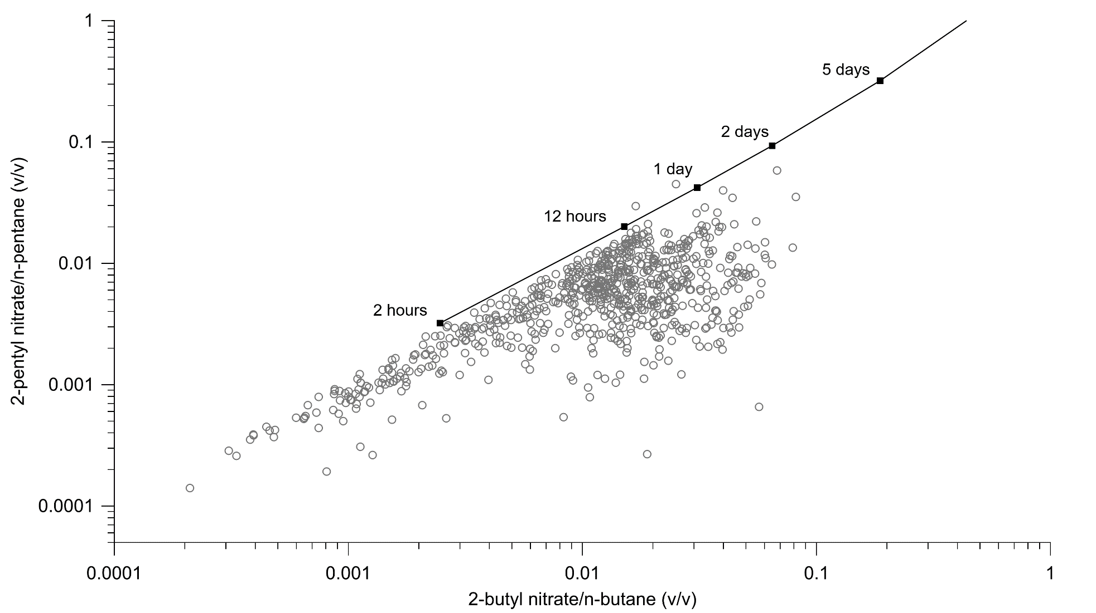
Photochemical Age using Alkyl Nitrates
Air mass aging (photochemical age) from ratios of alkyl nitrates to parent n-alkanes illustrate that VOC and NO_{x} emissions are fresh and air masses are impacted by local sources.
20
Notes:
Alkyl nitrates are produced during the VOC/NOx reactions that form ozone. The ratios of alkyl nitrates to their parent compounds can give us a good estimate of how long the air pollutants have been reacting when they reach the park. This graph shows that the vast majority of the reaction times are below 12 hours. This clearly shows that the ozone forming NOx and VOCs are nearby. The fact that the points fall off the idealized model line implies that the model doesn't capture everything that is occurring.

Slide 21
The data support the need for this rule
Ozone concentrations at Carlsbad Caverns National Park frequently exceed the national ambient air quality standard for ozone.
The information presented highlights the need for both NO_{x} and VOC reductions and supports the proposed engine & turbine standards.
NMED’s proposed NO_{x} limits for engines and turbines are similar to on-the-books standards in other states including Texas and Pennsylvania.
  Note: California engine NO_{x} limits are significantly more stringent than NMED’s proposal—our recommended changes are based on Pennsylvania’s Best Available Technology limits.

Slide 22


Recommended changes (1)
Based on examples from Pennsylvania’s state requirements, we recommend the following changes be incorporated to strengthen the proposed rule.
  Rich-burn Engines
    Require all new and existing rich-burn engines >500 HP to meet a limit of 0.2 g NO_{x}/hp-hr
      NMED proposal is 0.5 g NO_{x}/hp-hr
    Require all new and existing rich-burn engines >100 HP and <500 HP to meet a limit of 0.25 g NO_{x}/hp-hr
      NMED is not proposing limits for this class size
    Require all new rich-burn engines <100 HP to meet a proposed limit of 1.0 g NO_{x}/hp-hr
      NMED is not proposing limits for this class size
Notes:
We looked at engine and turbine limits included in state rules across the country. Based on this review, we suggest that slightly more stringent standards are feasible for engines and turbines and are necessary given the contribution of oil and gas emissions to air quality issues in NM. We recommend that NMED modify their proposal to reflect these limits as well as adopt standards for additional engine size classes.
The limits we are proposing are currently being used by Pennsylvania as part of their general permit program for oil and gas sources except for the proposed limit for existing large (>60,000 HP) turbines. This limit is in Pennsylvania’s proposed RACT III requirements.
Specifically, we request that all new and existing rich-burn engines greater than 500 horsepower meet a lower limit of 0.2 grams of NOx per horsepower-hour rather than the current proposal of 0.5 grams of NOx per horsepower-hour. Next, require all new and existing rich-burn engines greater than 100 horsepower and less than or equal to 500 horsepower to meet a limit of 0.25 grams of NOx per horsepower-hour versus no limits as part of the current proposal. Last for rich burn engines, require those less than or equal to 100 horsepower to meet a limit of 1 gram per horsepower-hour rather than no limits as part of the current proposal.

Slide 23
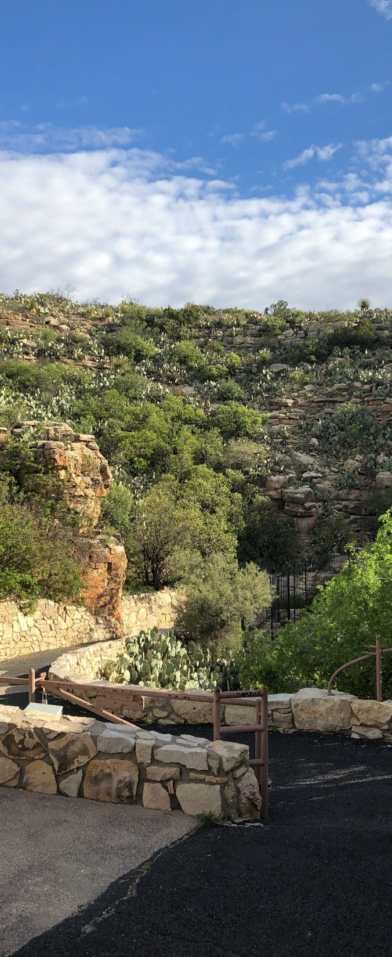
Recommended Changes (2)
  Lean-burn Engines
    Require all existing lean-burn engines <100 HP to meet a proposed limit of 2.0 g NO_{x}/hp-hr
      NMED is not proposing limits for this size class
    Require all existing lean-burn engines >100 and <500 HP to meet a proposed limit of 1.0 g NO_{x}/hp-hr
      NMED is not proposing limits for this size class
    Require all existing lean-burn engines >500 HP to meet the proposed limit of 0.5 g NO_{x}/hp-hr
      NMED is proposing this limit for all existing engines greater than 1,000 HP
    Require all new lean-burn engines < 500 HP to meet a proposed limit of 1.0 g NO_{x}/hp-hr
      NMED is not proposing limits for this size class
Notes:
For lean-burn engines we request that NM set the following NOx limits (see slide above).

Slide 24

Recommended Changes (3)
  Existing Turbines
    Require all existing turbines ≥1,000 and <5,000 HP to meet a NO_{x} limit of 25 ppmvd @15% O₂
      NMED is proposing a limit of 50 ppmvd @15% O₂ for all turbine size classes
    Require all existing turbines ≥ 5,000 HP and < 60,000 HP to meet a NO_{x} limit of 15 ppmvd @15% O₂
      NMED is proposing a limit of 50 ppmvd @15% O₂ for all turbine size classes
    Require all existing turbines ≥ 60,000 HP to meet a NO_{x} limit of 9 ppmvd @15% O₂
      NMED is proposing a limit of 50 ppmvd @15% O₂ for all turbine size classes
Notes:
For turbines, we request that NM set the following NOx limits (see slide above).

Slide 25
National Park Service Summary
Ozone concentrations exceed the level of the National Ambient Air Quality Standards (NAAQS) for ozone at Carlsbad Caverns National Park
The NPS has studied ozone formation at a number of parks. Carlsbad Caverns National Park stands out as being most affected by oil and gas sources.
Two studies have been done at Carlsbad in 2017 and 2019, during times when peak ozone concentrations are measured there. The two studies show consistent results.

Slide 26
Summary (continued)
Volatile Organic Compounds (VOCs) measured at Carlsbad Caverns NP indicate the main sources of VOCs affecting ozone formation are from oil and gas activities
Nitrogen oxide (NO_{x}) emissions that affect high ozone concentrations at Carlsbad Caverns NP are from nearby sources
The measures proposed in this rule will help to reduce high ozone concentrations –this is a necessary step
  More measures and/or more stringent measures are likely necessary to get below the NAAQS
NO_{x} and VOC control measures are necessary to reduce ozone

Slide 27
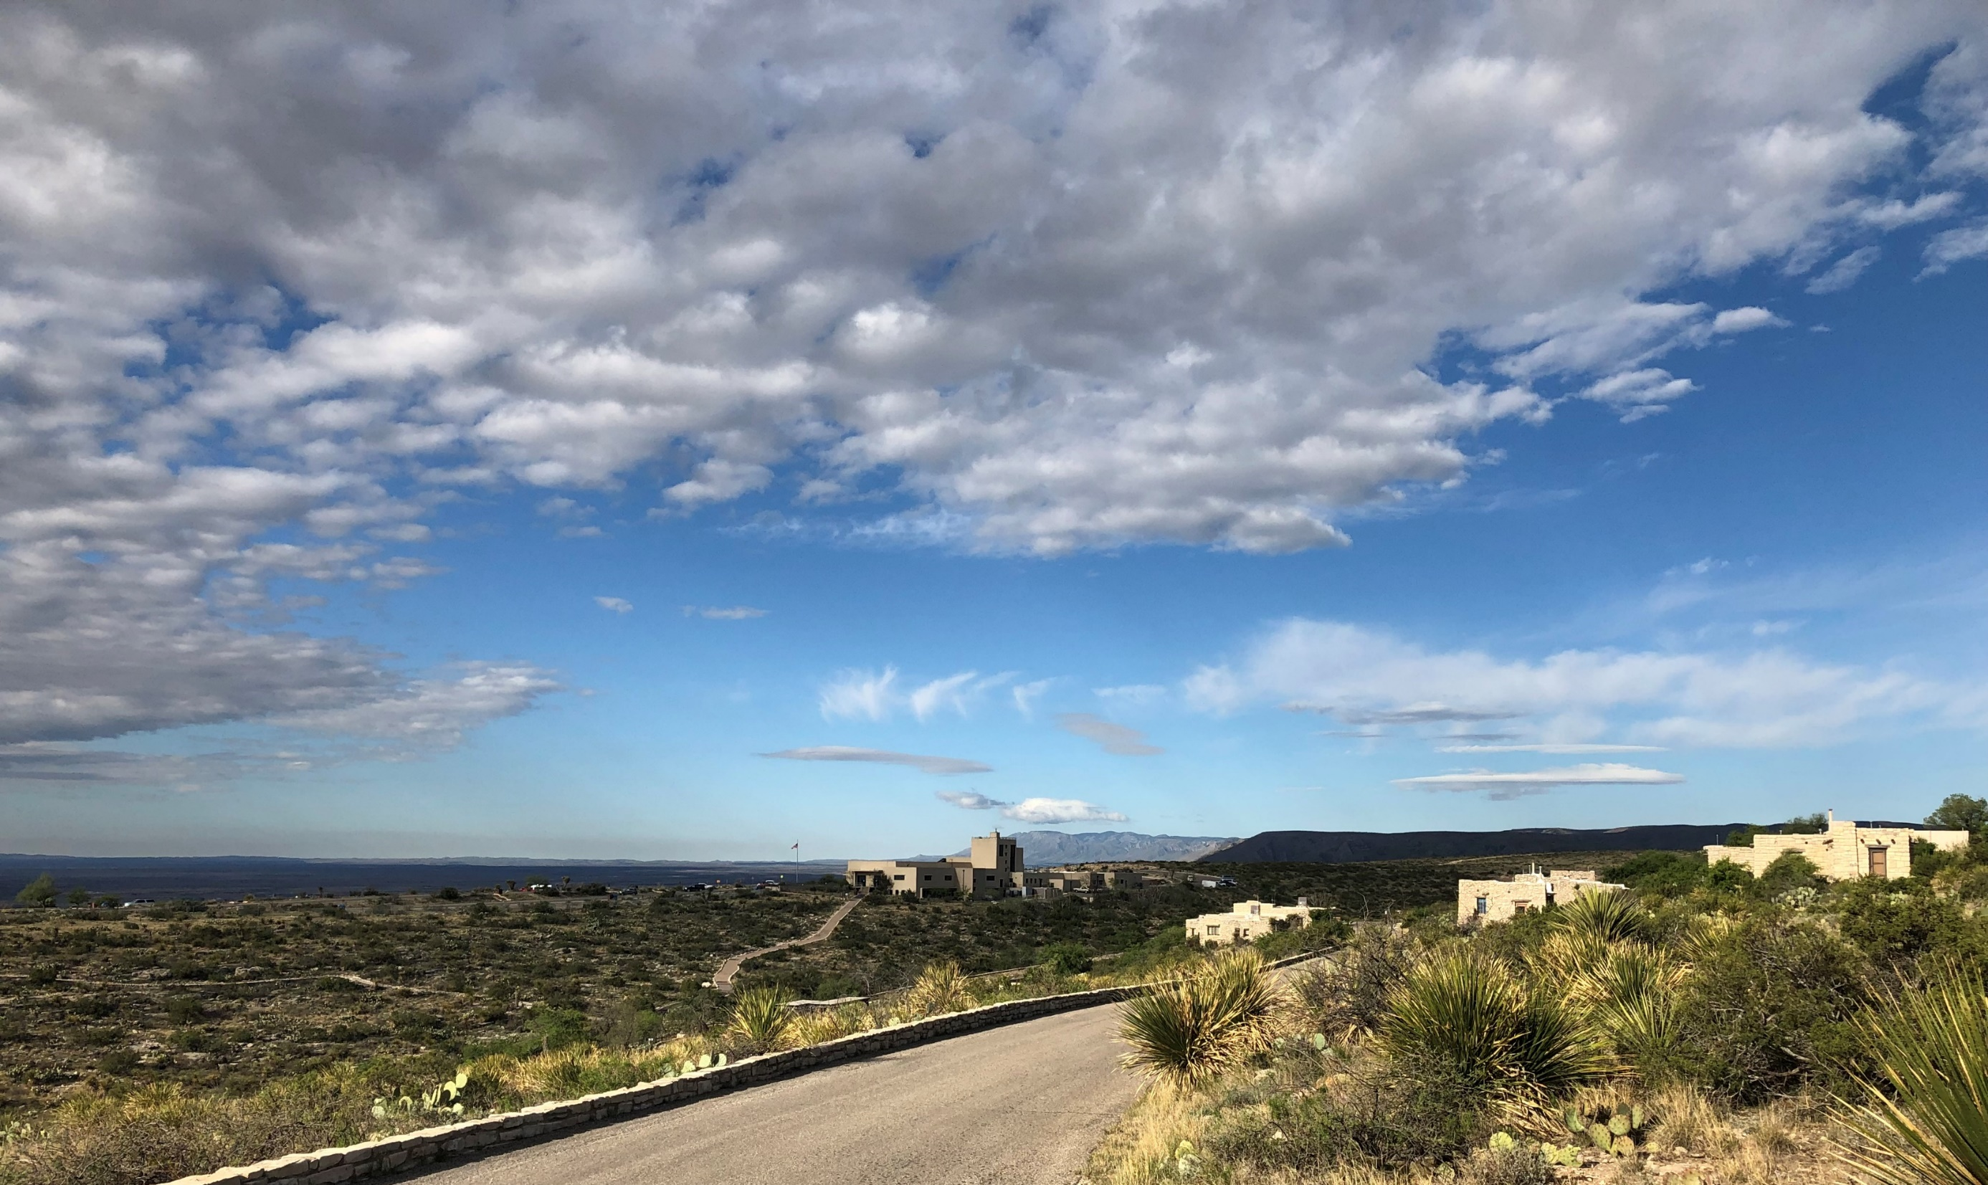
Questions?

