Slide 1
STATE OF NEW MEXICO
ENVIROMENTAL IMPROVEMENT BOARD
IN THE MATTER OF
PROPOSED NEW REGULATION
20.2.50 NMAC NO. EIB-21-27 (R)
Oil and Gas Sector – Ozone Precursor Pollutants
REBUTTAL TESTIMONY OF TECHINCAL WITNESS
PROFESSOR CLIFFORD J. VILLA

Slide 2
“Environmental Justice”
NMED (2021): Environmental justice means –
“The fair treatment and meaningful involvement of all people,
regardless of race, color, national origin, or income,
with respect to the development, implementation, and enforcement
of environmental laws, regulations, and policies.”

Slide 3
EJ Concerns in New Mexico
Española
Village of Questa
South Valley of Albuquerque
Grants Mining District

Slide 4
Legal Requirements to Address
EJ Concerns in New Mexico
Air Quality Control Act
Civil Rights Act Title VI
Executive orders
Case law

Slide 5
Colonias Dev’t Council v. Rhino Envt’l Services
N.M. Supreme Court found that NMED was required to consider environmental justice issues such as the “the cumulative effects” of garbage dumps in part because of the purpose of the Solid Waste Act waste to protect “public health” and “welfare.” Colonias Dev’t Council v. Rhino Envt’l Services, 138 N.M. 133 (2005).

Slide 6
Air Quality Control Act
“… The Air Quality Control Act also provides sufficient statutory authorization, like the Solid Waste Act, for the promulgation of regulations involving the consideration of public health and welfare….” N.M. Att’y Gen. No. 08-03 (2008).

Slide 7
Air Quality Control Act
“Therefore, pursuant to the Rhino roadmap,” the promulgation of regulations under the Air Quality Control Act “will allow Board staff, in the future, to assign weight to public testimony regarding environmental justice principles.” N.M. Att’y Gen. No. 08-03 (2008).

Slide 8
Air Quality Control Act
EIB “shall give weight it deems appropriate to all facts and circumstances.”
74-2-5(F) NMSA

Slide 9
Air Quality Control Act
EIB must consider the “character and degree of injury to or interference with health [and] welfare.”
74-2-5(F)(1) NMSA

Slide 10
Civil Rights Act Title VI
“No person in the United States shall, on the ground of race, color, or national origin, be excluded from participation in, be denied the benefits of, or be subjected to discrimination under any program or activity receiving Federal financial assistance.” 42 U.S.C. § 2000d-1.

Slide 11
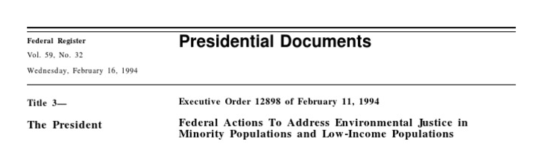
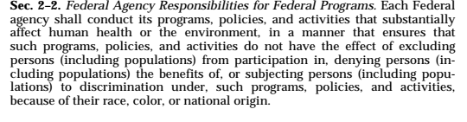
Executive Orders

Slide 12
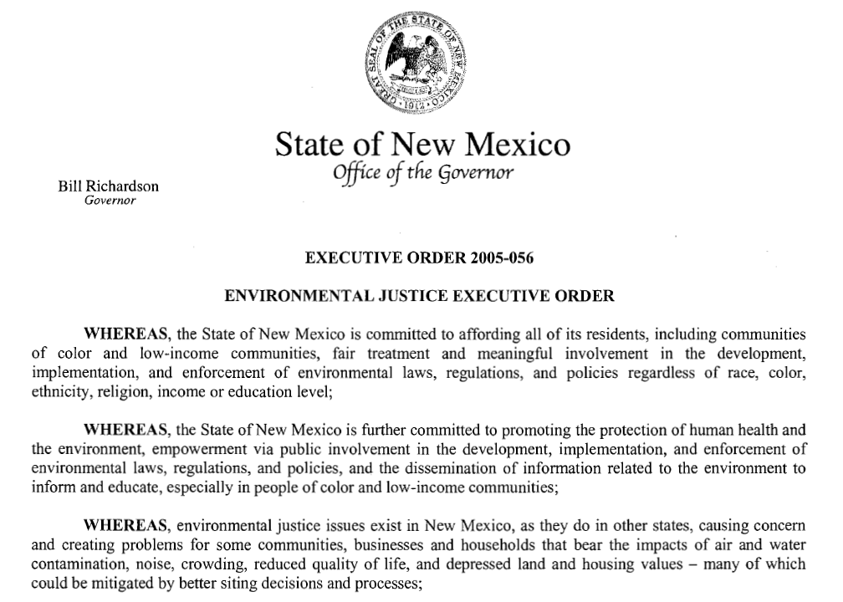
Executive Orders

Slide 13
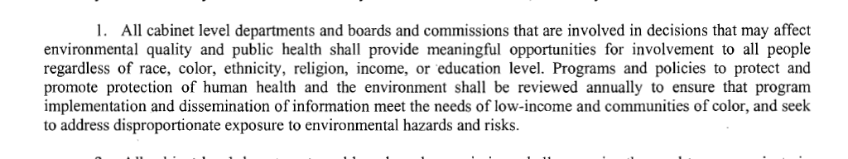

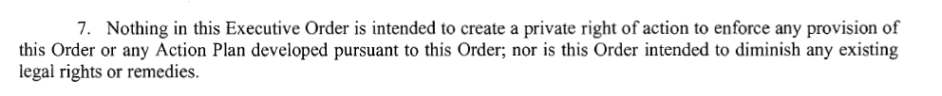
Executive Orders

Slide 14
Federal Case
Friends of Buckingham v. VA Air Pollution Control Board, 947 F.3d 68 (4th Cir. 2020).
Striking down CAA permit for Atlantic Coast Pipeline, court found that the board failed in its statutory duty to consider the “character and degree of injury” that the proposed pipeline might pose to the health of the local population.

Slide 15
Federal Case
Friends of Buckingham v. VA Air Pollution Control Board, 947 F.3d 68 (4th Cir. 2020).
“[E]nvironmental justice is not
merely a box to be checked….”

