Slide 1
Cancer Concerns in Sunland Park, New Mexico
Wednesday – September 30, 2026

Slide 2
Cancer is a leading cause of illness and death
in New Mexico and in the United States
Type of Cancer | Expected Number of New Cases - 2026
 | New Mexico | United States
All Types of Cancer | 11,840 | 2,114,850
Female Breast | 1,910 | 321,910
Prostate | 2,140 | 333,830
Lung and Bronchus | 920 | 229,410
Colorectal | 940 | 158,850
Cutaneous Melanoma | 750 | 112,000
Non-Hodgkin Lymphoma | 430 | 79,320
Uterine Cervix | 100 | 13,490
SOURCE: Cancer Facts & Figures 2026. American Cancer Society.

Slide 3
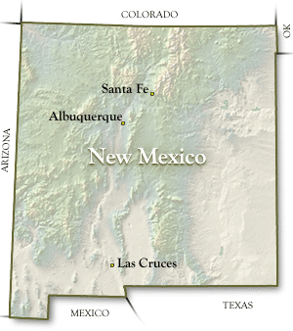
The New Mexico Tumor Registry conducts population-based
public health surveillance for cancer throughout New Mexico
and in American Indian communities in Arizona
New Mexico Tumor Registry
Established in 1966
Founding Member of NCI SEER* Program in 1973
Areas of Coverage
-New Mexico Statewide
-Arizona American Indians
…in collaboration with the Arizona Cancer Registry
and the Indian Health Service
* National Cancer Institute (NCI) – Surveillance, Epidemiology and End Results (SEER) Program

Slide 4
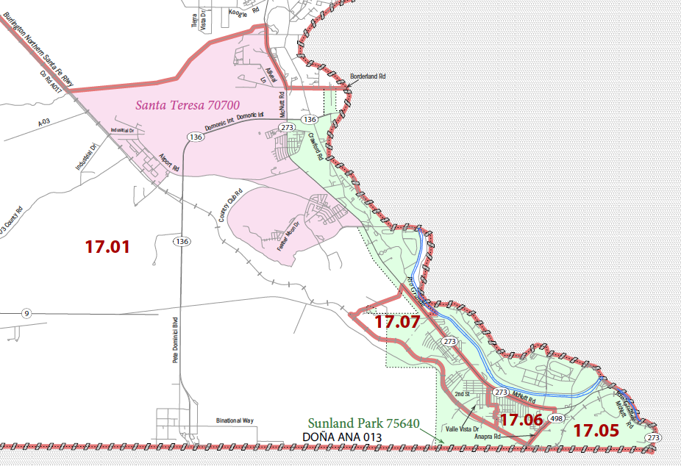
Area of Focus
Sunland Park, New Mexico

Slide 5
Comparison of Observed-To-Expected Case Numbers
2014-2013
Strong Association with Arsenic
Possible Association with Arsenic
Not Known to be Associated with Arsenic
Type of Cancer
Bladder
Lung & Bronchus
Non-Melanoma Skin
Kidney & Renal Pelvis
Liver
Prostate
Leukemia
Ovarian

Slide 6
Comparison of Observed-To-Expected Case Numbers
2014-2013
Strong Association with Arsenic
Possible Association with Arsenic
Not Known to be Associated with Arsenic
Type of Cancer | Observed (O) Number of Cases
Bladder | 8
Lung & Bronchus | 36
Non-Melanoma Skin | 1
Kidney & Renal Pelvis | 25
Liver | 19
Prostate | 46
Leukemia | 15
Ovarian | 7

Slide 7
Comparison of Observed-To-Expected Case Numbers
2014-2013
Strong Association with Arsenic
Possible Association with Arsenic
Not Known to be Associated with Arsenic
Type of Cancer | Observed (O) Number of Cases | Expected (O) Number of Cases
Bladder | 8 | 16.83
Lung & Bronchus | 36 | 40.72
Non-Melanoma Skin | 1 | 1.71
Kidney & Renal Pelvis | 25 | 19.61
Liver | 19 | 11.35
Prostate | 46 | 52.55
Leukemia | 15 | 16.42
Ovarian | 7 | 6.64

Slide 8
Comparison of Observed-To-Expected Case Numbers
2014-2013
Strong Association with Arsenic
Possible Association with Arsenic
Not Known to be Associated with Arsenic
Type of Cancer | Observed (O) Number of Cases | Expected (O) Number of Cases | O/E Ratio | P-Value
Bladder | 8 | 16.83 | 0.48 | 0.0018
Lung & Bronchus | 36 | 40.72 | 0.88 | 0.4312
Non-Melanoma Skin | 1 | 1.71 | 0.58 | 0.4767
Kidney & Renal Pelvis | 25 | 19.61 | 1.28 | 0.2807
Liver | 19 | 11.35 | 1.67 | 0.0792
Prostate | 46 | 52.55 | 0.88 | 0.3343
Leukemia | 15 | 16.42 | 0.91 | 0.7142
Ovarian | 7 | 6.64 | 1.05 | 0.8904

Slide 9
Chuck Wiggins, Ph.D Co-Director
cwiggins@salud.unm.edu
Sarah Nash, Ph.D. Co-Director
SarNash@salud.unm.edu
New Mexico Tumor Registry
MSC 11 6020
1 University of New Mexico
Albuquerque, New Mexico 87131

