Slide 1
New Mexico Environment Department
House Joint Memorial 3 Status Update
PFAS Protection Act Program
Office of Strategic Initiatives
October 8, 2026

Slide 2
HJM3 – 2 Reports to the Legislature
HJM3 passed in the 2026 legislative session and directs the Environmental Improvement Board and NMED to produce two separate reports
EIB to provide to legislature/Governor (Report 1):
  A status update report, PFAS Protection Act implementation, evaluating rule effectiveness
NMED to provide to the legislature/ Governor (Report 2):
  status update report, analyzing public health, environmental, and economic risks associated with the current exemptions in the PFAS Protection Act
  Recommendations for legislative action (keep exemptions, modify, or remove)

Slide 3
HJM3 – Process and Timeline
NMED’s report:
  NMED is conducting primary literature reviews in consult with other state agencies to provide the state of the science of the public health, environmental, and economic risks associated with the exemptions in the PFAS Protection Act.
August 2026 webinar as beginning of public comment opportunity.
October 2026 in-person meeting as continuation of stakeholder engagement process.

Slide 4
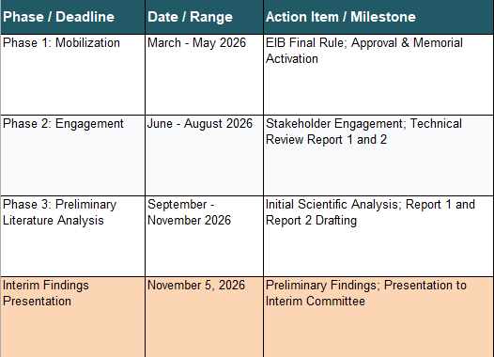
HJM3 Timeline

Slide 5
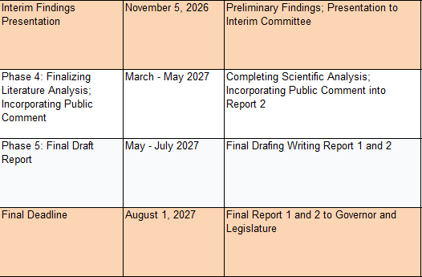
HJM3 Timeline

Slide 6
HJM3 Next Steps – Reports
The EIB will produce Report 1.
Public comment opportunity for Report 2 was open for 30 days in September 2026.
NMED will continue technical analysis and incorporate public comments into Report 2.
NMED will provide a preliminary presentation to the Radioactive and Hazardous Materials Interim Committee on Nov 5.
NMED reopened the public comment portal and it will remain open through the end of the year.

Slide 7
Resources
General PFAS information:
https://www.env.nm.gov/pfas
Manufacturer page:
https://www.env.nm.gov/manufacturers
Comment portal (now open until Dec 31, 2026):
https://nmed.commentinput.com/?id=x2khCUR9pK

Slide 8
HJM3 Questions and Stakeholder Input

Slide 9
Thank you
  PFAS Protection Act and HJM3 Inquiries:
  NMED-PFAS@env.nm.gov

