Slide 1
New Mexico Environment Department
Impacts of PFAS and Overview of State Policy Implementation
New Mexico State University
Eric Chapman, Ph.D., Science Coordinator
Office of Strategic Initiatives
Greg Smithkier, Assistant General Counsel
Office of General Counsel
May 1, 2026

Slide 2
Outline
Health impacts overview
PFAS general information
Environmental impacts overview
New Mexico’s PFAS Landscape
  CAFB and HAFB PFAS contamination
  PFAS Laws in New Mexico
    PFAS Protection Act
    Firefighting Foam Bill

Slide 3
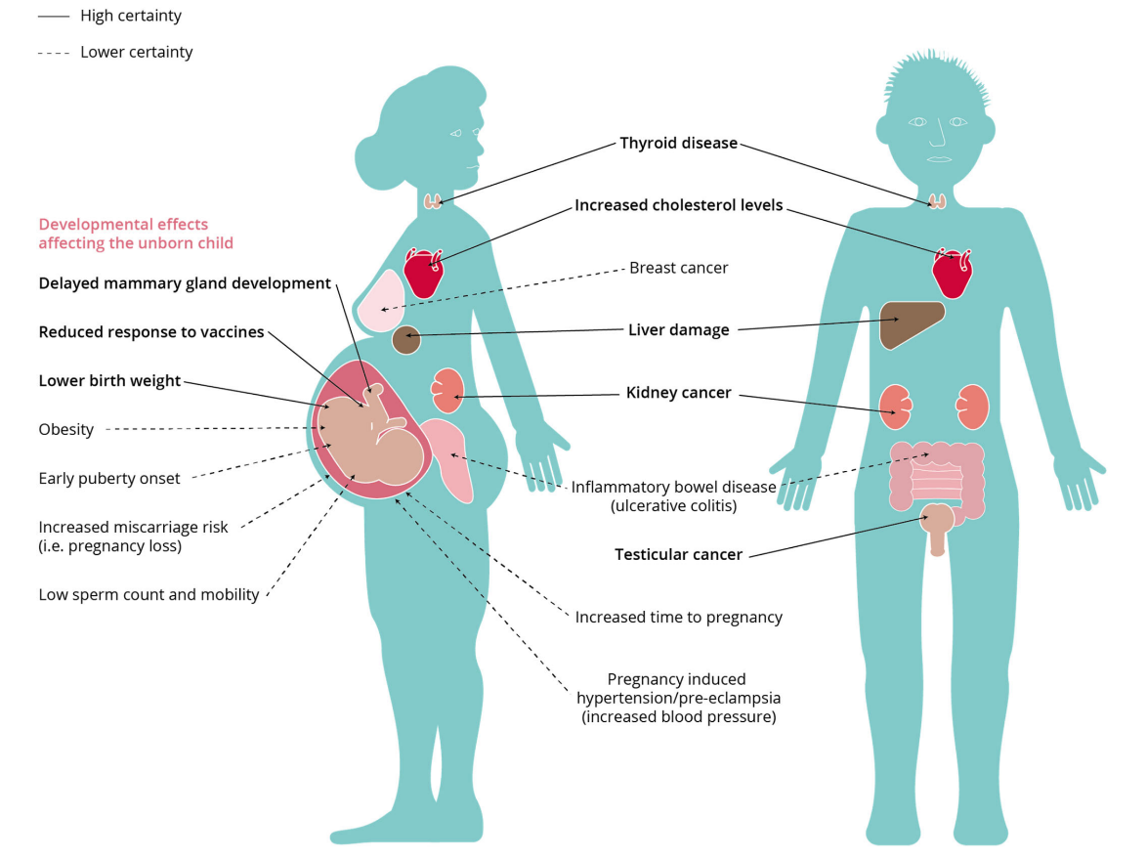
Health Effects and Occupational Use of AFFF
Fenton et al. (2023)

Slide 4
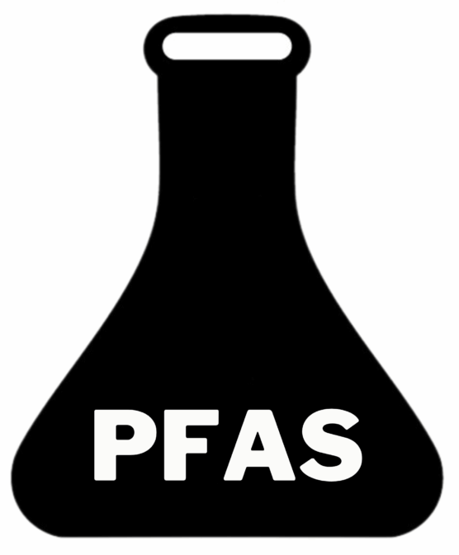
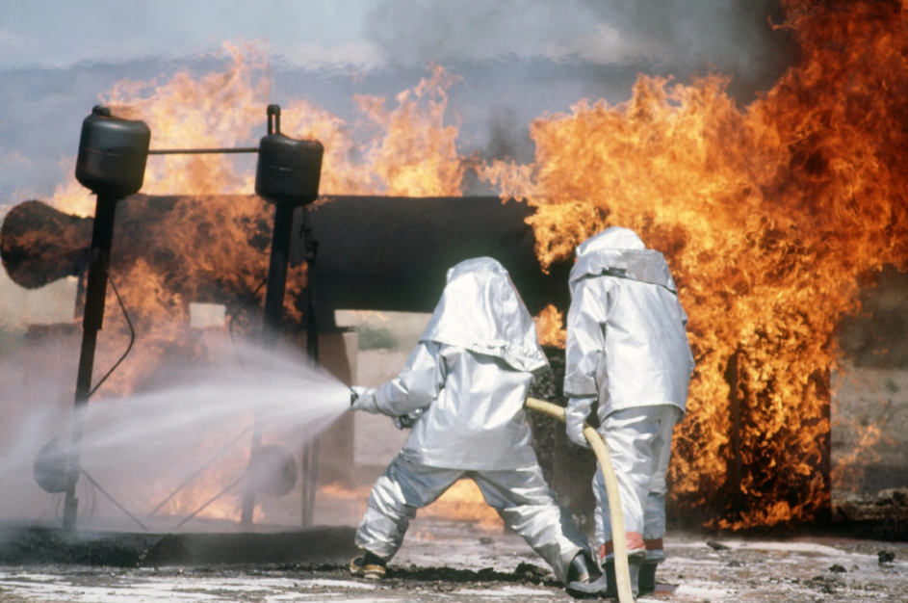
NM PFAS Landscape
NMED
https://www.kunm.org/local-news/2019-02-08/what-do-we-know-about-the-holloman-groundwater-contamination

Slide 5
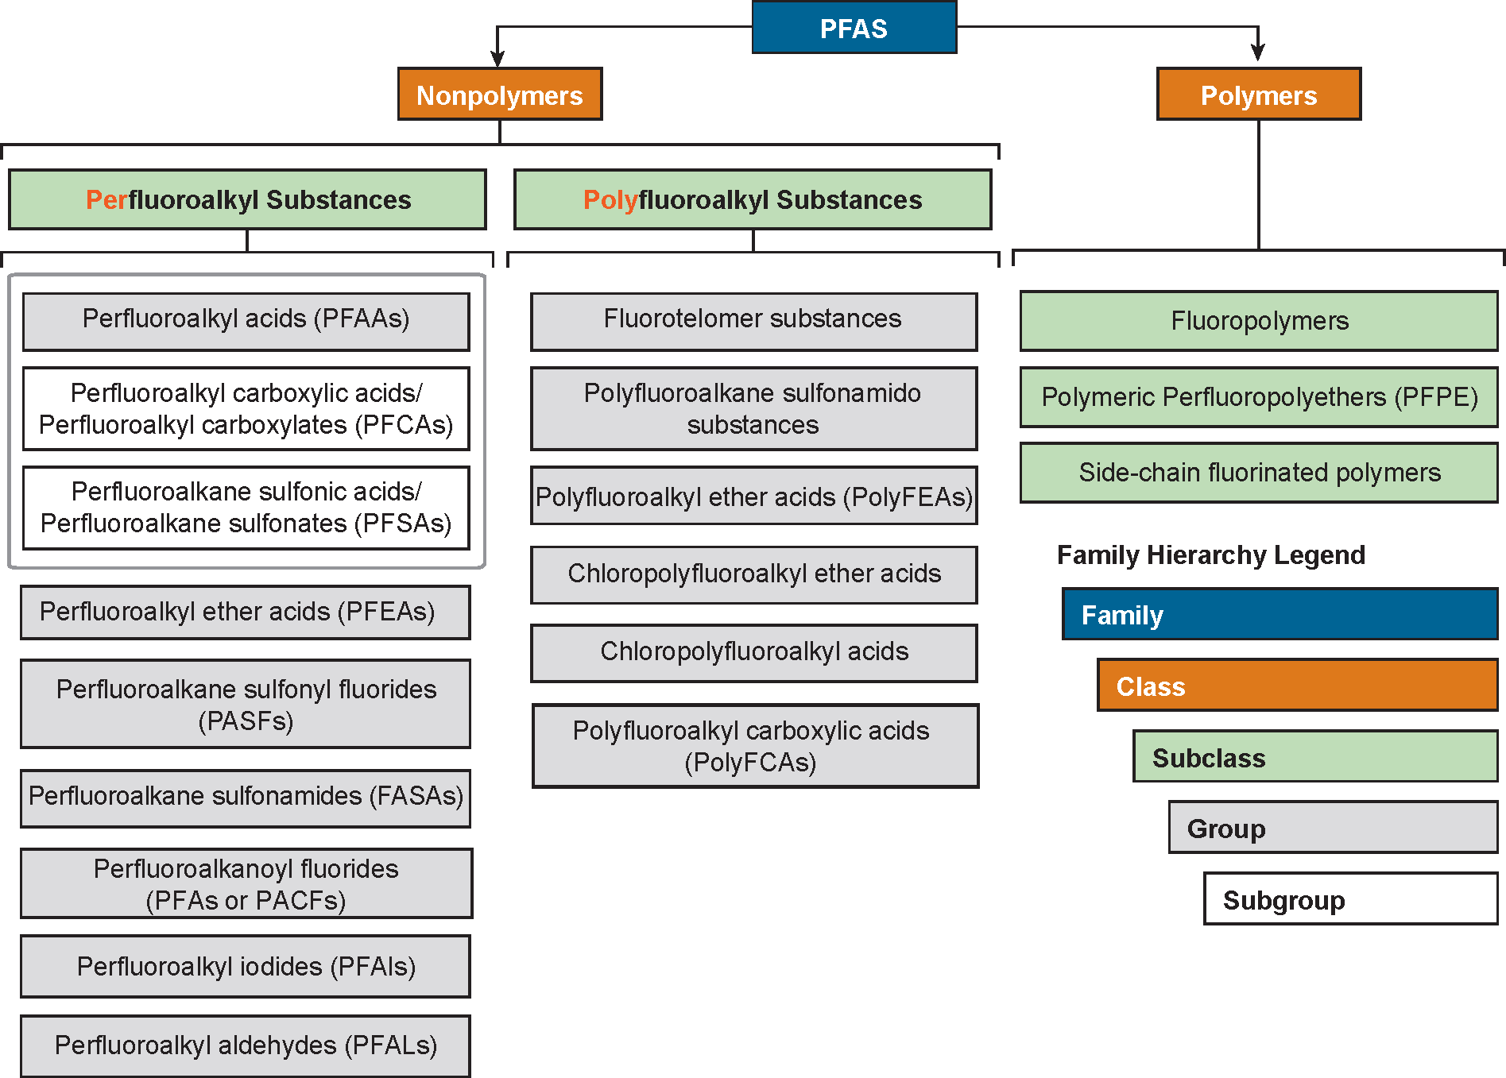
PFAS Family and the Environment
From: Interstate Technology and Regulatory Council, (www.itrcweb.org)

Slide 6
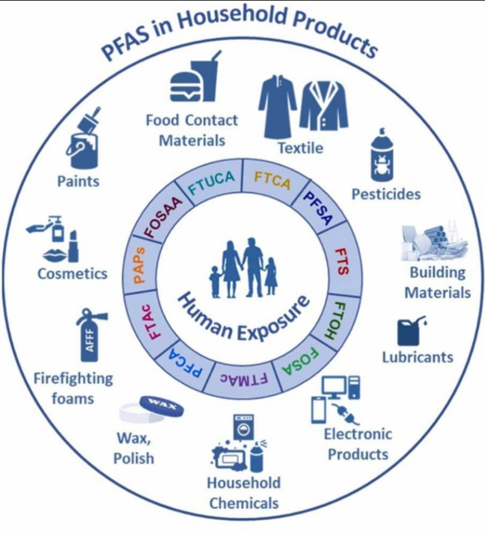
Consumer Products as Source of PFAS in the Environment
Dewapriya et al. (2023)

Slide 7
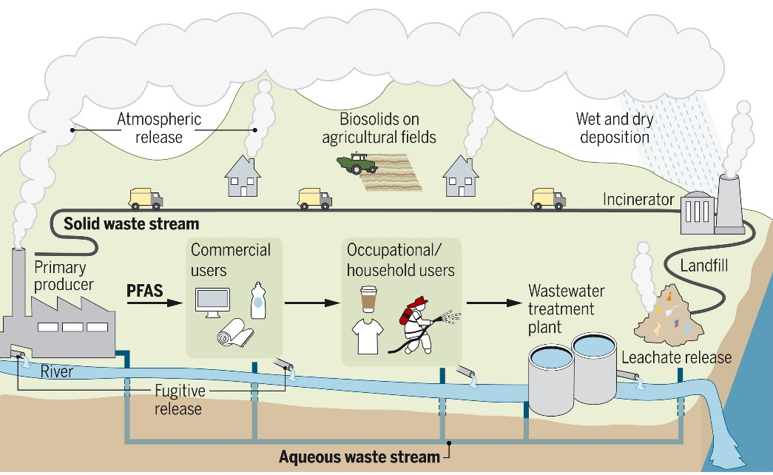
PFAS: From Source to Environment
Evich et al. (2022)

Slide 8
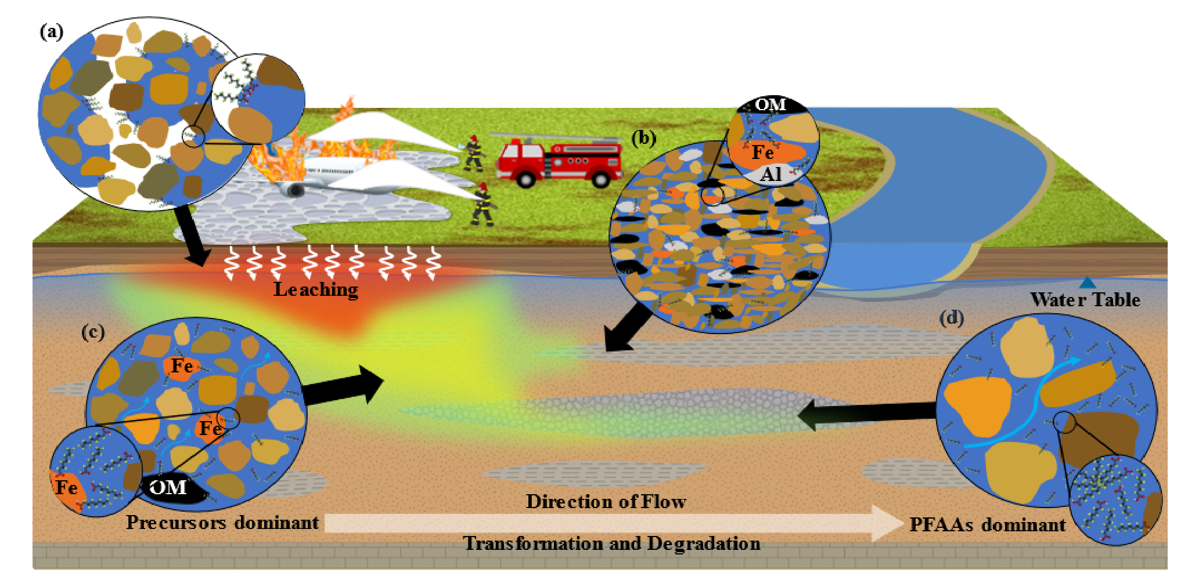
PFAS Fate and Transport from AFFF
McGarr et al. (2023)

Slide 9
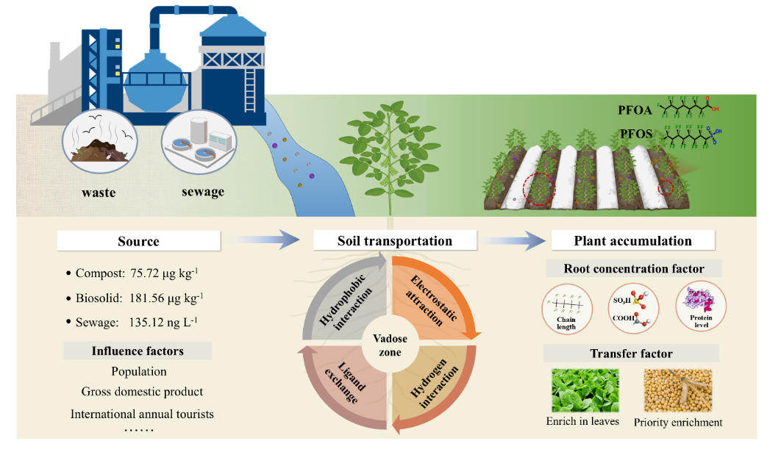
PFAS in Food Systems
Han et al. (2025)

Slide 10
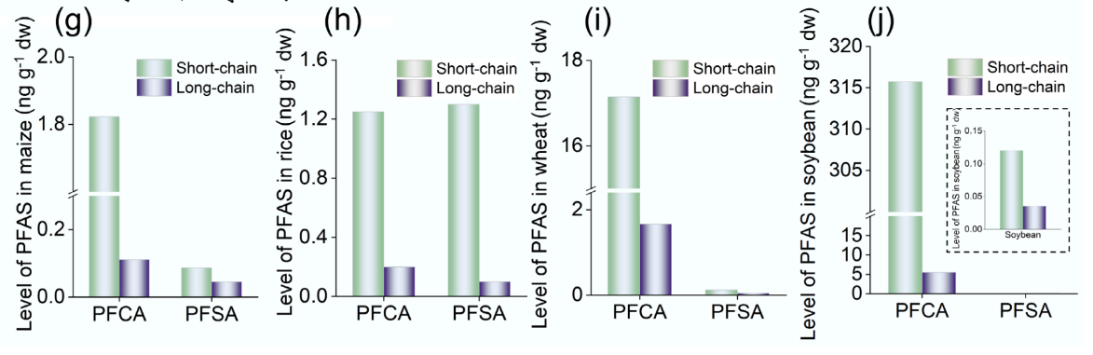
PFAS Uptake, Chain Length and PFAS in Edible Crops
Maize
Rice
Wheat
Soybean
Han et al. (2025)

Slide 11
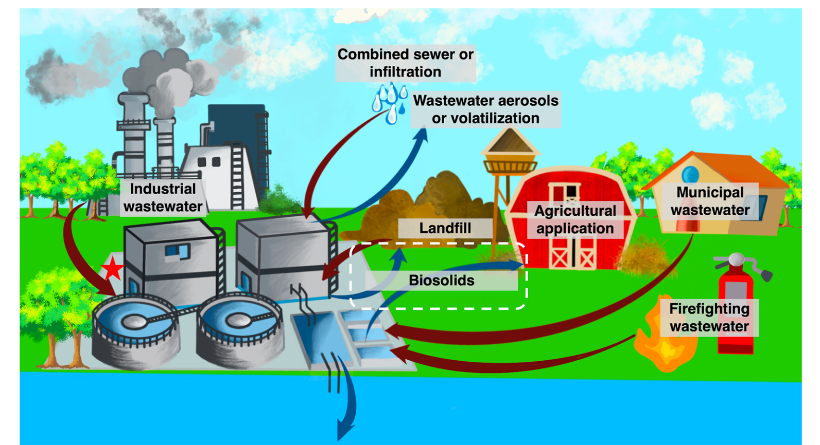
PFAS Transformation, Fate, and Transport in WWTPs
Liu and Charbonnet (2025)

Slide 12
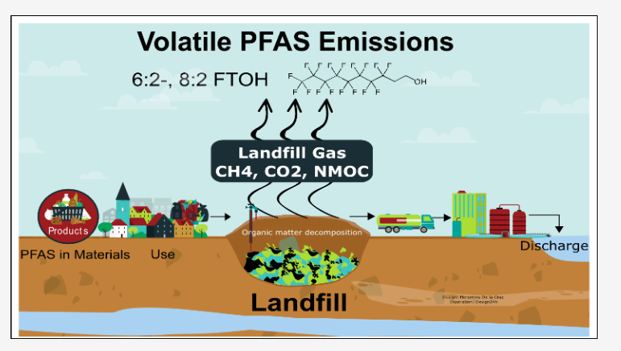
PFAS at Landfills
De la Cruz et al. (2025)

Slide 13
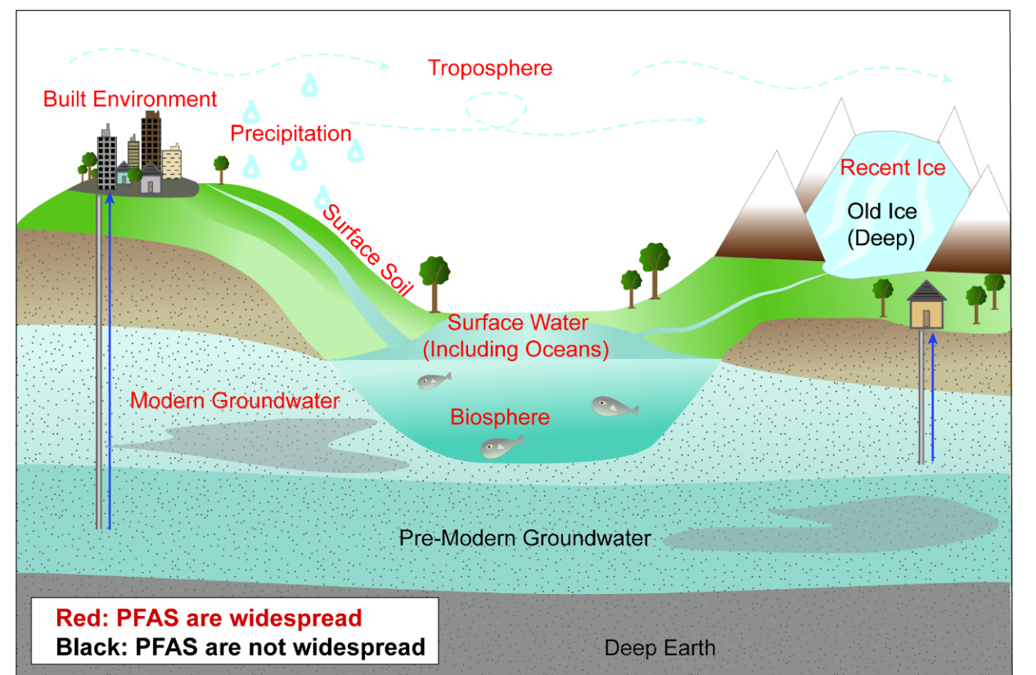
PFAS Transformation, Fate, and Transport in Water
Tokranov et al. (2025)

Slide 14
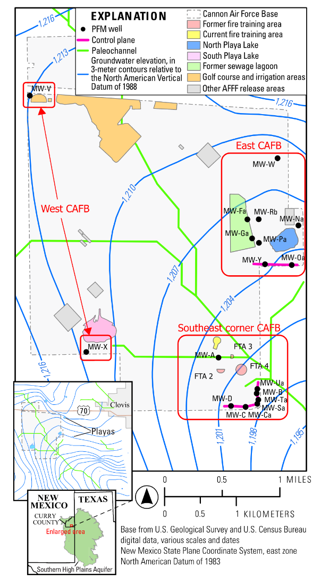
PFAS Contamination in New Mexico at Cannon Air Force Base
Gray et al. (2025)

Slide 15
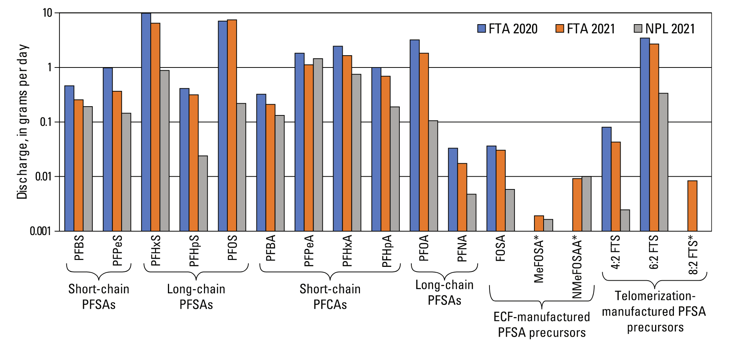
PFAS Groundwater Contamination at CAFB
FTA: Fire Training Areas
NPL: North Playa Lake
Gray et al. (2025)

Slide 16
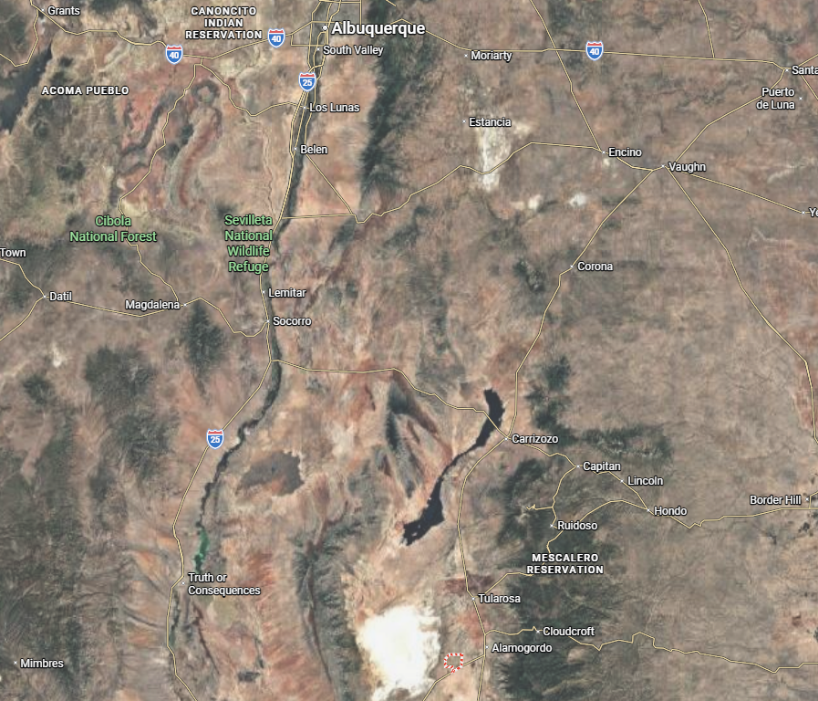
Holloman AFB and PFAS
Witt et al. (2024)
HAFB
Witt et al. (2024)

Slide 17
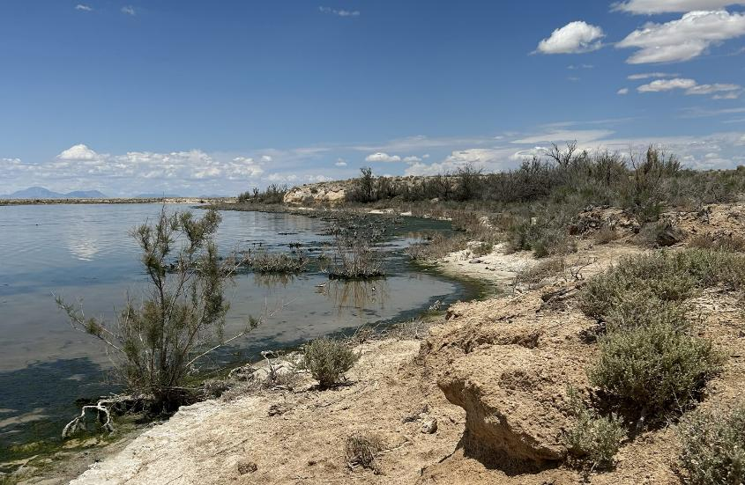
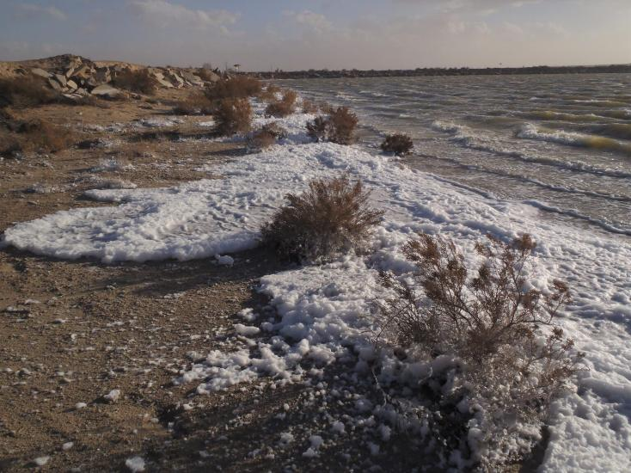
Holloman AFB and PFAS
DBS&A
NMED
Witt et al. (2024)
HAFB
Witt et al. (2024)

Slide 18
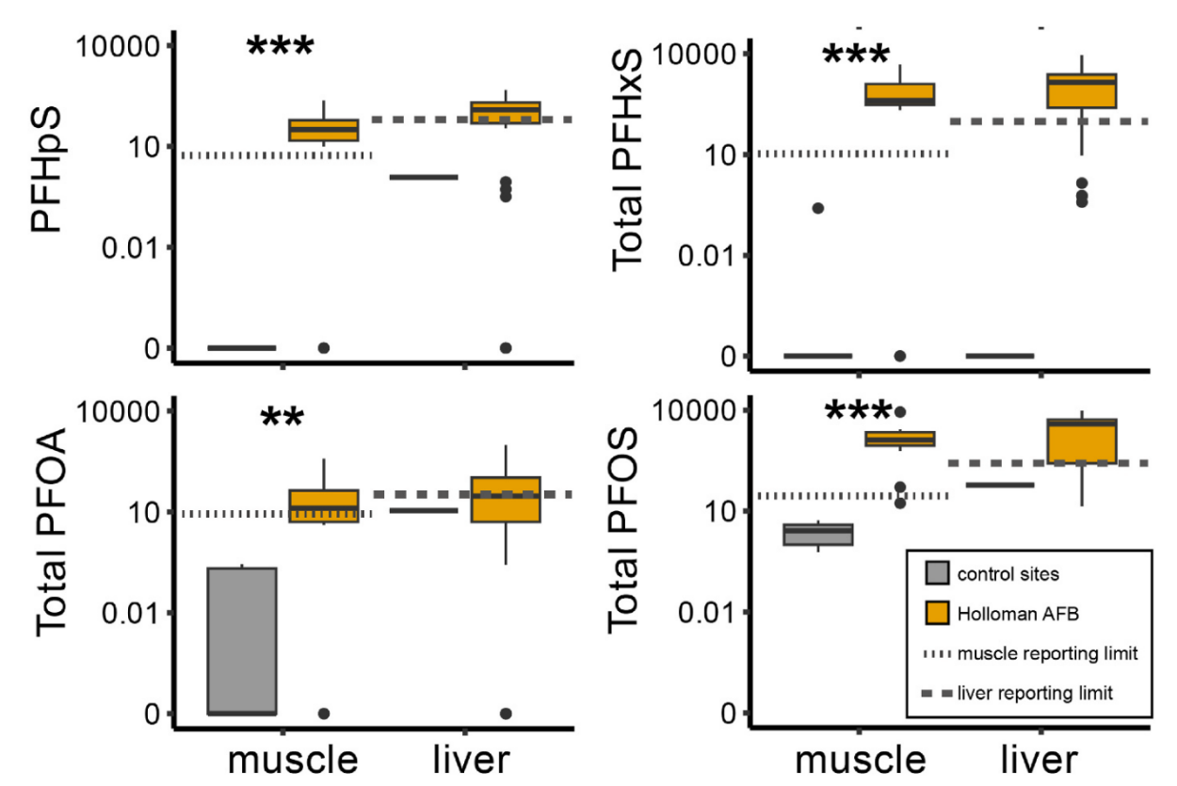
Holloman AFB and PFAS
DBS&A
NMED
Witt et al. (2024)
HAFB
Witt et al. (2024)

Slide 19
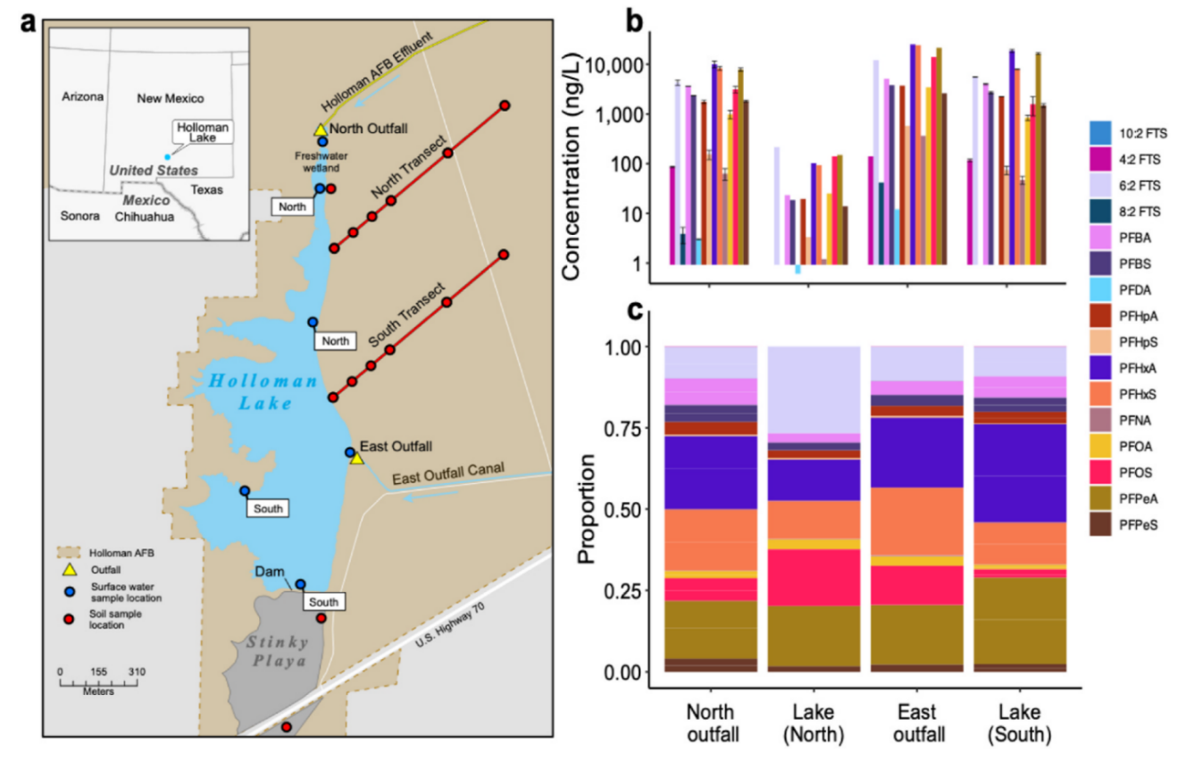
PFAS Types and Concentrations in Water Samples
Catron et al. (2025)

Slide 20
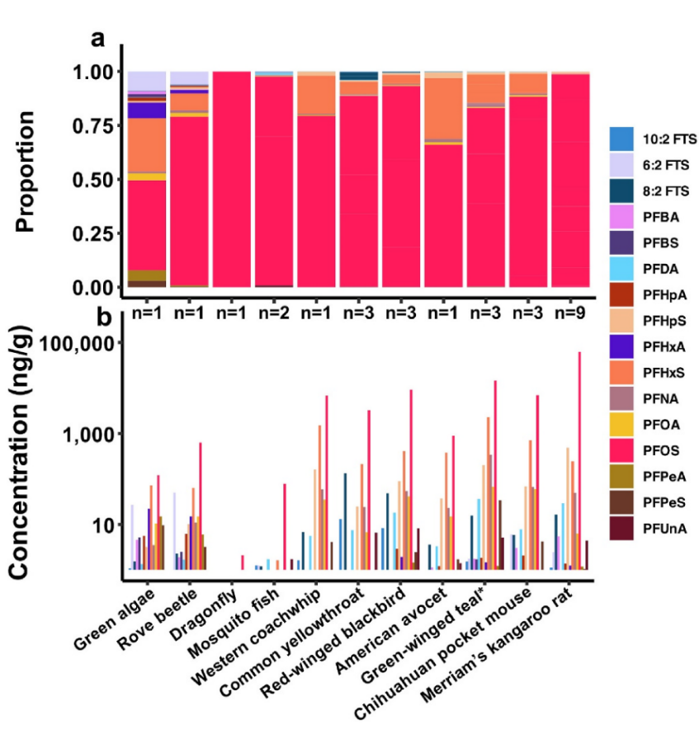
PFAS Types and Concentrations in Biological Samples
Amongst the highest levels of PFAS found in wildlife on the planet
Catron et al. (2025)

Slide 21
PFAS in the Environment Summary
PFAS are persistent, many are bioaccumulative and toxic
Once released into the environment, PFAS contamination becomes diffuse, widespread, and difficult to remediate.
AFFF use sites are hotspots of PFAS contamination and consumer products are sources of widespread and diffuse PFAS contamination.
Coupled with the PFAS in Consumer Products regulation and NM action regulating PFAS in Firefighting Foam will reduce environmental and human exposure to PFAS.

Slide 22
PFAS Laws in New Mexico
Recent developments in New Mexico’s PFAS regulatory landscape:
  Governor Michelle Lujan signed the PFAS Protection Act (HB212) into law on April 8, 2025
  Also signed HB140 which designated Aqueous Film Forming Foam (AFFF) containing intentionally added PFAS as a hazardous waste under the NMHWA.

Slide 23
NMED Rulemaking
The PFAS Protection Act and HB140 directed the Environmental Improvement Board to adopt rules to implement the Acts.
NMED presented a rule related to consumer products February 23 through 26 and the EIB voted to adopt the rule on March 23.
NMED presented rules related to AFFF as a hazardous waste on April 13, and the EIB voted to adopt the rule the same day.

Slide 24
PFAS Protection Act Rule
Regulates consumer products containing intentionally added PFAS.
First prohibitions go into effect January 1, 2027.
Labeling requirement for products manufactured on or after January 1, 2027.
Also regulates AFFF as a product
  Inventory of AFFF
  Use in emergency situations only
  Must be cleaned up pursuant to NMHWA

Slide 25
Product Prohibitions and Timeline
January 1, 2027:
  1) cookware; (2) food packaging; (3) dental floss; (4) juvenile products; and (5) firefighting foam
January 1, 2028:
  (1) carpets or rugs; (2) cleaning products; (3) cosmetics; (4) fabric treatments; (5) feminine hygiene products; (6) textiles; (7) textile furnishings; (8) ski wax; and (9) upholstered furniture
January 1, 2032:
  All non-exempted products

Slide 26
Labeling Requirement
Manufacturers of products containing intentionally added PFAS will be required to label products manufactured on or after January 1, 2027, with this label:
Labeling required except for a few
narrow exceptions.
Complex products such as
automobiles and major appliances will have the label in the product specification sheet.

Slide 27
AFFF
The PFAS Protection Act Rule and amendment of the NMHWA regulate AFFF as a product prior to use and as a waste.
The PFAS Protection Act Rule (20.13.3 NMAC) regulates AFFF as a product and requires an inventory and use in emergency purposes only.
Once AFFF is discharged or discarded, then it is regulated by the NMHWA and is treated like any other hazardous waste.

Slide 28
Conclusion
The PFAS Protection Act and the HB140 amendment to NMHWA work together to regulate two of the major sources of PFAS contamination in New Mexico.
New Mexico is the first state to designate AFFF containing intentionally added PFAS as a hazardous waste.
New Mexico’s labeling requirement is the first to include a graphical symbol.

