Slide 1
Comments Regarding Ozone Modeling
Doug N. Blewitt
Certified Consulting Meteorologist
Air Quality Resource Management (AQRM)
September 15, 2021

Slide 2
Requirements of the Air Quality Control Act, Section 74-2-5(C), which states:
“If the environmental improvement board or the local board determines that emissions from sources within the environmental improvement board's jurisdiction . . . cause or contribute to ozone concentrations in excess of ninety-five percent of the primary national ambient air quality standard for ozone . . . shall adopt a plan, including rules, to control emissions of oxides of nitrogen and volatile organic compounds to provide for attainment and maintenance of the standard.”
The purpose of this regulatory action is to protect New Mexico from new violations of the current
ozone NAAQS of 70 ppb by establishing a safety factor
This regulatory action is not about reducing methane emissions
The required plan outlined in the regulation must:
  Develop a control strategy that reduces ambient ozone concentrations at the monitors where violations of the standard have been recorded and ensure that all monitors are below 95 percent of the NAAQS
  Potential controls must identify culpable sources, focus on precursor emissions responsible for ozone formation and must address significant impacts on ozone formation by pollutant (NOx vs VOC)
  The plan must address regulatory action (definition of sources affected) and ultimately implement regulations to enforce the plan
  The plan needs to evaluate cost to control in terms of ambient impact
The plan developed in support of 74-2-5(C) fails to satisfy these requirements

Slide 3
Emission Inventories
The RAMBOLL modeling developed three emission inventories:
  2014 base case
    Based on EPA NEI (NMED removed some sources that were double counted)
  2028 future year base case
    Documentation of the 2028 future base case is lacking (i.e., what sources are included, calculation methods, future year assumptions from 2014 to 2028)
    The lack of documentation of the 2028 future base case makes it impossible to confirm the accuracy of emission estimates as well as growth assumptions
  2028 future base case with additional NOx and VOC controls on oil and gas sources
    Oil and gas controls alone will not achieve the 95 percent required goal unless the 2028 future base case is implemented through regulatory action

Slide 4
Issues with Emission Inventories Used in the Modeling
The 2028 future year base case provides no documentation for emission calculations, emission growth (by source category) and assumptions regarding emission reductions that will be implemented as a result of new control requirements from new promulgated regulations
Basin growth assumptions for oil and gas sources are critical because emissions from many oil and gas sources are contingent on production levels as well as the rate of drilling new wells
A review of the Farmington Mancos-Gallup Draft Resource Management Plan Amendment and Environmental Impact Statement identified numerous issues with the Mancos modeling inventories
  The Mancos analysis is directly related to the New Mexico Ozone Attainment Initiative Photochemical Modeling Study

Slide 5
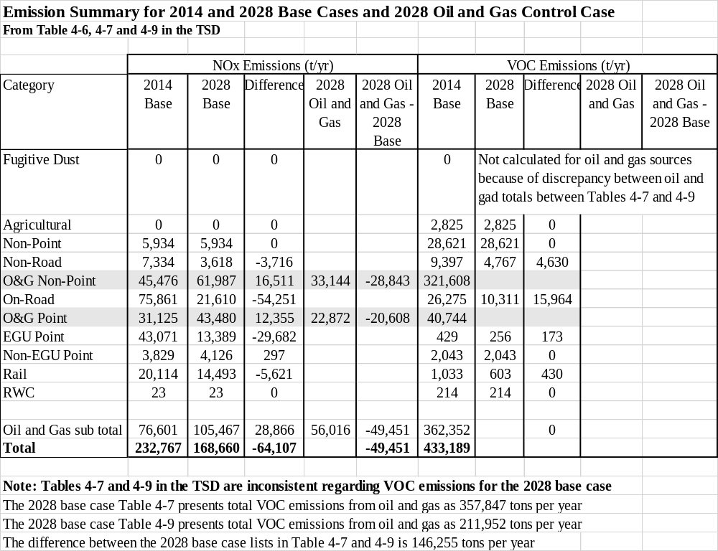

Slide 6
Production Decline Will Result in Emission Reductions for NOx and VOC Emissions
All production from oil and gas wells will exponentially decrease over time
Basin production decline is offset by drilling new wells which slows the rate of overall decline
As well production declines, some oil and gas emissions from selected sources will be reduced e.g., compressors (NOx), dehys (NOx and VOCs) and tanks (VOCs)
Well decline is not accounted for in most oil and gas inventories
Typically, in future year inventories new well emissions at initial production are added to existing wells at initial production and result in substantially overstating actual emissions
The lack of documentation regarding oil and gas inventories prevents confirmation of values used in the modeling

Slide 7
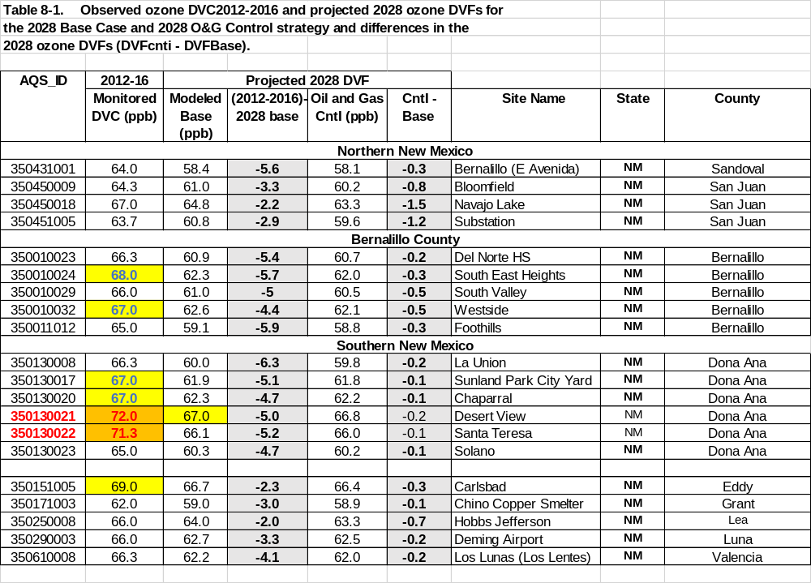
Summary of Changes in O3 From the 2028 Future Year Base Case Using 2012 – 2016 Data
(Time Period Follows EPA Guidance)
Conclusions
For the 2012-2016 time frame the only monitors that have a design value
above the NAAQS are Desert View and Santa Teresa 72.0 and 71.3 ppb
respectively
2) For the 2012-2016 case the South East Heights, Westside, Sunland Park City
Yard, Chaparral and Carlsbad monitors have design values for the 2012-2016
base case above 67 ppb (95 % of the 70 ppb NAAQS)
For the 2028 base case all modeled design values are below 67 ppb except at Desert View monitor
At Desert View the 2028 base case design value 67 ppb is equal to the threshold value
Additional Oil and Gas controls reduce impacts for the Desert View monitor 0.2 ppb total O3 66.8 ppb
Combined Oil and Gas controls are a very ineffective way to reduce impacts
below 67 ppb
If different years are used for the dv, slightly different conclusions are found.
According to the TSD the use of the 2012-2016 baseline follows EPA guidance
Legend: Orange highlight is above O3 NAAQS of 70 ppb
Yellow highlight is above 95% of O3 NAAQS or 67 ppb
From RAMBOLL TSD page 91, with some modification

Slide 8
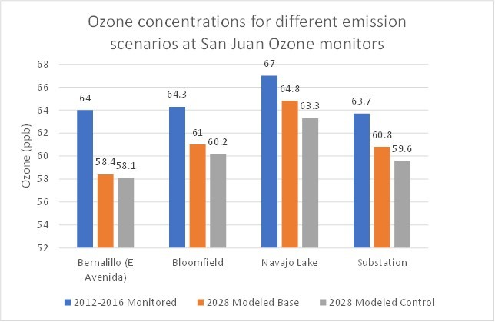
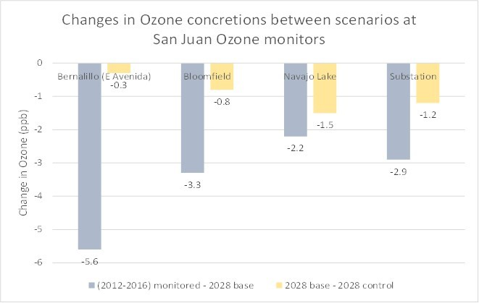
From IPAMS Exhibit 8, page 11/33
Changes in O3 Concentrations for Alternate Scenarios (San Juan Monitors)
Notes:
NOx and VOC emission changes are combined
2012-2016 impacts are monitored not modeled
Conclusions
At the Navajo Lake monitor (dv=67 ppb) the 2028 future year base case predicted impacts are 64.8 ppb, a reduction of 2.2 ppb (no additional controls on Oil and Gas)
If additional Oil and Gas controls are implemented, the 2028 design value is reduced to 63.3 ppb (a decrease of 1.5 ppb)
Results indicate future case compliance with the 70 ppb NAAQS and the 67 ppb safety factor threshold
Compliance is therefore demonstrated without the implementation of additional Oil and Gas controls

Slide 9
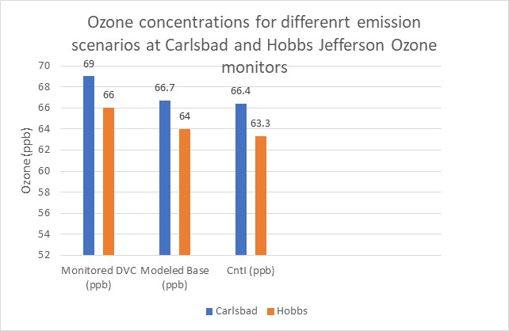
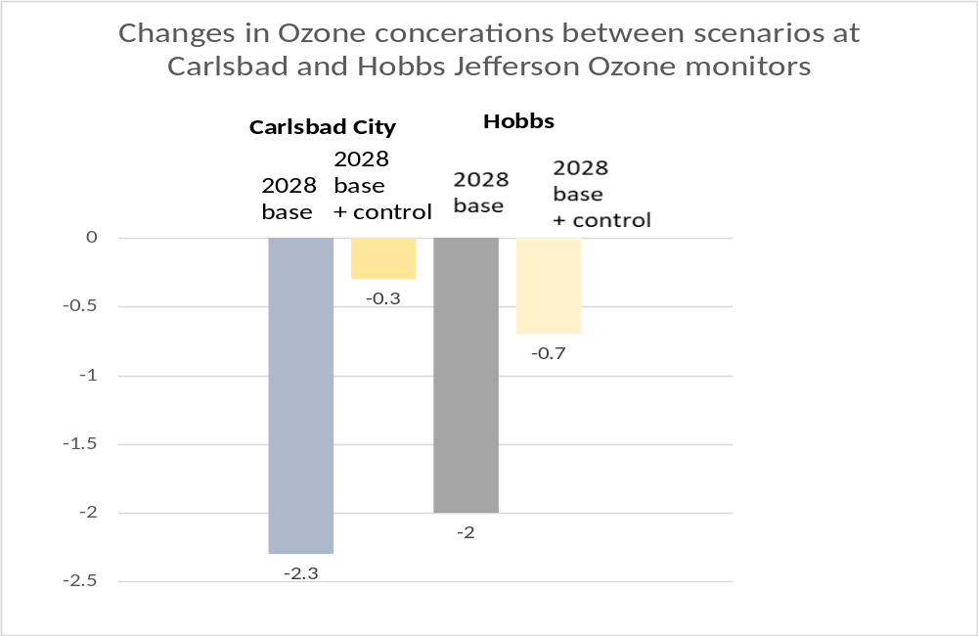
Changes in O3 concentrations for alternate scenarios Carlsbad and Hobbs Jefferson O3 monitors
Notes:
NOx and VOC emission changes are combined
2012-2016 impacts are monitored not modeled
Conclusions
The Carlsbad monitor has a dv 69 ppb and the 2028 future year base case predicted impacts are 66.7 ppb, a reduction of 2.3 ppb (no additional controls on Oil and Gas)
If additional Oil and Gas controls are implemented, the 2028 design value is reduced to 66.4 ppb (a decrease of 0.3 ppb)
Implementing the Oil and Gas control strategy results in an insignificant improvement in O3
The Hobbs Jefferson monitor dv is below the 66.5 ppb threshold
From IPAMS Exhibit 8, page 13/33

Slide 10
Comparison of Ozone Reduction from NOx vs VOC Controls
Ralph Morris indicates in his testimony that ozone concentrations in New Mexico are NOx limited. This means that raising or lowering NOx emissions will result in changes in ozone concentrations, while changes in VOC emissions will not result in changes in ozone levels
He further indicated there were a limited number of grid cells where ozone was VOC limited. Unfortunately, no details are provided for review. The identification of VOC limited conditions is important for policy considerations
The modeling combined NOx and VOC impacts and consequently it is not possible to understand the benefits of NOx controls versus VOC controls – given that the region is primary NOx limited, the effectiveness of VOC controls in inhibiting ozone formation needs to be evaluated

Slide 11
Conclusions
The 2028 future base case represents a plan for achieving ozone concentrations below the 70 ppb NAAQS without implementing additional controls on oil and gas
The 2028 future base case results in large NOx and VOC emission reductions as well as reductions in ozone
Unfortunately, no documentation is provided regarding what emission reductions are included
A further problem is that ozone reductions from NOx and VOC controls are combined. Analysis is needed to separate NOx and VOC impacts to evaluate the effectiveness of NOx versus VOC controls
If oil and gas controls are implemented without formalizing the 2028 future base case through appropriate rulemaking, the goals of achieving ozone concentrations less than the NAAQS will not be realized

