Slide 1
New Mexico Environment Department
Fifth Meeting - Water and Natural Resources Committee
Air Quality Around Oil and Gas Operations and Effectiveness of Methane and Ozone Rules
Michelle Miano, Director
Environmental Protection Division
October 29-30, 2025

Slide 2
Timeline Overview
2019 – Governor Lujan Grisham by Executive Order set the state's climate goal to: Reduce greenhouse gas emissions by 45% from 2005 levels by 2030​.
2021 – Legislature passed directive under NMSA 1978, Section 74-2-5(C) to:
Adopt a plan for ground-level ozone, including rules, to control emissions of oxides of nitrogen and volatile organic compounds to provide for attainment and maintenance of the [ground-level ozone] standard.…within the area of the state where the ozone concentrations exceed ninety-five percent of the primary national ambient air quality standard.
2021 – Energy, Natural Resources & Minerals Department took action at Title 19 Chapter 15 Parts 27 and 28 to: Adopt Methane Waste Rules.
2022 – Environment Department took action at Title 20 Chapter 2 Part 50 to: Adopt Ozone Precursor Rule.​
2022-Present – Rule implementation and phase-in; data gathering and analysis.

Slide 3
NMED-Specific Trends
Increase in permitting – over 2,000% in Air Quality Bureau
Rule implementation and phase-in
  Lowering ground-level ozone data in oil & gas counties (NMED)
  Decreasing methane emissions (EMNRD)
Increasing carbon dioxide emissions
Compliance continues to be key need
Local concerns reported

Slide 4
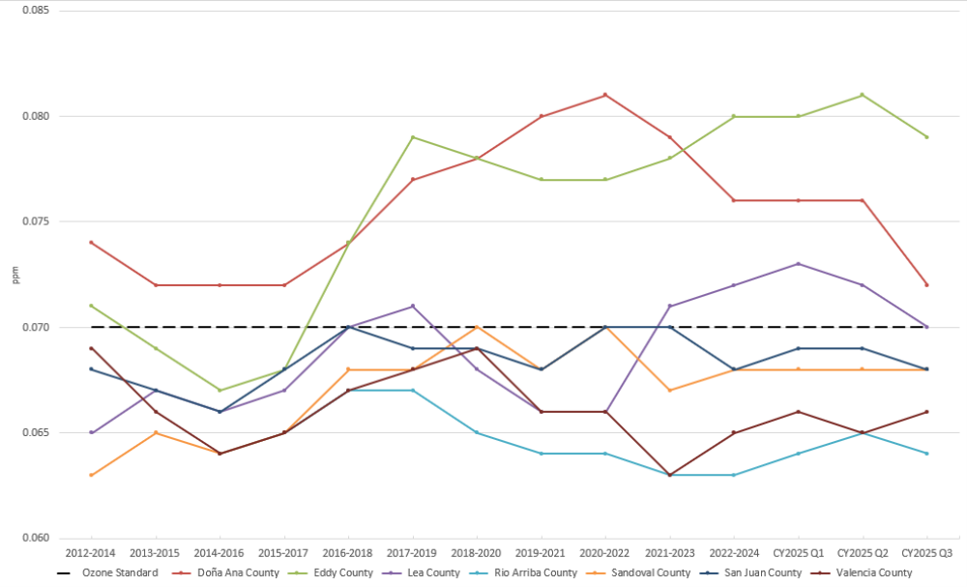
NMED - Ozone NAAQS Values
https://www.env.nm.gov/air-quality/my-air-quality/#ozone

Slide 5
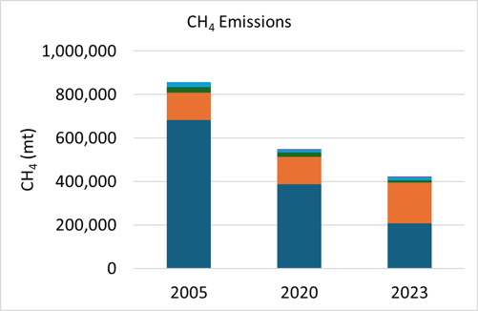
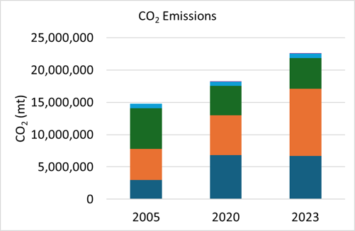
NMED - Preliminary Data
New Mexico Oil & Gas Greenhouse Gas Emissions Inventory for Year 2023
Methane (CH4) and Carbon Dioxide (CO2)
Greenhouse Gas Inventories for the oil & gas industry conducted for 2005 and 2020 ​
Crude oil production grew from ~100 million barrels in 2010 to ~745 million barrels in 2024 (https://nm-secm.org/new-mexico-oil-production/)

Slide 6
NMED - Excess Emissions by Pollutant
The Air Quality Bureau received 877 excess emission reports between January 1, 2025, and September 25, 2025.
Oil and Gas facilities filed 80% of the excess emission reports.

Slide 7
NMED - The Look Ahead
Preserve progress achieved since 2019
Develop combination of incentives, voluntary programs and policy approaches
Compliance and Enforcement = Level-playing field
Publish new Greenhouse Gas Inventory
Publish Climate Action Plan (Master Plan) with EMNRD
Prepare for finalization of federal changes
Stabilize NMED Air Quality Program funds

