Slide 1
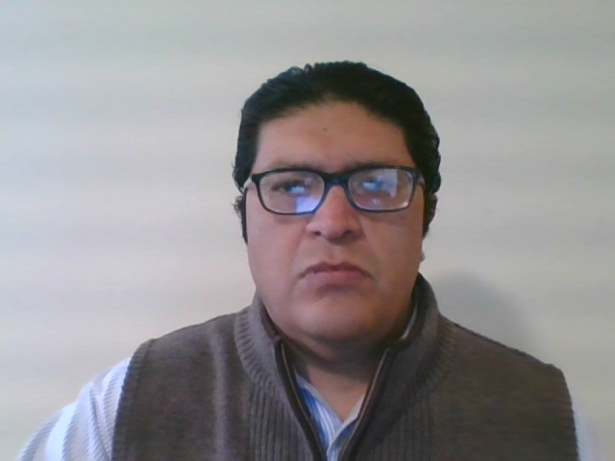
New Mexico Environment Department
Solid Waste Bureau
Registering for Annual Report Database
(Secure Extranet Portal-SEP)
Levi Lementino, Outreach Specialist
December 2020
Notes:
Hello my name is Levi Lementino I am an outreach specialist with the SWB. This video is intended as a guide to follow when registering for the Annual Report Database.
Registering for the Annual Report Database is a 3-step process:
Step is to apply for registration
Step is to complete the registration process
Step waiting for NMED to Authorize your registration
Once you complete these steps, which may take a few days, you will be ready to start uploading your Annual Report.

Slide 2

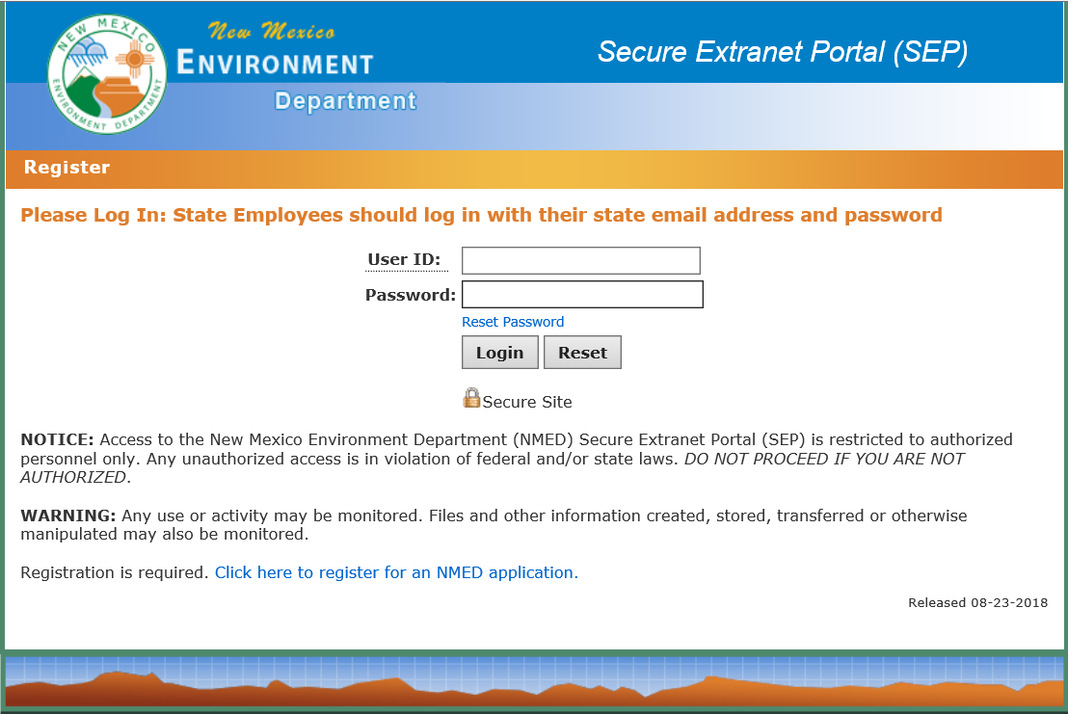
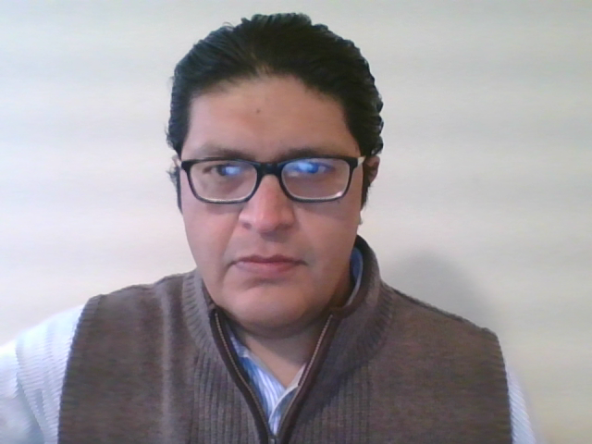
Follow Link to Log-In Page
Enter: https://sep.net.env.nm.gov/sep/login-form into the browser search bar
Notes:
Let’s begin by typing in the weblink : https://sep.net.env.nm.gov/sep/login-form into the search bar of your internet browser (using either Internet Explorer or Microsoft Edge) as shown here and press enter on your computer keyboard. This link should direct you to New Mexico Environment Dept.’s Secure Extranet Portal where you will start step 1 by applying for registration.

Slide 3
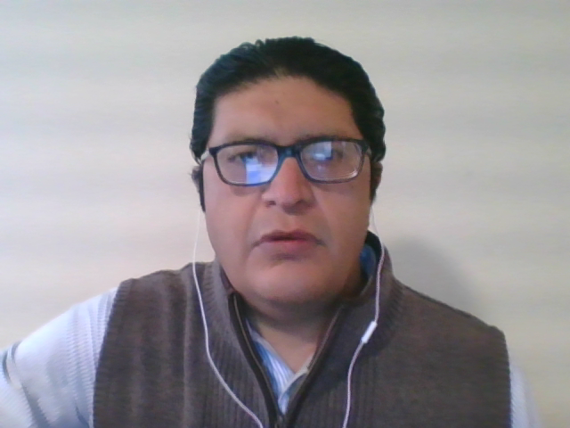
Click Link to Application Page
Move to Bottom of Page
“Click Here to Register for an NMED application”
Notes:
Once you are on the Log-In page you should see the screen shown here. Please navigate to the bottom of the page and click the link that says ”click here to register for an NMED application” highlighted here by the red oval. This will take you to the next page to start the application process.

Slide 4
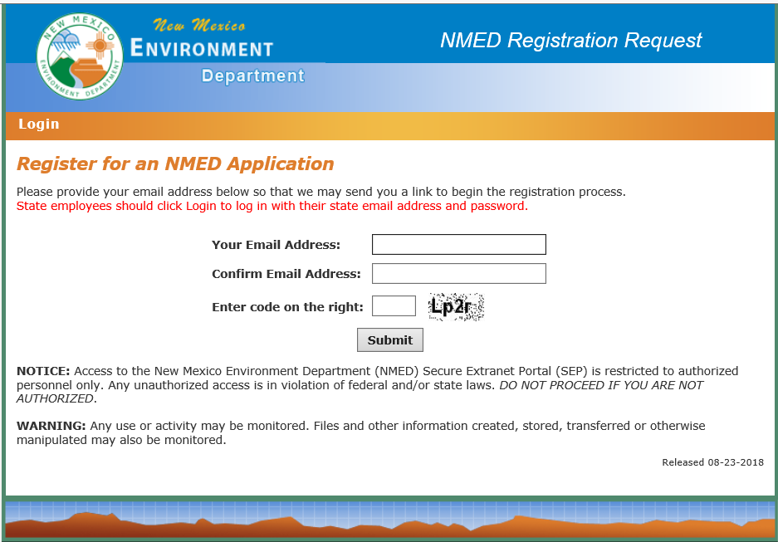
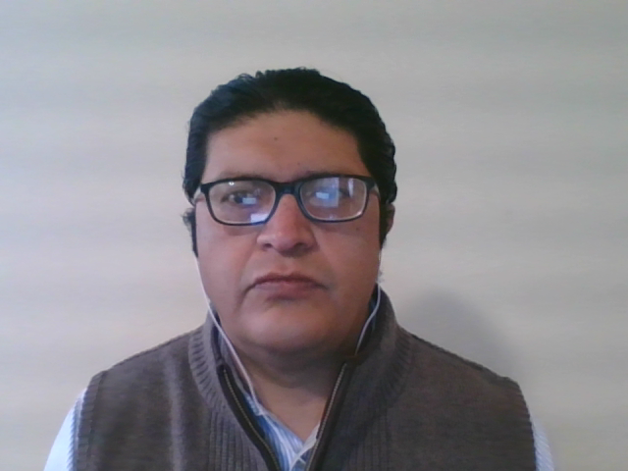
Application for Registration
Apply to SEP to Use Annual Report Database
Enter your email twice and type in code at bottom
Press submit button
Notes:
Registration for the Annual Report Database or portal will require a valid email address that the Solid Waste Bureau has on file as the contact email for your facility. You will enter this email twice, once into the “Your email address” box and again into the “confirm email address” box. Next enter the Captcha code shown at the bottom then click submit button. Follow all instructions that are sent to the email address.

Slide 5
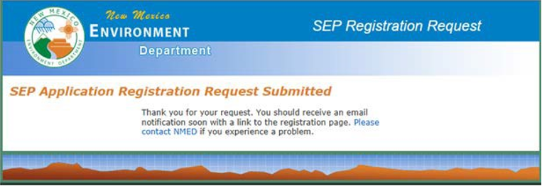
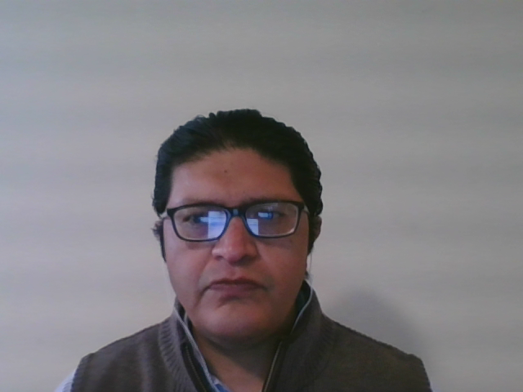
Confirmation of Application
Notes:
After submitting your initial application, you will next receive this confirmation screen seen here. You may now check the email address you have applied with to continue the registration process.

Slide 6
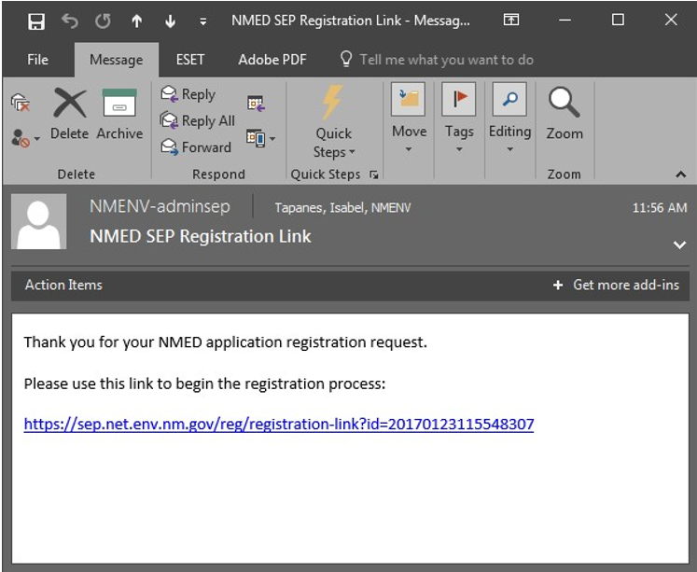
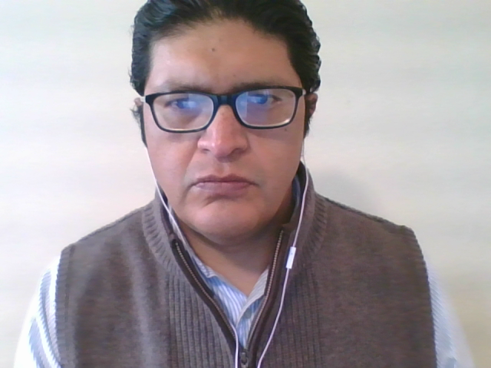
Registration-Start
Registration link will be sent to email address the Solid Waste Bureau has on file as the contact email for your facility
Notes:
Next, you will access the email account that you registered with to retrieve and open the link that was sent to you. Again, this email address should be on file as the contact email for your facility with the Solid Waste Bureau. Once you open your email and retrieve the Registration Link, Click on the highlighted link (as shown above) to begin filling in your user profile andNMED application information.
If you do not receive an email, please wait for at least a day and if no email has still not been sent please contact the SWB Outreach section for assistance.

Slide 7
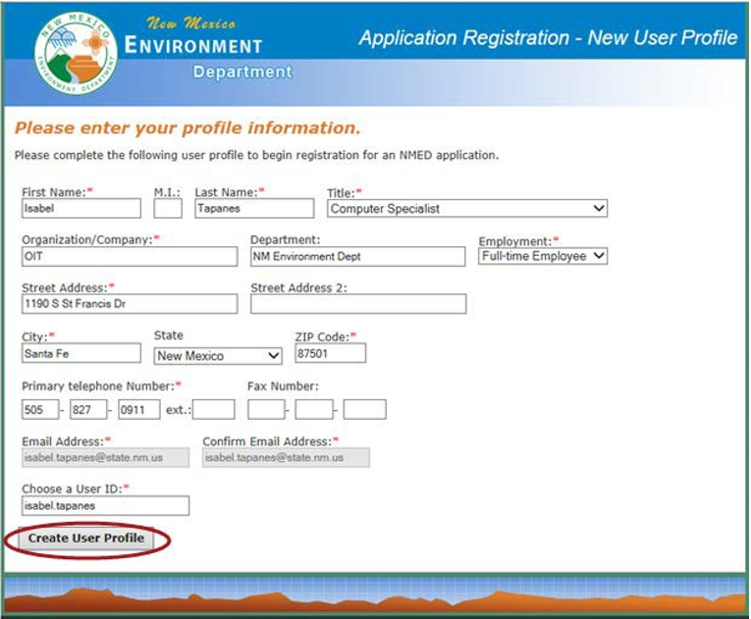
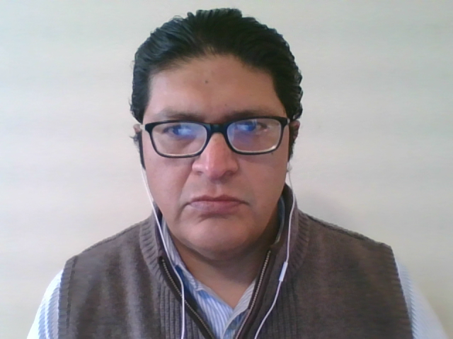
Registration-New User Profile
Enter your profile information
Fill in requested information on Application
Choose User ID:
Click Create User Profile
Register by Link for Annual Report Database
Notes:
Once you are in the New User Profile page, start filling in the requested information and make sure to fill all boxes marked with a red asterisk. During this step you will choose a USER ID to access the database in the future. We recommend you use your first name followed by a period and then you last name as shown here, also please record this ID for later sessions. Once you have picked a USER ID click on “Create User Profile” button and you will be prompted to the next screen to pick the SWB AR Form application.

Slide 8
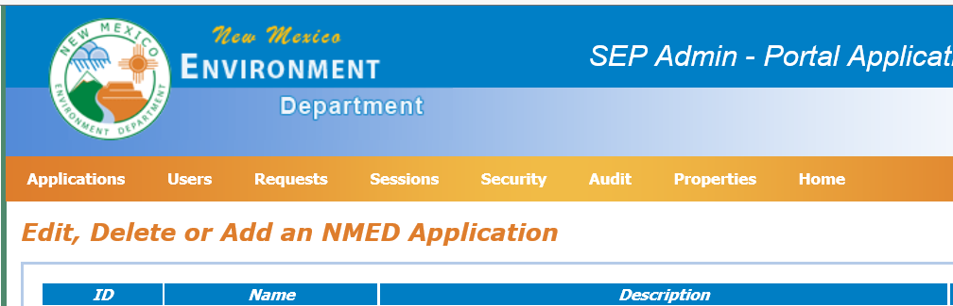

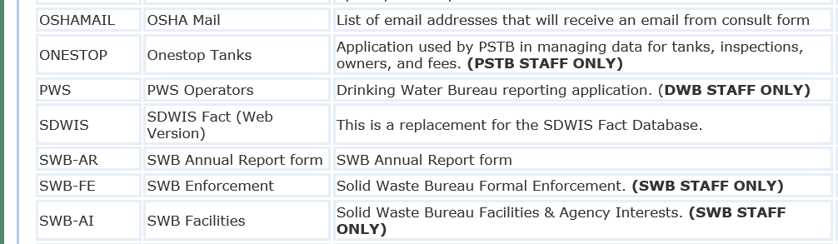
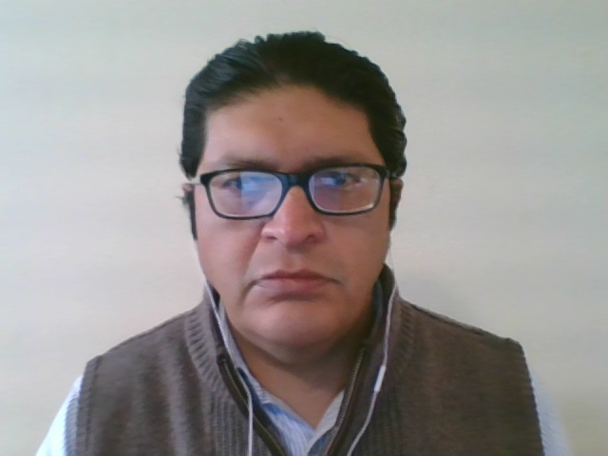
Registration-Select SWB-AR
Click on “register” button to select
You may only have only one application option on your screen
Notes:
Once you are on the application page, select the Solid Waste Bureau Annual Report Form notated here as SWB-AR by clicking the “register” link on the right. Once you have clicked the register button you should receive a confirmation page

Slide 9
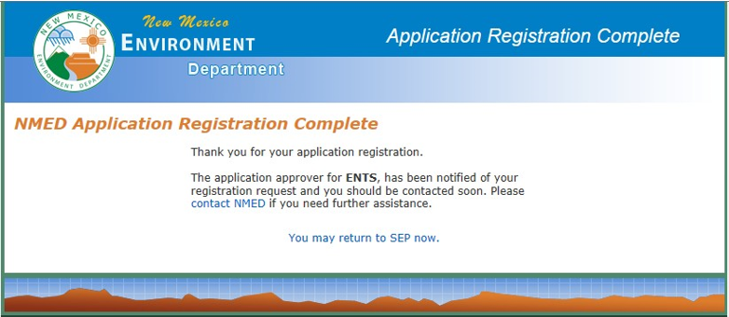
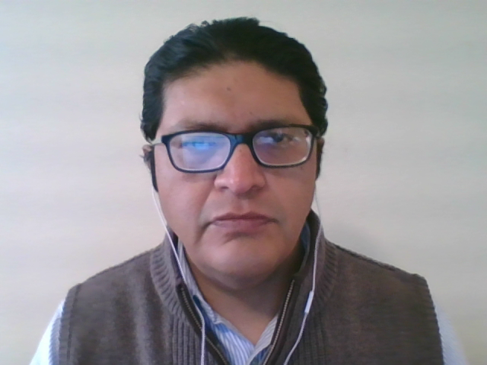
Registration-Complete
Notification Will Appear
Follow Instructions on Application
Notes:
Once you have received a notification on your screen such as the one shown above, you are done and will now have to wait till IT contacts you by email or phone once the application is approved.

Slide 10
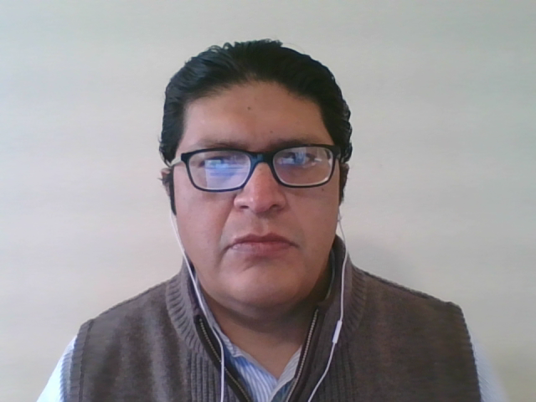
Ready to Start Annual Reporting
Also Watch “Log-In to SEP” Video
For Log In Assistance, please watch “Log-In to SEP” Instruction Video
Notes:
Once you have been approved for the Annual Report Database you may go back to the original login page and enter your USER ID and password to begin entering your annual report data.

Slide 11
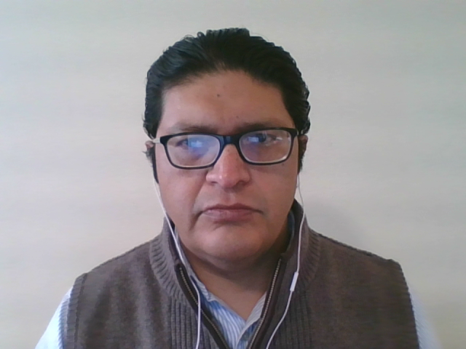
Additional Support
Outreach Section
Levi Lementino Outreach Specialist 505-795-1255 Levi.Lementino@state.nm.us
Amanda Otieno Outreach Specialist 505-795-1502 Amanda.Otieno@state.nm.us
Genevieve Morgan Outreach Section Manager 505-490-5356 Genevieve.Morgan@state.nm.us
Notes:
For any additional assistance, questions, or concerns please contact the SWB Outreach Section

