Slide 1

New Mexico Environment Department
Annual Report Database Log-in Tutorial
Solid Waste Bureau
Amanda Otieno
Outreach Specialist
December 2020
Notes:
Hello my name is Amanda Otieno and I am one of three outreach specialist within the Solid Waste Bureau. In this video tutorial, you will learn how to log in to the Solid Waste Bureau's Annual Report database so you may submit your Annual Report by February 14th 2021. The log-in process to access the Annual Report database has not changed from last year and will require your pre-registered User ID and Password. For instructions on how to complete registration for the Annual Report database and acquire a User ID, view the video tutorial by Outreach Specialist Levi Lementino which is also available on our website.

Slide 2





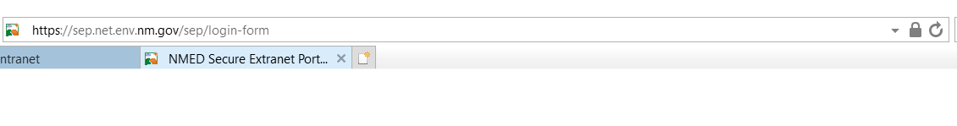
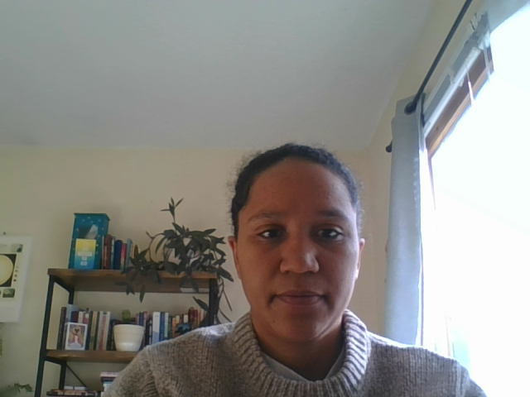
Logging in to the Annual Report
X
X
X
Microsoft Internet Explorer
Sep.net.env.nm.gov
Notes:
In order to gain access to the Annual Report database please use Microsoft internet explorer or its updated version called Microsoft Edge. Using any other browser can lead to issues navigating the annual report. Avoid google chrome, firefox or other options. In the web browser type in sep…

Slide 3
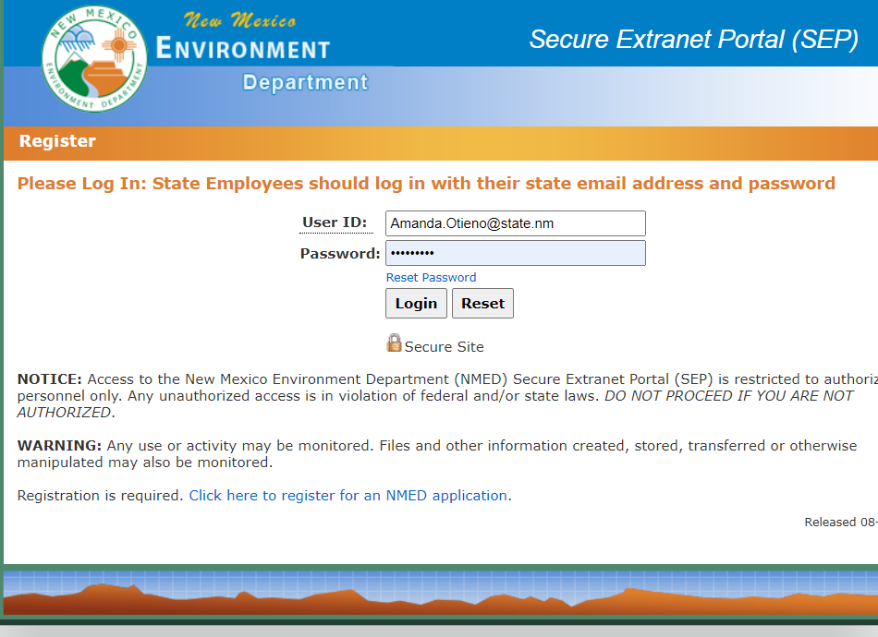

The annual report database is accessed through SEP
You may have to ask your manager for the USER ID!
Notes:
This webpage will appear. Type in your previously registered User ID and password and click the Login button. This is the Secure Extranet Portal (also known as SEP). You will gain access to the Annual Report Database by logging in to SEP. Please follow the instructions on this page. Type in the user id and password and hit the login button. Your user ID and password should have been set up by your facility’s operator or manager.

Slide 4
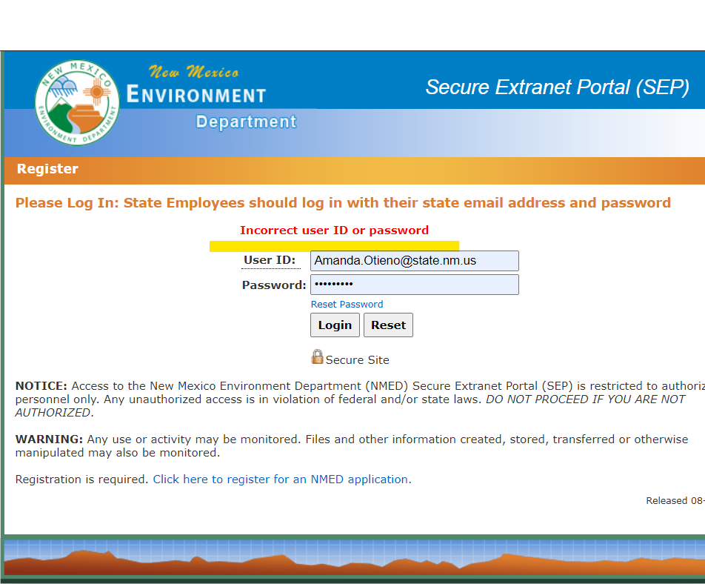
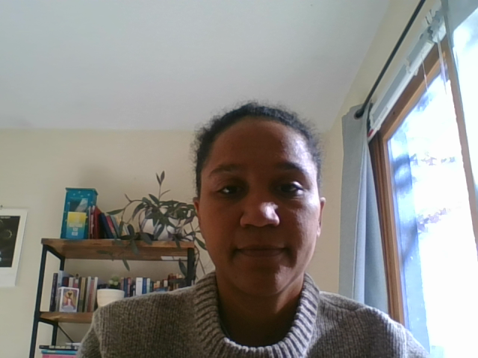
The USER ID must be registered and connected to facility
Notes:
If you receive this message your User ID, Password or both are incorrect. First make sure your password is correct. Simply reset your password by clicking the hyperlink. Keep in mind the email to reset your password will be sent to the email registered with your facility. IF your password is correct then you are most likely using the wrong User ID. You should ask your manager or person previously responsible for filing the Annual Report for the User ID, otherwise email or call the outreach section staff and ask because we keep a record of User IDs.
On another note, if you were successful in logging in but are having issues logging back in please close all the web browsers, open one page and start from the beginning.

Slide 5
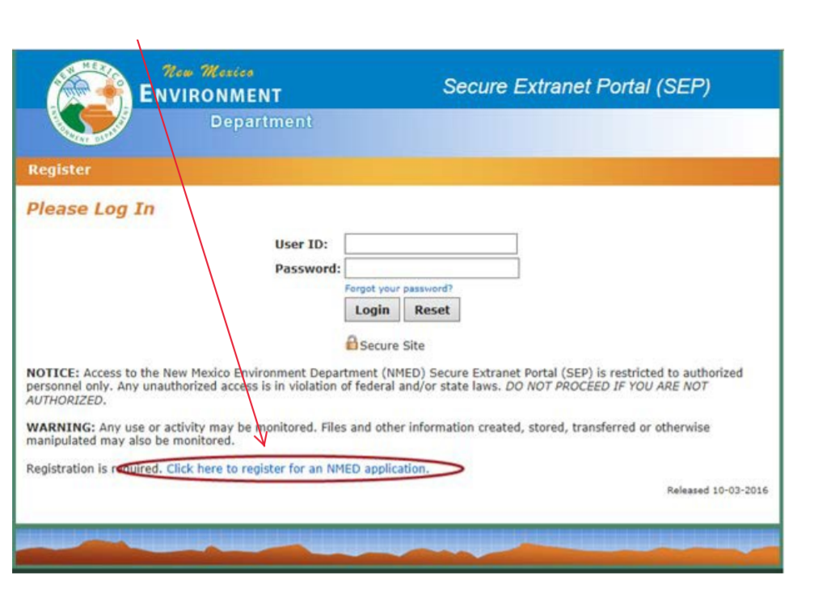

Notes:
If you are a new user or facility recently permitted or registered with the Solid Waste Bureau and have not yet submitted an Annual Report to the Solid Waste Bureau, then you will have to register to become a user of the Secure Extranet Portal, or SEP, which will give you access to the Annual Report database.
Please watch Levi Lementino’s tutorial for instructions for registering for an ID. You will see a hyperlink at the bottom of the page to register for a SEP application.

Slide 6

Solid Waste Bureau Annual Report Instructions
https://www.env.nm.gov/solid-waste/wp-content/uploads/sites/24/2020/12/2020-Annual-Report-Instructions.FINAL_12.31.20.pdf
Notes:
If you are able access the annual report database but need some help navigating the database, or just have questions about how to properly report the solid waste managed by your facility, please click on this hyperlink for step by step instructions

Slide 7

Please call or email
Levi Lementino Levi.Lementino@state.nm.us 505-795-1255
Amanda Otieno Amanda.Otieno@state.nm.us 505-795-1502
Genevieve Morgan Genevieve.Morgan@state.nm.us 505-490-5356
Notes:
Again we are available to assist you with any issues regarding the Annual Report database or any other questions you may have about completing your Annual Report, please email or call us for guidance. Thank you!

